Slide 1
Milestone 3:
Interim Demo
Alexandra Colf
Christian Barbu
Luka Demetrashvili

Slide 2
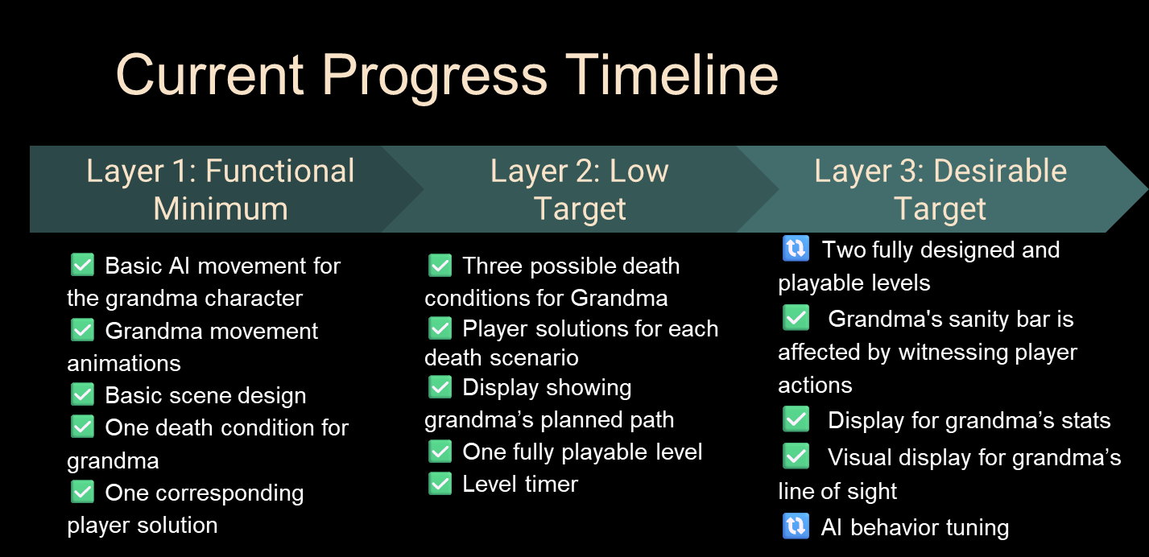

Slide 3
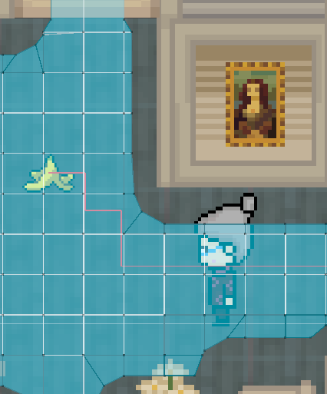
AI Behavior
NavMeshPlus
4-directional movement
Off-NavMesh points are corrected
NavMeshAgent used only for pathfinding, movement handled manually

Slide 4
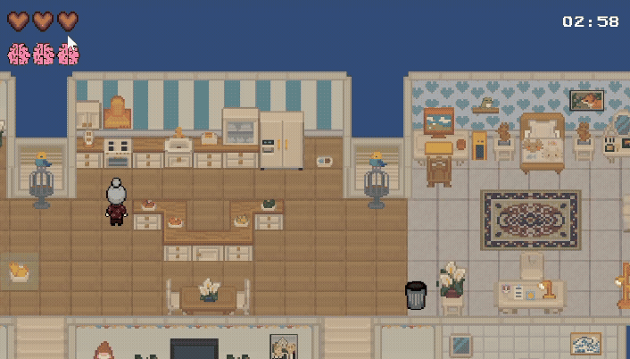
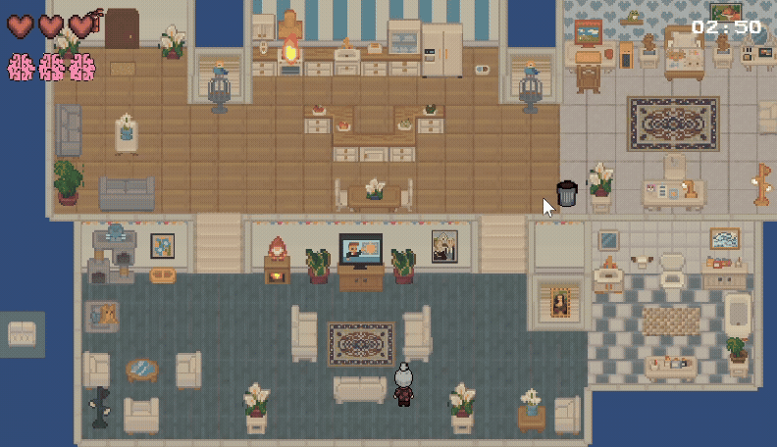
Camera movement
WASD Movement
Zoom In + Zoom Out

Slide 5
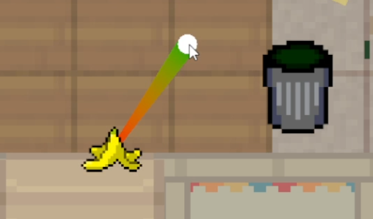
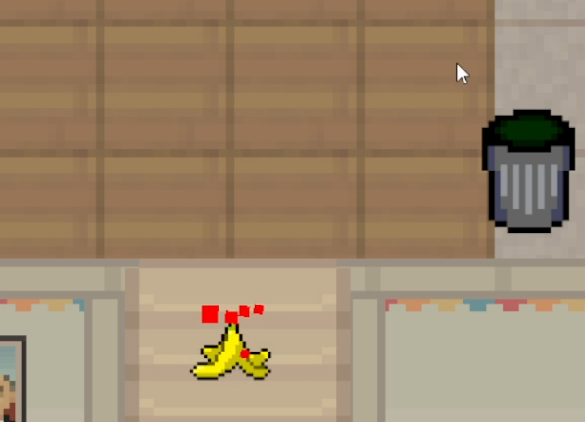
Hazards
Banana:
grandma drops these after finishing her actions at the fridge or on the couch
player can remove them and pull them into the trash bin by dragging
uses a spring and drag effect

Slide 6
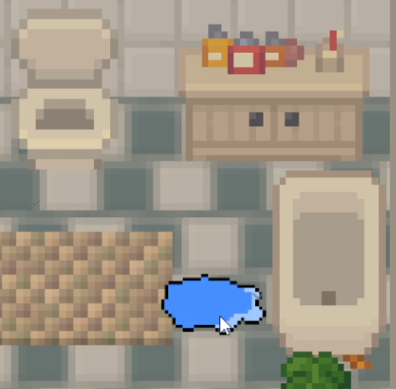
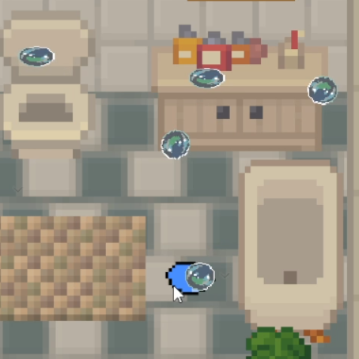
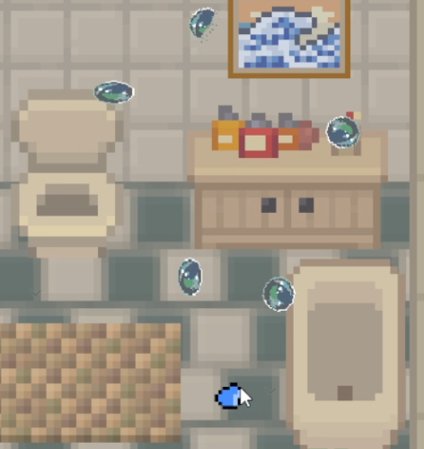
Hazards
Water spill:
those emerge after she went to the toilet or took a bath in the bathtub
player can remove them by rapidly moving the mouse over them
water spill decreases size and particles emerge from it to illustrate the cleaning progress

Slide 7
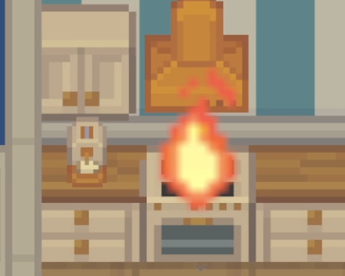
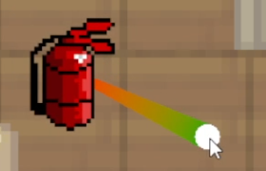
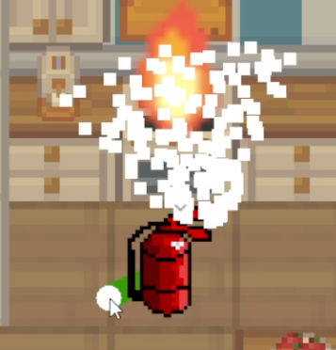
Hazards
Fire
happens, after grandma went to the kitchen and cooked something
player can remove it by dragging the fire extinguisher close to the fire
particle system illustrates the process

Slide 8
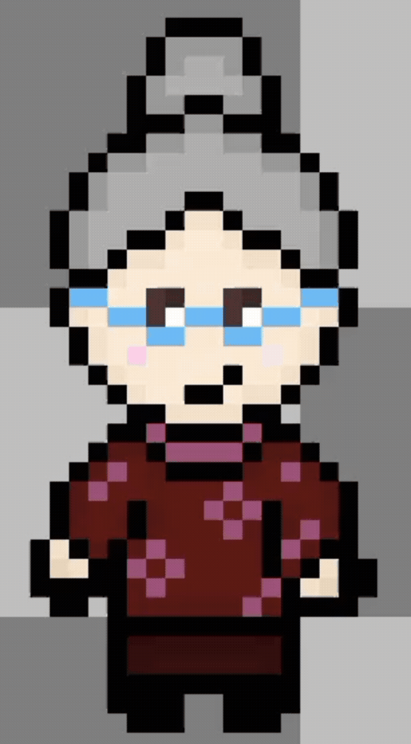
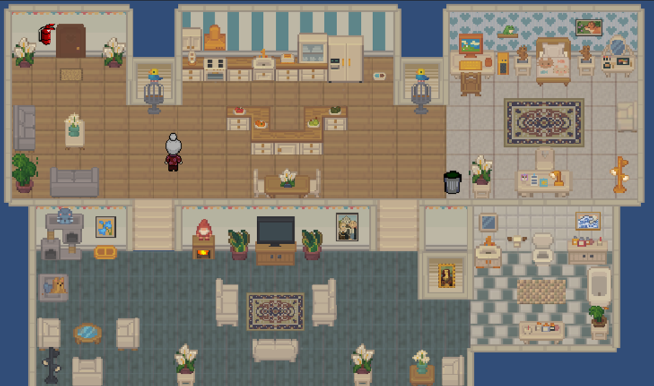
Design
Room Layout
Main Character

Slide 9
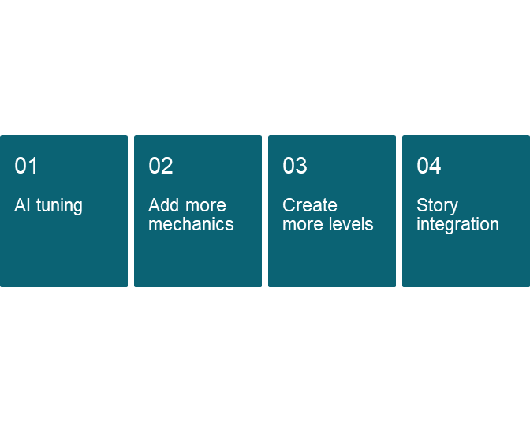
Next steps

Slide 10
Thank you for listening!
→ Live Demo

