Slide 1
Milestone 1:
Game Proposal
(Caretaker Chaos)
Alexandra Colf
Christian Barbu
Luka Demetrashvili

Slide 2
Story and Setting
game opens with the death of the grandmother
grandson sees a live feed of his grandma from three days in the past
(-> time travel)
manipulate past environment by tapping and dragging objects
The Player's Mission: rescue grandma from dying

Slide 3
Game Description
grandma died -> player wants to save her by manipulating the past
player can interact with objects in the past, by clicking on them
drag-and-drop items without grandma realizing
win condition:
  prevent possible death scenarios
  avoid changes to be seen by grandma

Slide 4
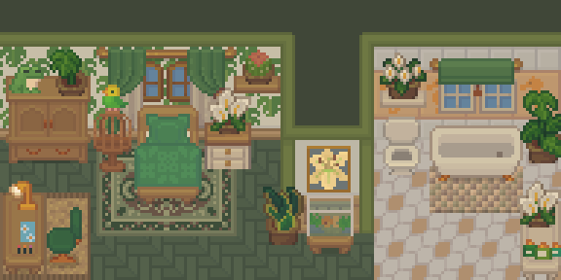
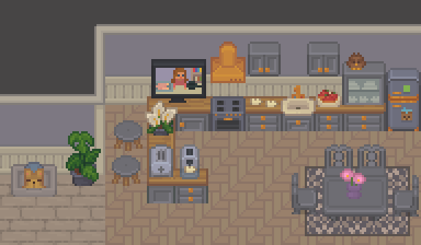

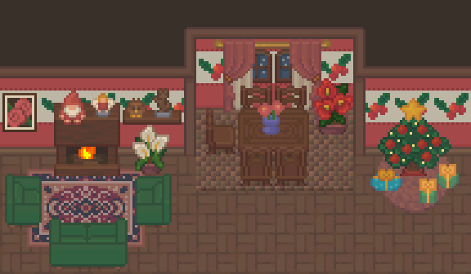
Tools & Assets
Using Unity Engine 6
Using the Cozy Interior Asset Pack

Slide 5
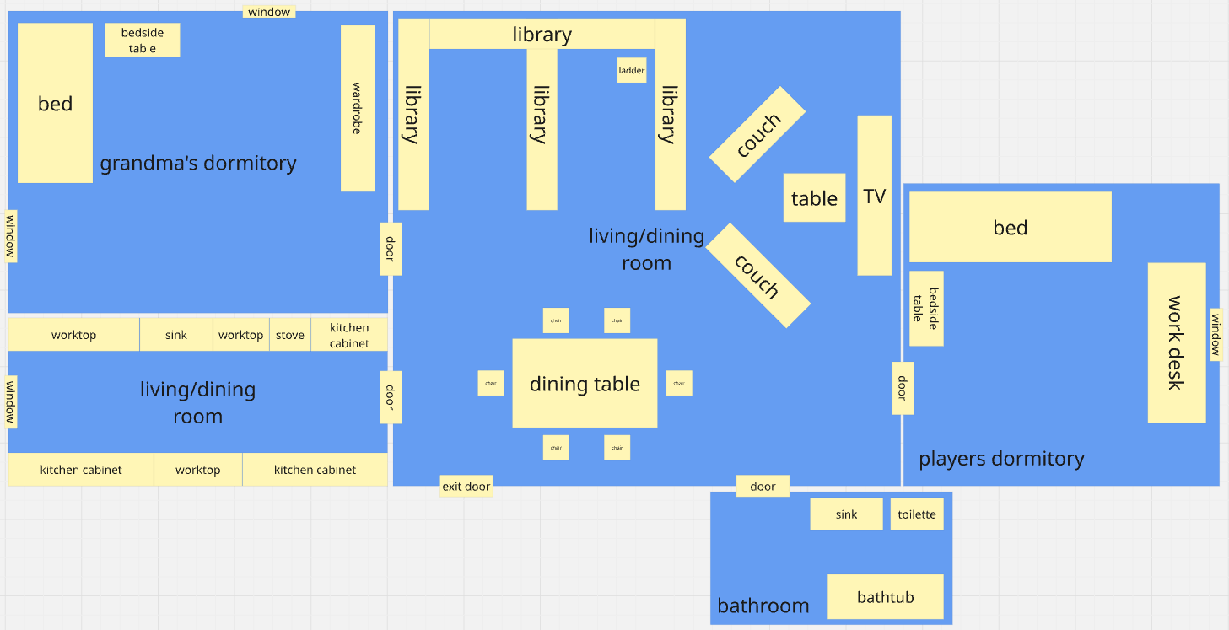

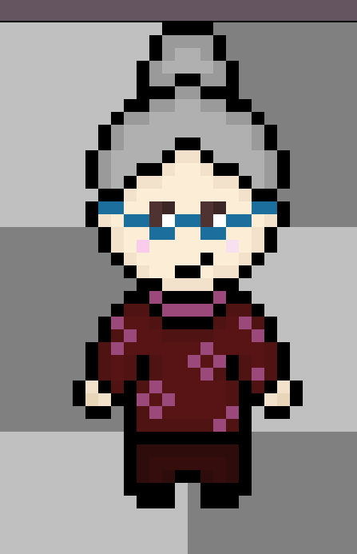
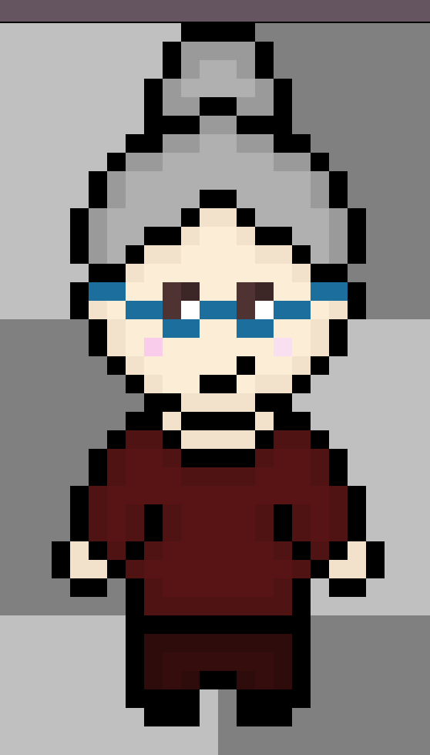
Sketches

Slide 6
Technical Achievements
(AI)
achieve AI behaviour that is realistic, yet still easy to understand
AI should easily adapt to any environment in which it’s place
making use of utility AI (behaviour-with-activation-level)
inspiration: The Sims

Slide 7
Technical Achievements
(AI: Main Loop, basic idea)
Create a queue with possible actions
If the queue is not empty -> pop the next one off and perform it
If you run out of actions -> perform action selection based on the internal state

Slide 8
Big Idea Bullseye
Quick-paced strategy and simulation
Technical
Innovation
Dynamic utility based AI

Slide 9
Layered Development Plan
Add more agents to the level, additional levels new game mechanic
Extras
Menus, Cutscenes, 3 playable levels, story & audio integration, final polish (visuals, UI, bugs, performance)
High Target
Two playable levels, Improvements for grandma’s AI (sanity mechanic, line-of-sight visual, behavior tuning), Grandma stat UI (health/sanity)
Desirable Target
Three possible death conditions for grandma, Player solutions for each death scenario, Showing grandma’s planned path to help the player strategize, One fully playable level, Level timer
Low Target
Basic AI movement for grandma character, Grandma movement animations, Basic scene design, One death condition for grandma, One corresponding player solution to prevent grandma’s death
Functional Minimum

Slide 10
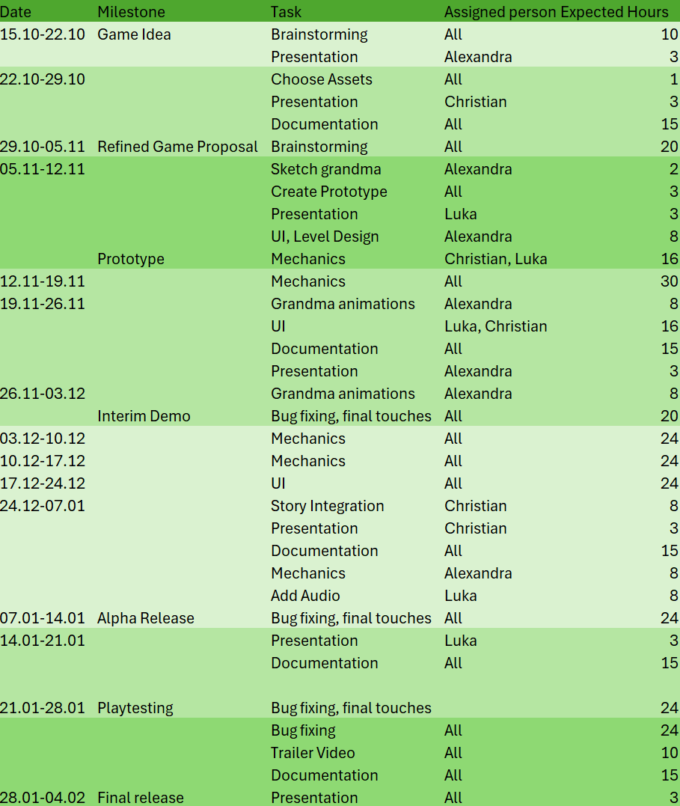
Timeline

Slide 11
Assessment
Goal: humorous approach of preventing grandma’s death by fixing possible death scenarios
aimed to entertain all age groups, as mechanics are intended to be easy

Slide 12
Questions?

