Slide 1
The Memory Chamber
Team XY
Jasmina Vulovic
Aleksandar Arnaudov
Louis Sajuk
Muhammed Bayram
2025/26
WS

Slide 2
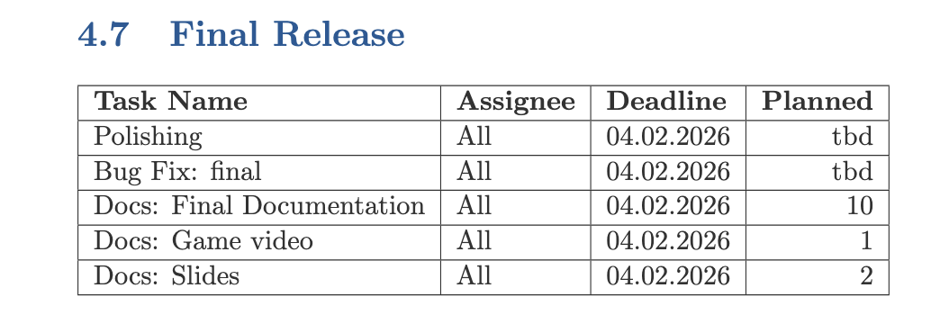

Targets
Targets

Slide 3
Updates
Updates
Overall, gameplay has been improved.
More visual clues have been added.
Environment design has been improved.
Overall, more guidance added to better direct players in the puzzles.
Close the information messages with Q instead of K.
Door pin-codes can now also be entered using the mouse.
A clue counter has been added to the Scene Reconstruction puzzle.
The directions for the biology puzzle have been clarified.

Slide 4
Progress
Current progress
What we have completed:
Almost all targets from our original time plan
Minor bug fixes
Minor polishing

Slide 5
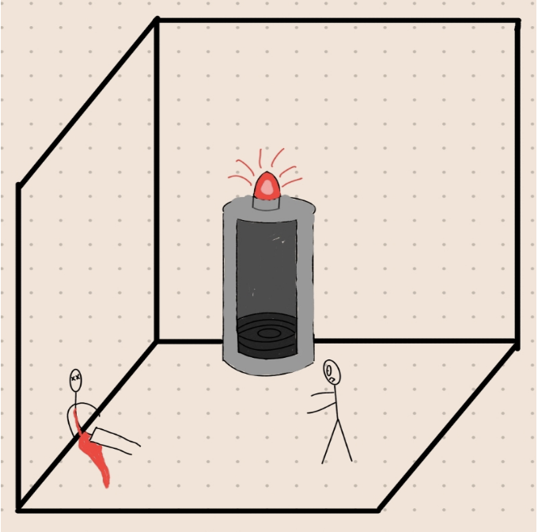
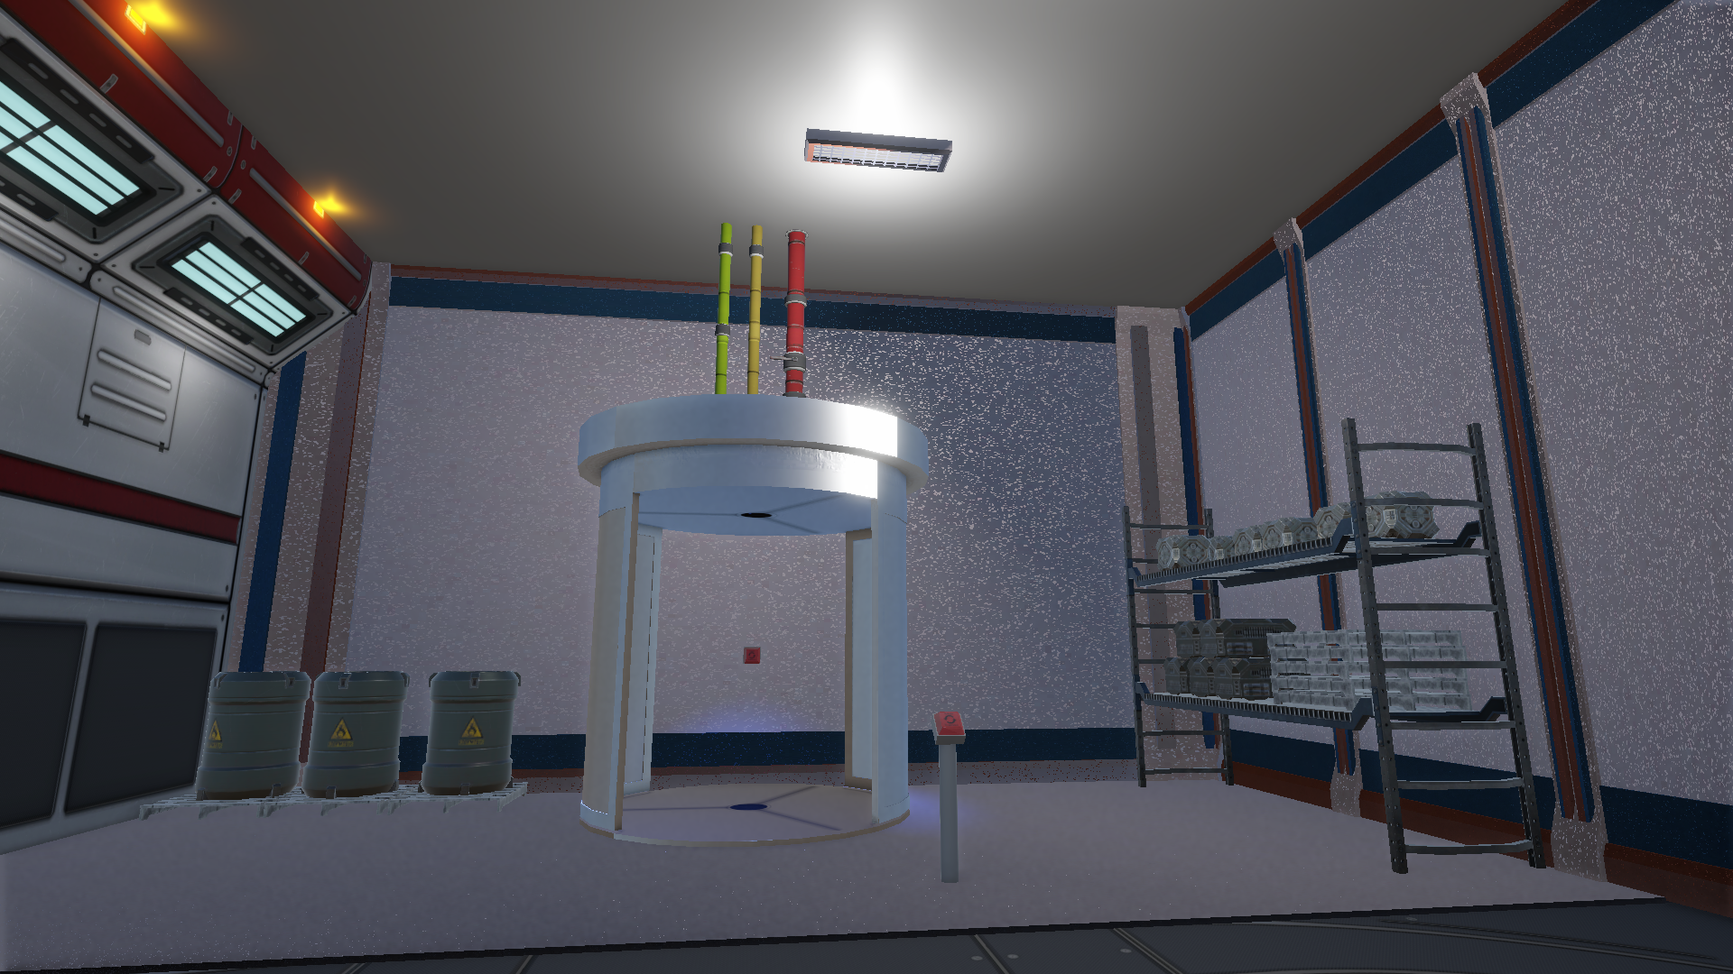
Sketches
Vs
Implementation

Slide 6
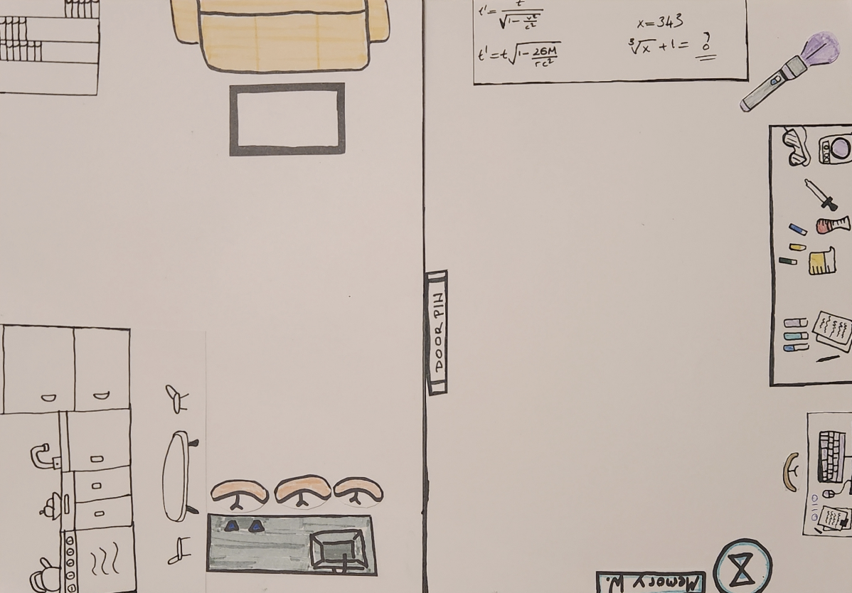
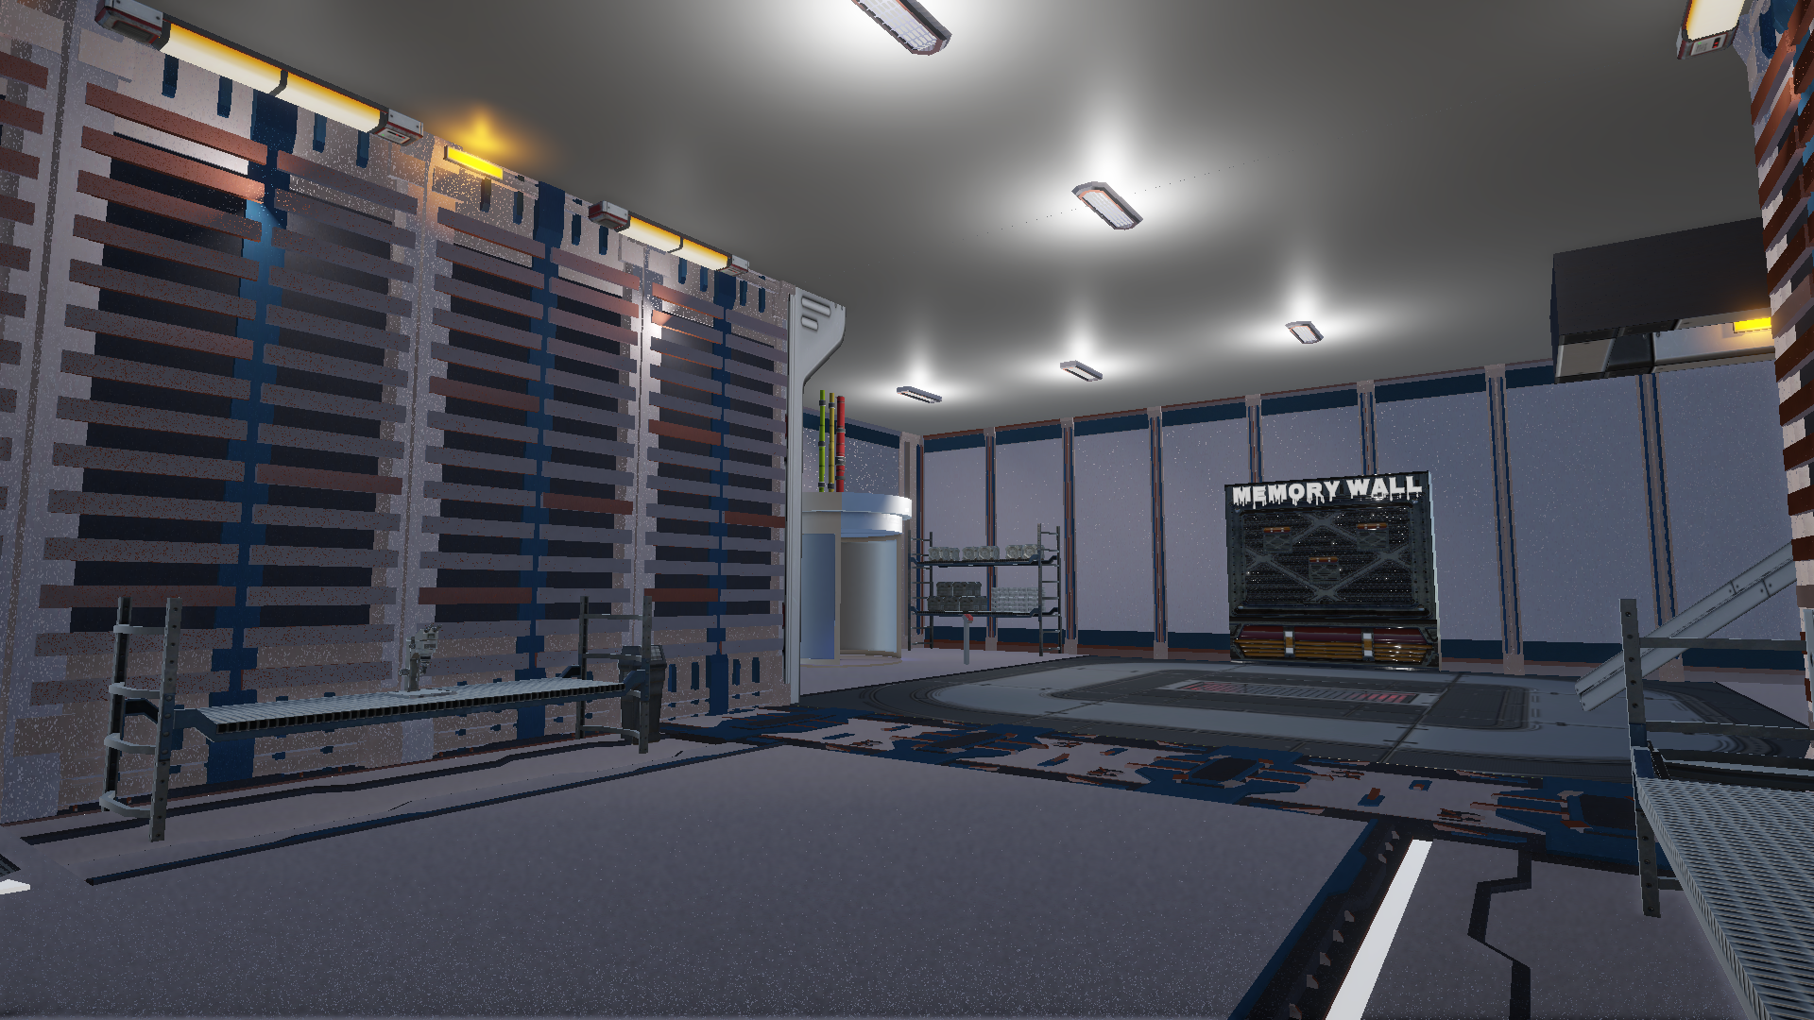
Sketches
Vs
Implementation

Slide 7
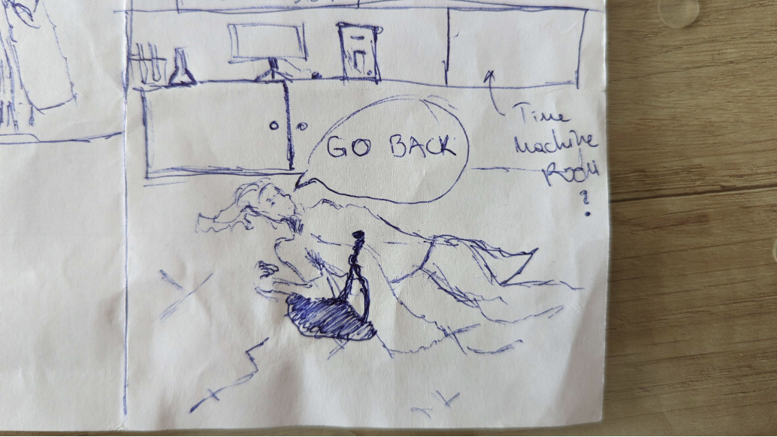
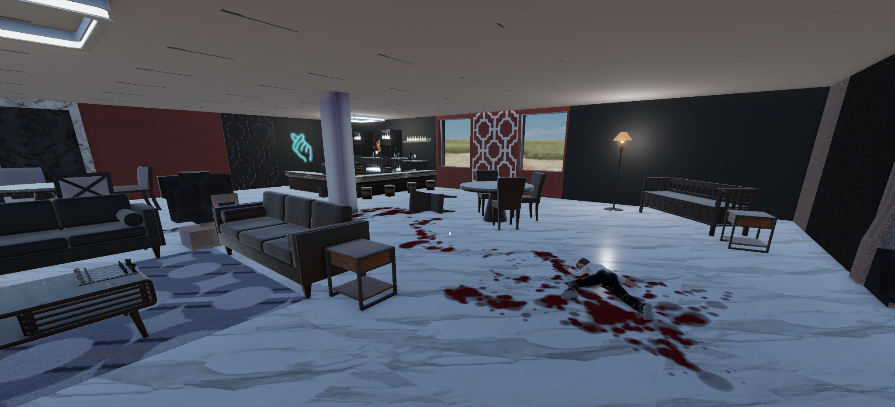
Sketches
Vs
Implementation

Slide 8
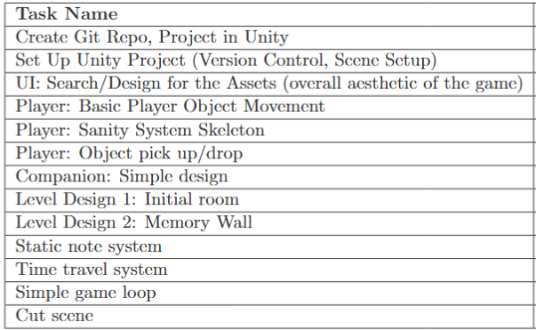
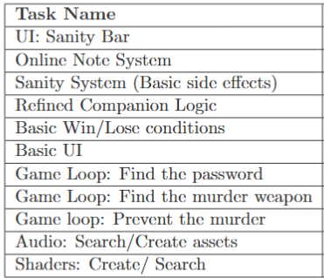

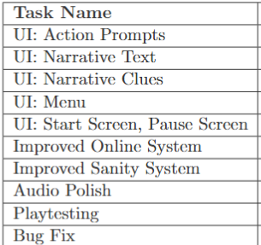
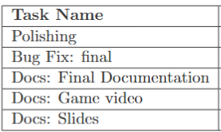
Progress
Overall Task Evaluation

Slide 9
Progress
What we are most proud of…
We met almost all targets from our original time plan
Game mechanics (from the puzzles to time travel, online note system)
Sounds/nice visuals
Overall story
Solid prototype for the game idea

Slide 10
Thank you!
Team XY

