Slide 1
The Memory Chamber
Team XY
Jasmina Vulovic
Aleksandar Arnaudov
Louis Sajuk
Muhammed Bayram
2025/26
WS

Slide 2
Playtesting Presentation
Purpose of the playtesting
Overview of participants
Key findings and improvements

Slide 3
Playtesting Session Organization
How the Sessions Were Organized ?
Introductory briefing (study & game overview)
Data collected anonymously
Participants could stop at any time
No spoilers given
Observed as third-party viewers
Post-session survey completed

Slide 4
Playtester Demographics
Who Did We Test With?
Mid-to-high gaming experience
Mix of active and casual players
Balanced familiarity with mystery/investigation games
Total of 6 play testers

Slide 5
Survey Structure
How We Collected Feedback
Rating-scale questions (1–5)
Agreement-based statements
Multiple-choice questions
Open-ended feedback

Slide 6
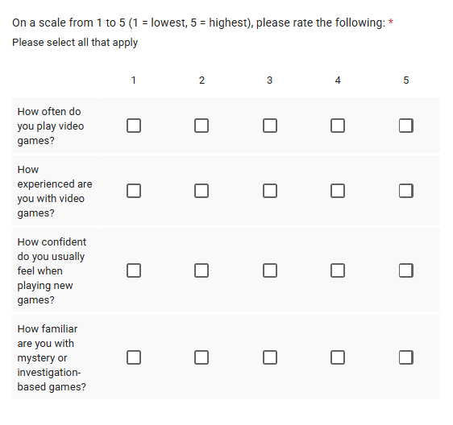
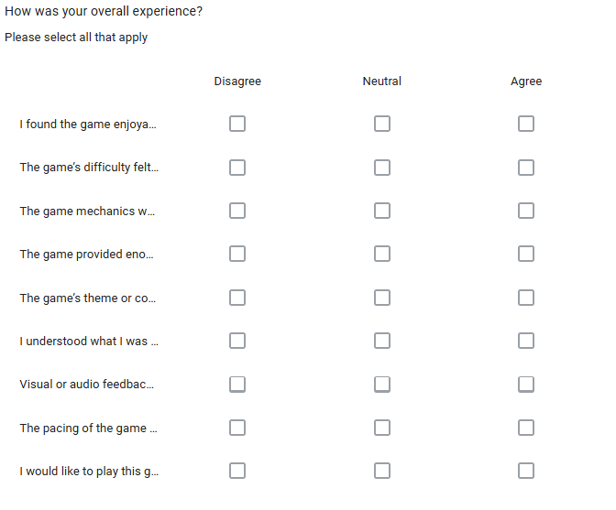
Survey Questions

Slide 7
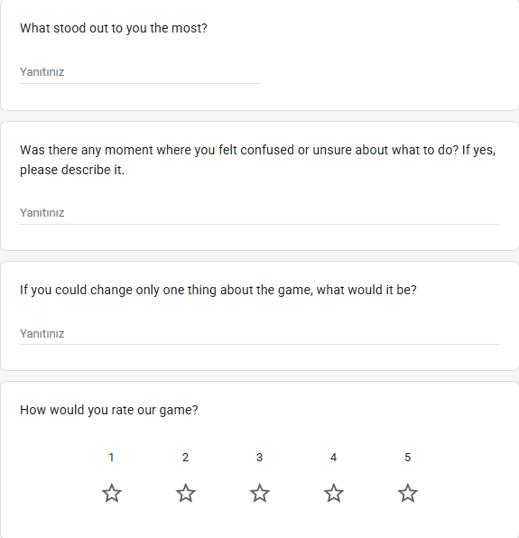
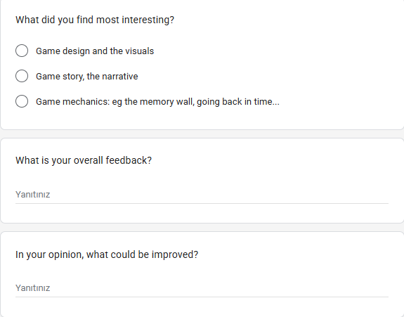
Survey Questions

Slide 8
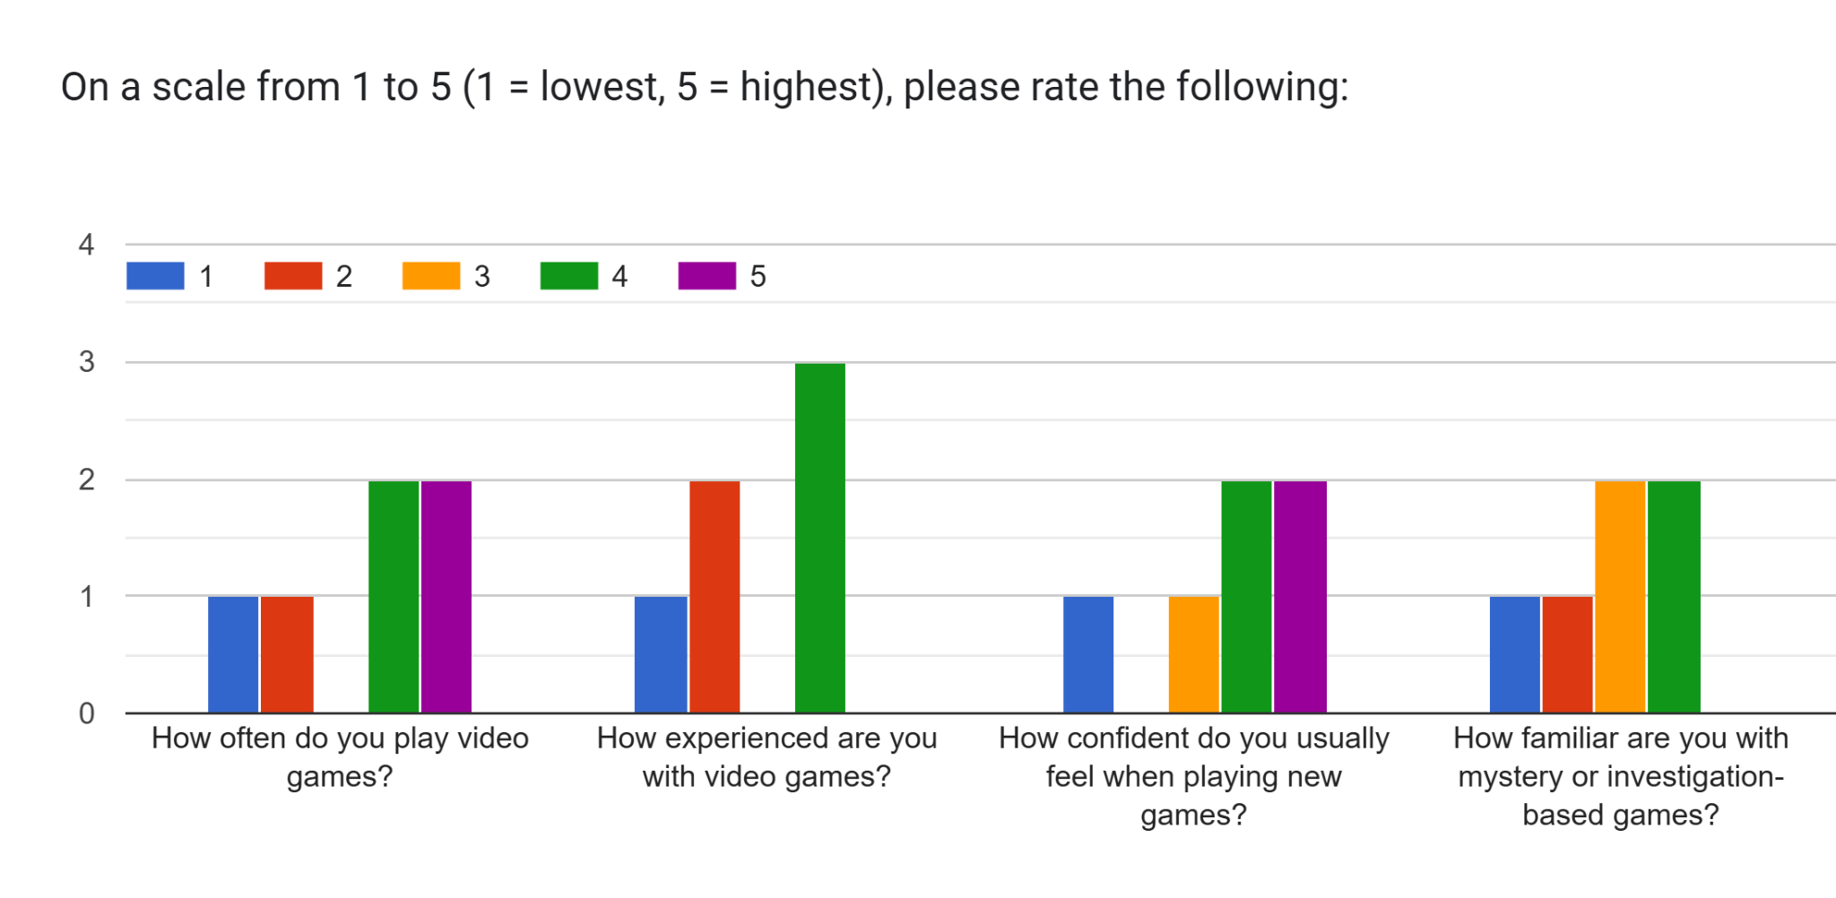
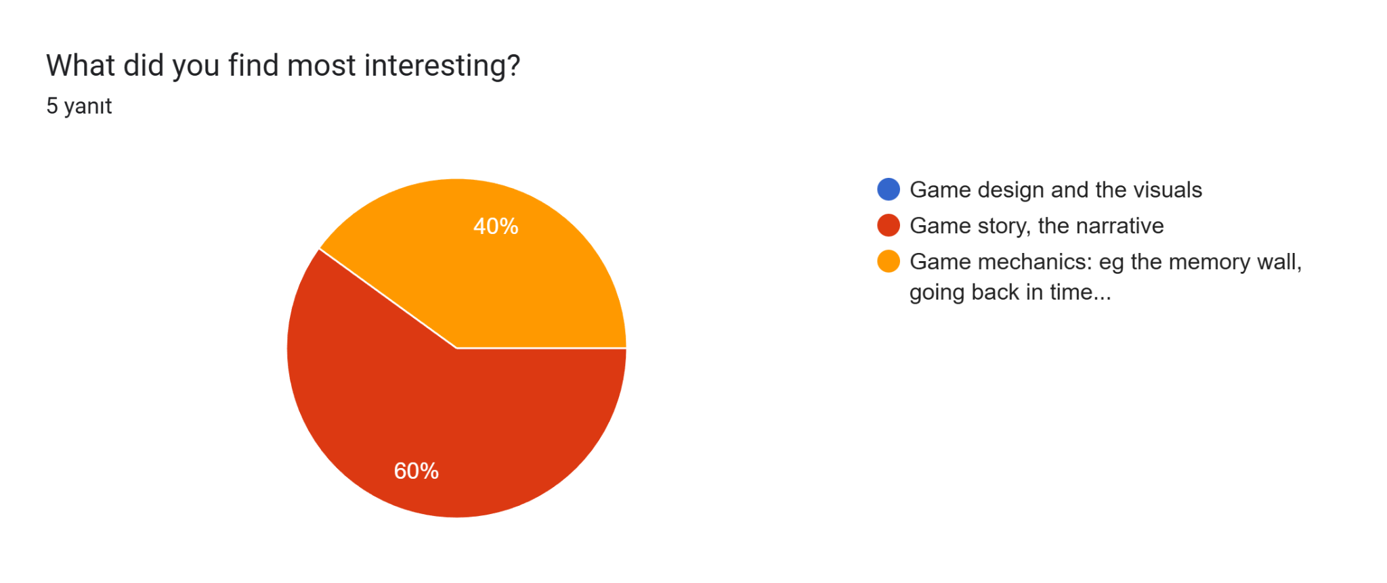
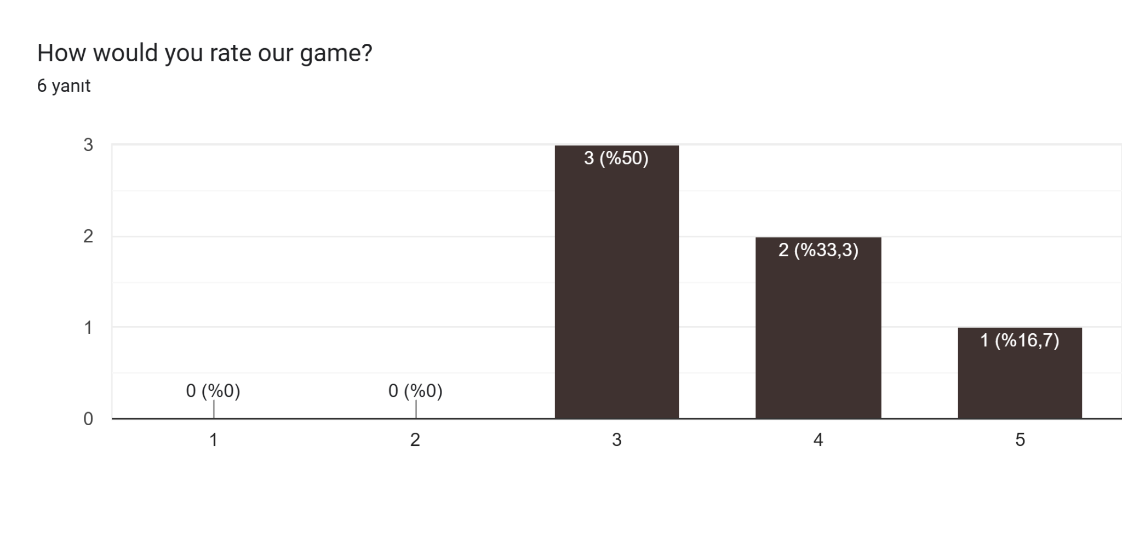
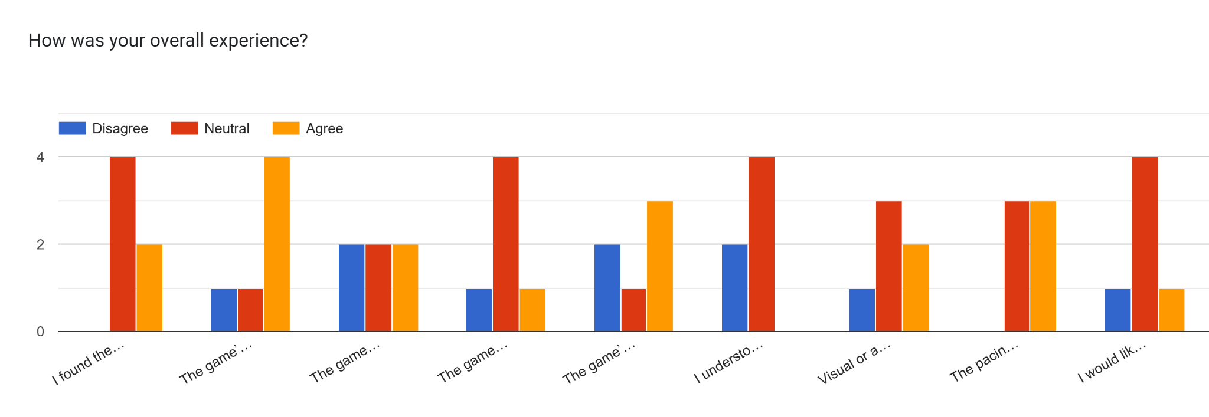
Survey Results

Slide 9
Player Feedback - Positive and Negative
“The mechanics are nice”
“Concept of memory wall is cool”
“Game idea, story and puzzles are great”
“Pretty interesting”
“I was confused what to do”
“Some interactions were unclear”
“Environment design needs improvement”
“Game felt too easy”
“No clear direction”
“Story isn’t clear”

Slide 10
Main Issues Identified
Direction:
Puzzles and time machine not highlighted
Missing clue counter for Scene Reconstruction
Missing direction to progress story, visual cues
Controls:
Close message with “K”
Enter PIN-Code with “E” not left-mouse
Puzzles:
Flashlight: Too small & missing a clue
Computer: requires CS-knowledge
Microscope: direction unclear
Laser: mouse bug
Environment:
Too monotonous
Sound:
Some effects too loud
Step sound monotonous

Slide 11
Changes Based on Feedback
What We Improved / Plan to Improve
Clearer UI prompts
  Constant task/current goal in one of the corners
  Improved monologue
Improved puzzle clarity
Visual signposting for key objects
Sound and bug fixes

Slide 12
Thank you!
Team XY

