Slide 1
Idea Pitch
Presented by
Aleksandar Arnaudov
Jasmina Vulovic
Louis Sajuk
Muhammed Bayram

Slide 2

Recursion
Horror ambience
Solving puzzles
Navigating through a evolving room/building
Main idea:

Slide 3

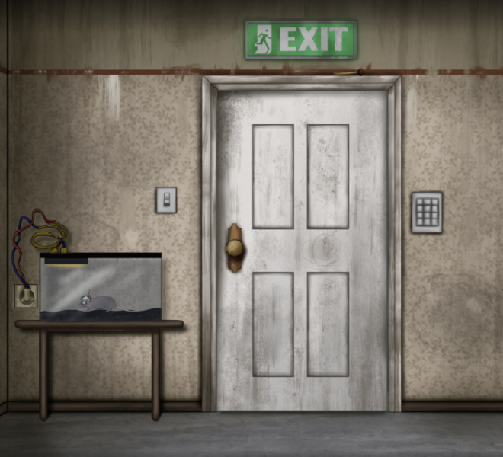
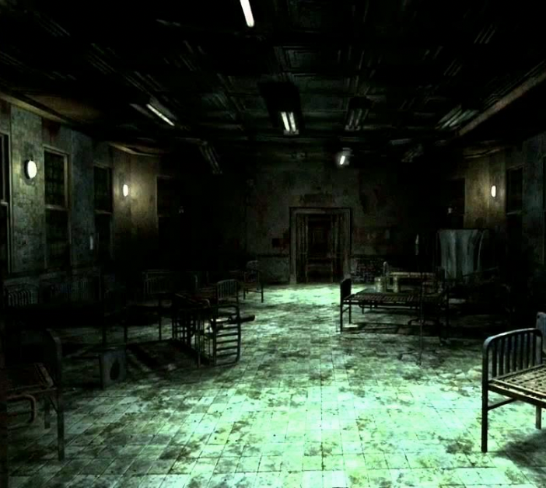
That idea will be centered around one of the following themes…
1
2
3
Solving a murder
Escaping the asylum
No way out (descending into madness)
Year
Notes:
While presenting, note that these are our top choices now, they CAN change possibly

Slide 4

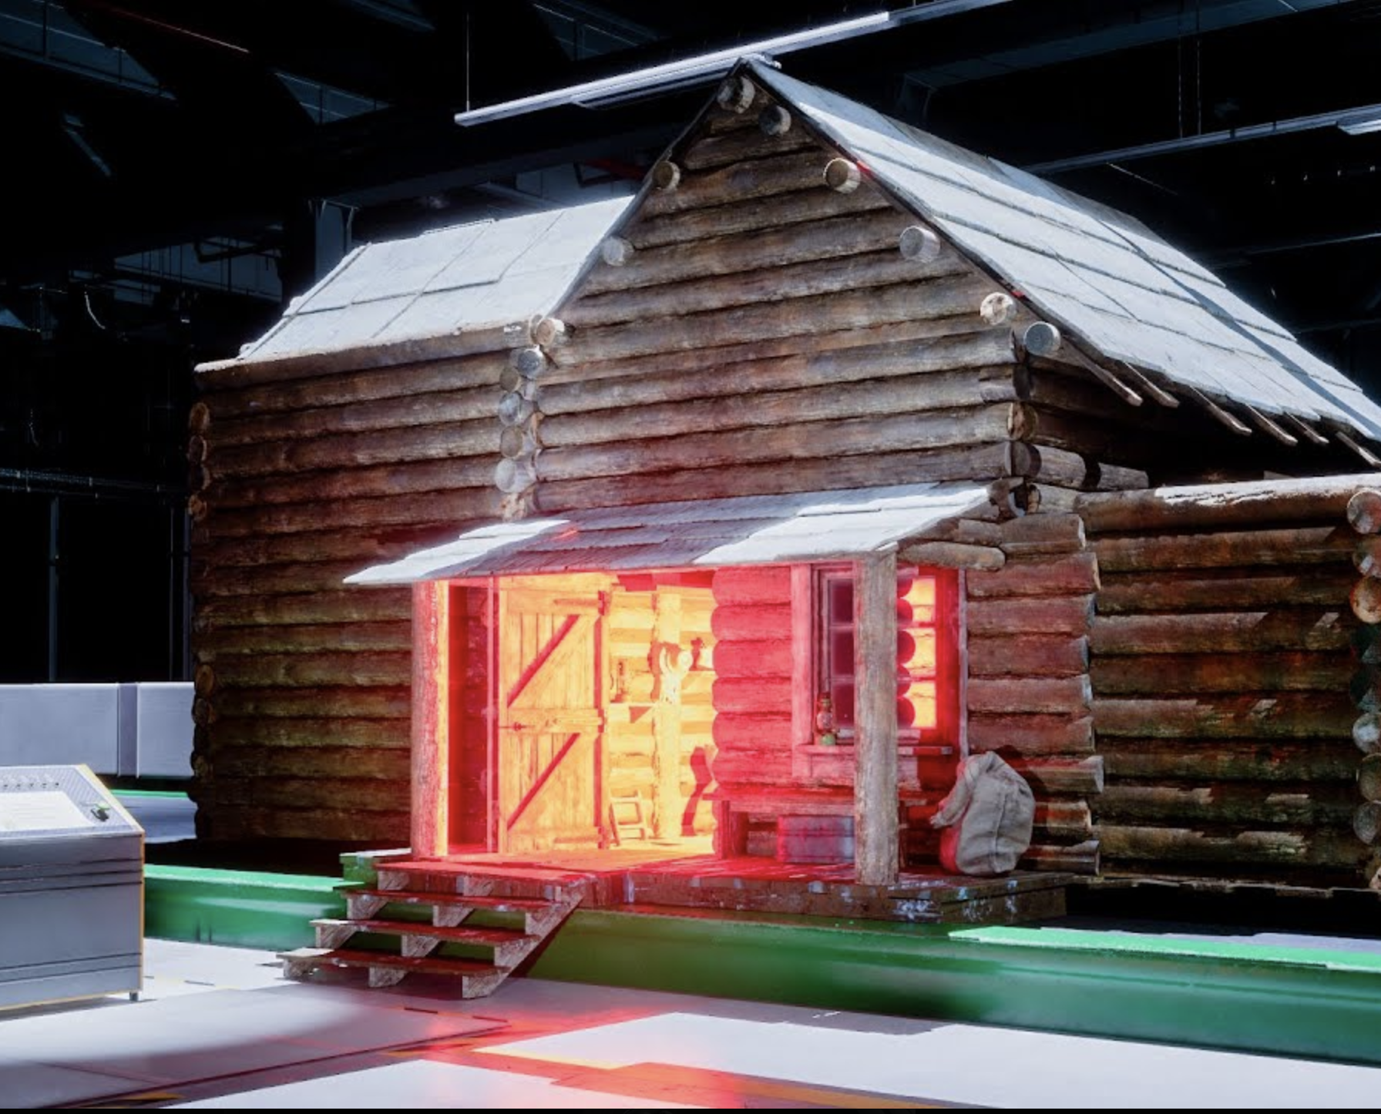
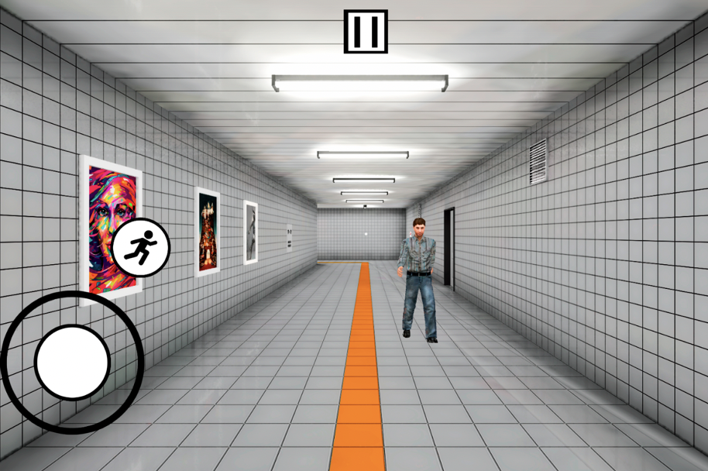
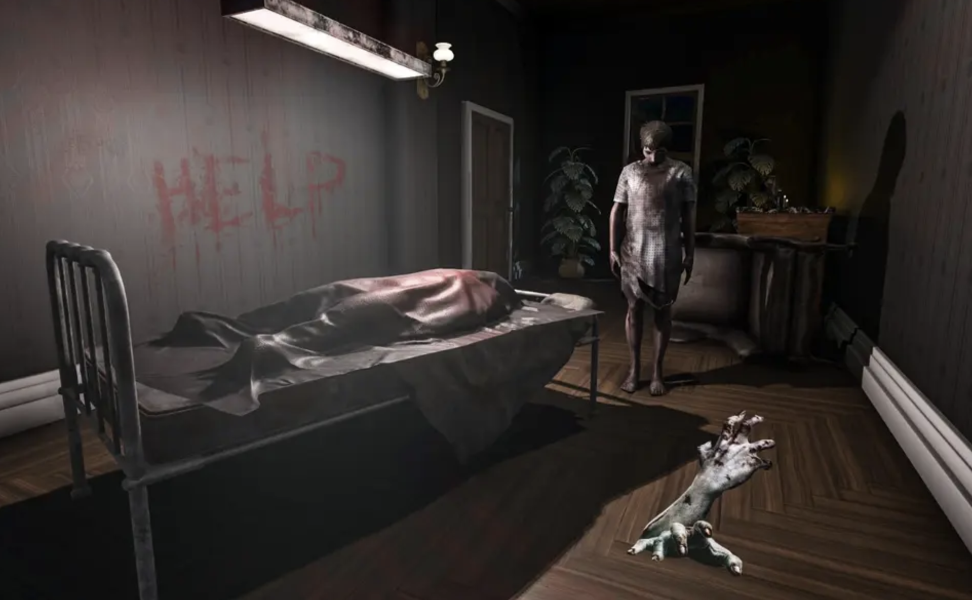
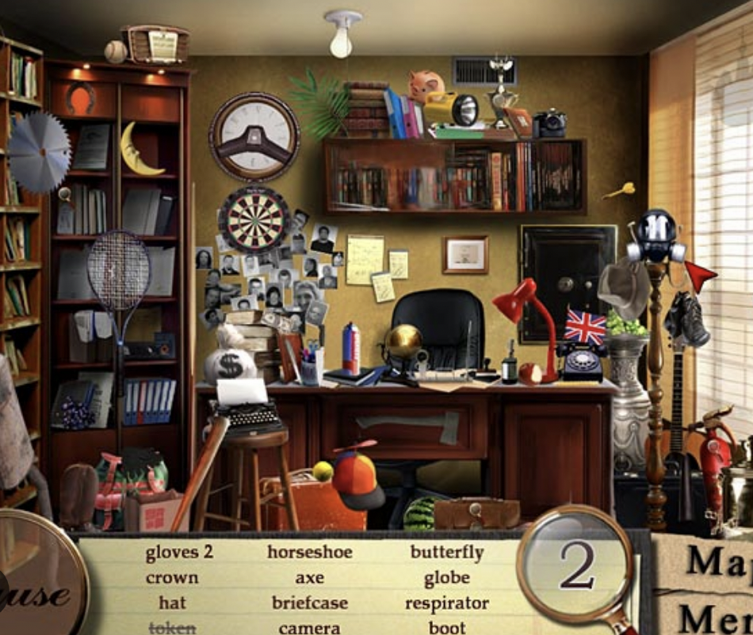
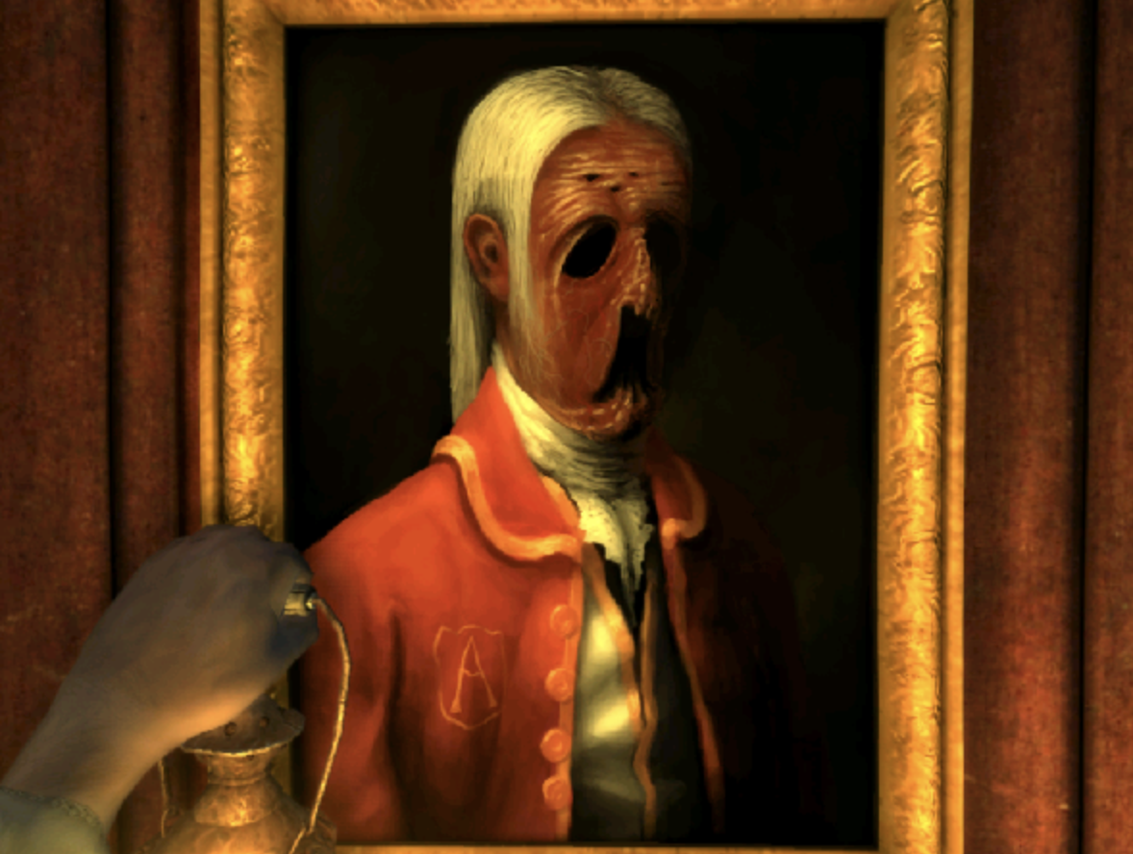
Mood Board

Slide 5
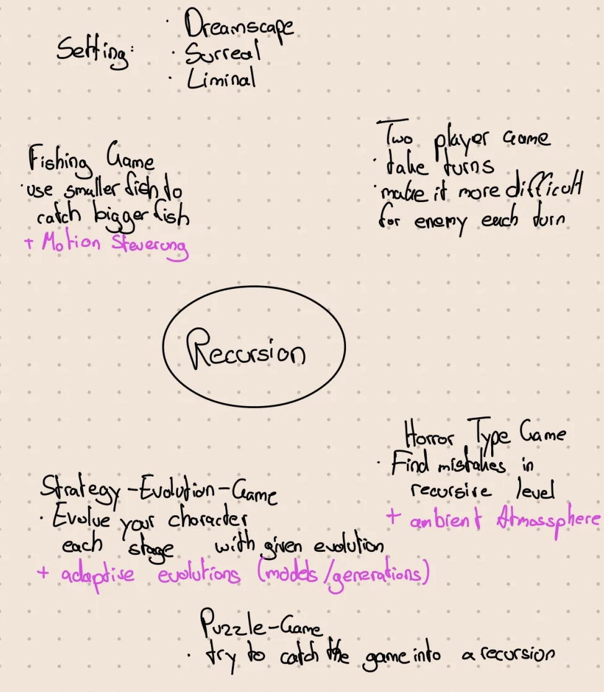
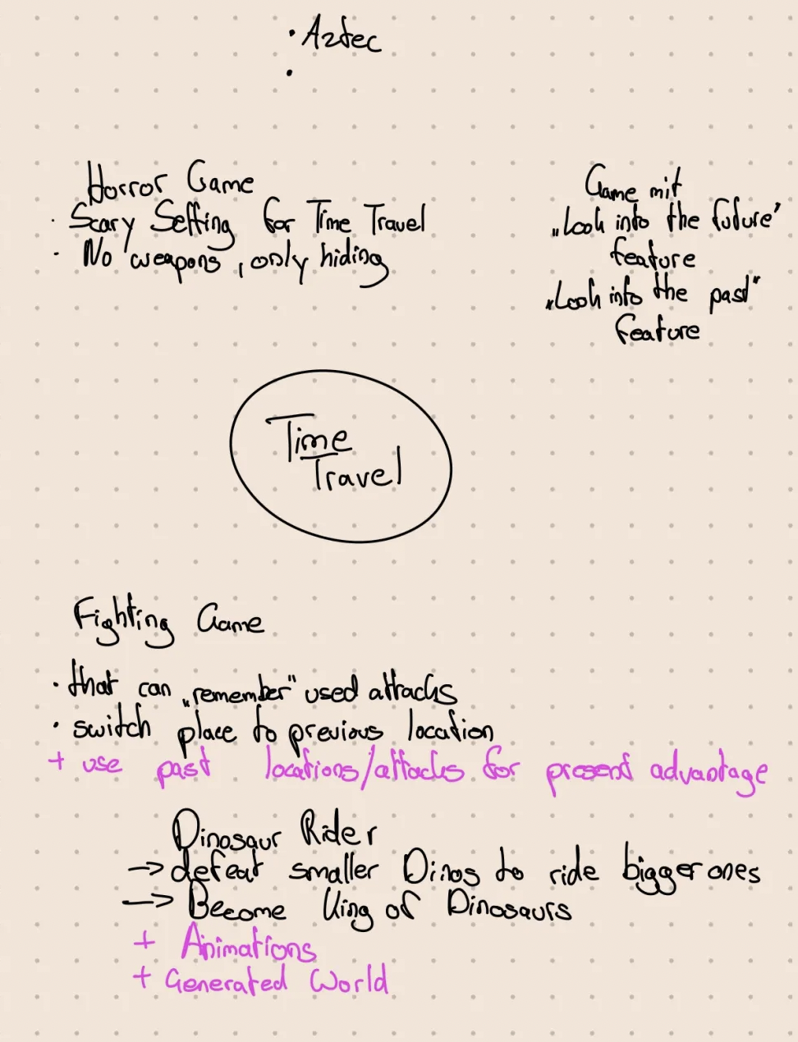
Some starter sketches…

Slide 6
Thank you

