Slide 1
THE MEMORY CHAMBER
Aleksandar Arnaudov
Jasmina Vulovic
Louis Sajuk
Muhammed Bayram

Slide 2
Overview
Game Description
Technical Achievements
Bullseye
Assessment
Sketches

Slide 3
Game Description
Narrative Backstory and Setting
  Claustrophobic lab setting.
  30-minute self-perpetuating murder loop.
  Alice Vance dies every loop.
  Protagonist is the unwitting killer.
Gameplay
  Only notes persist across loops.
  Execute actions to trigger memories.
Theme
  Recursive cycle of guilt/trauma.
  Player is the only one aware.

Slide 4
Technical Achievements
Goal
Build a recursive system that reflects the psychological and temporal effects of failed time travel.
Core Components:
1-) Incremental Loop Manager
- Controls all environmental and visual changes between loops.
- Adds mental and physical degradation effects
2-) Server-side Note Communication
- Stores player-written notes online and syncs them across matching loops.
- Prevents spoilers by restricting notes to predefined words and the same loop.
- Creates shared “echoes” between timelines and players.

Slide 5
BULLSEYE
Core Idea
A recursive psychological mystery where a scientist relives the same 30 minutes to prevent their companion’s death, using persistent notes to uncover hidden truths in a looping world.
Technical Innovation
A Game State Manager connects two systems:
1-) Server-based notes shared between players in the same loop.
2-) Madness system that visually shows mental decay through distorted text and UI changes.
Stretch Layer (Future Potential)
Adaptive puzzles and changing time limits could make each loop react to the player’s past actions and notes, creating a dynamic, unpredictable world that still preserves the recursive core of the game.

Slide 6
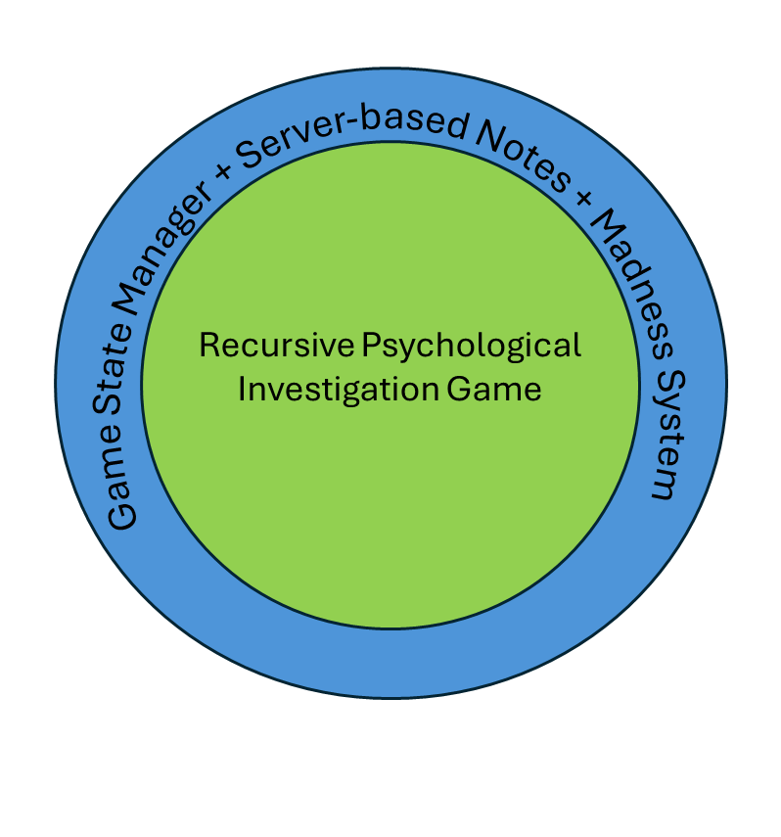
BULLSEYE

Slide 7
ASSESSMENT
What makes our game cool?
Main Strengths​
Psychological time-loop experience​
World resets, but the player does not​
Environment becomes darker and more distorted each loop​
Companion behavior changes with player sanity​
Persistent notes survive across loops​
Unique Hook​
Online note system: players find messages written by others in earlier timelines​
Notes act as shared clues from “parallel” versions of the world​
​
Core Gameplay​
Solve a mystery using memory, observation, and deduction​
No combat — tension comes from limited time and psychological decay

Slide 8
ASSESSMENT
Who Plays This & What Does Success Look Like?
Who Will Enjoy It
Fans of narrative mysteries and psychological thrillers
Players who enjoy subtle horror, environmental clues, and story-driven puzzles
Similar audience to: Outer Wilds, SOMA, PT, Observer
What Players Do
Explore the lab
Read and leave notes
Observe changes across loops
Uncover how to prevent the companion’s death
Success Criteria
Each loop feels more unsettling and different
Notes meaningfully help players progress
Sanity system creates emotional tension
Players feel a strong desire to attempt “just one more loop”

Slide 9
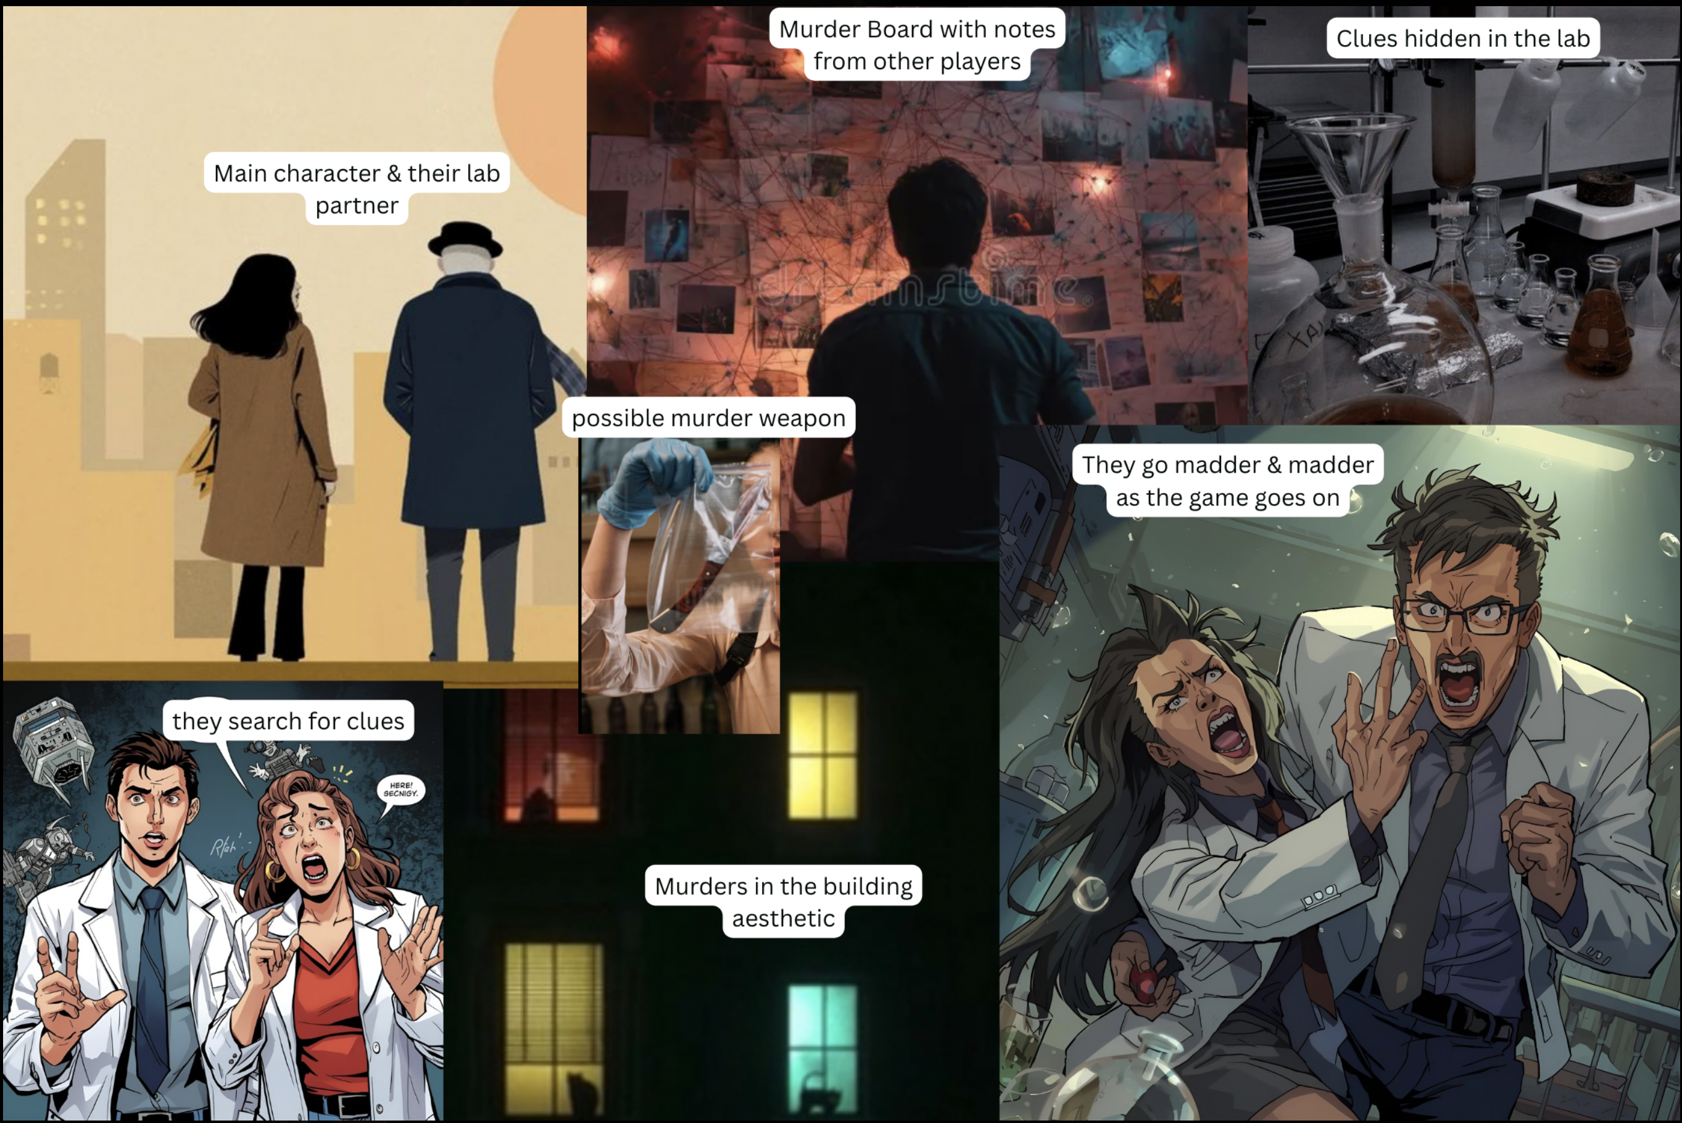
Sketches

Slide 10
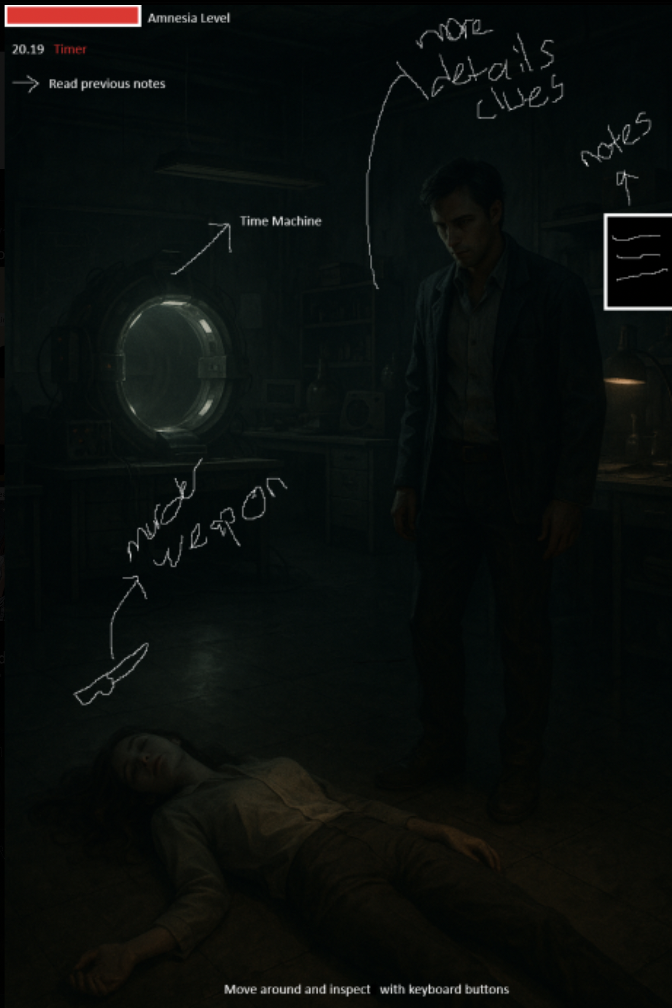
Sketches

Slide 11
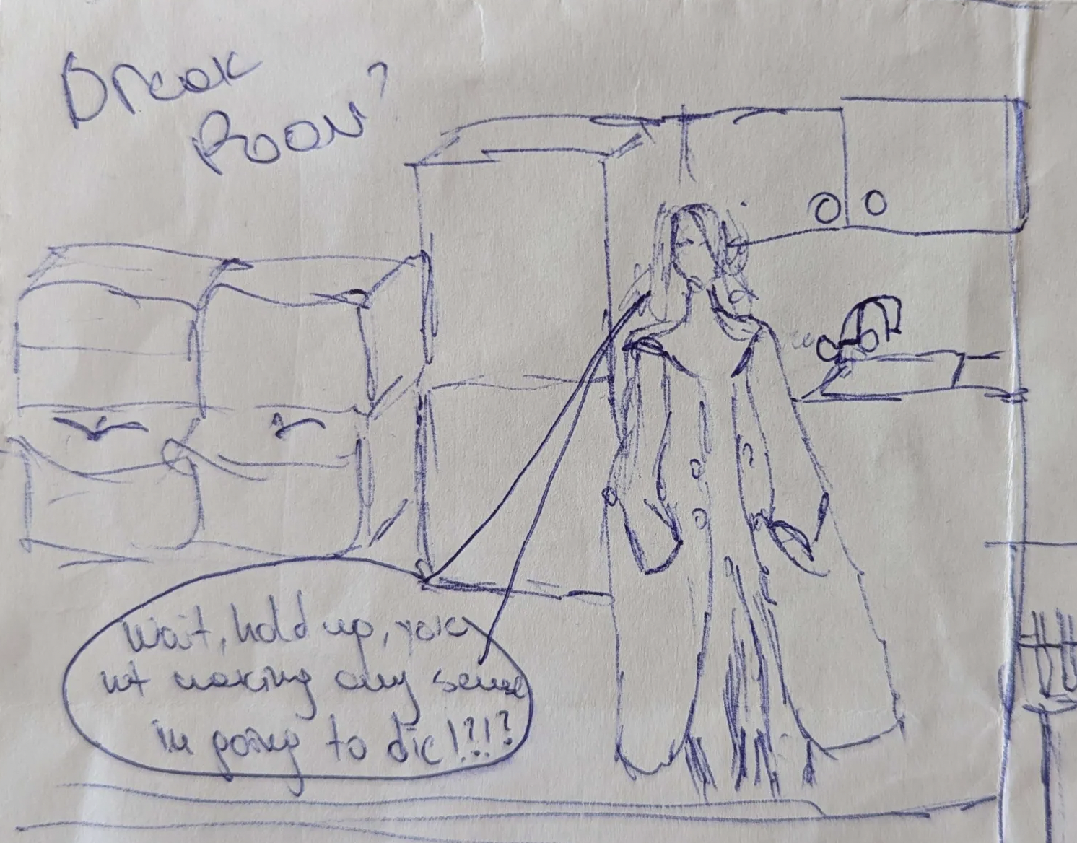
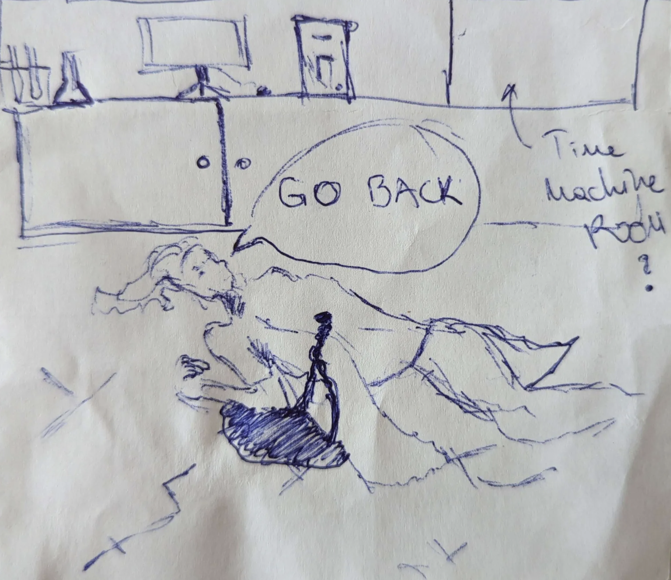
Sketches

Slide 12
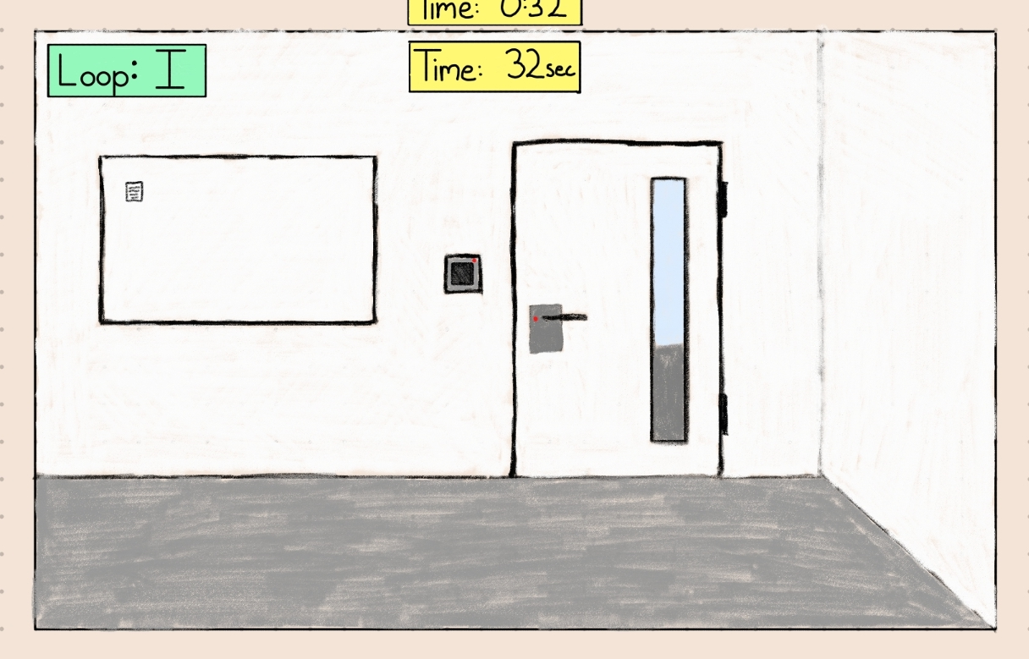
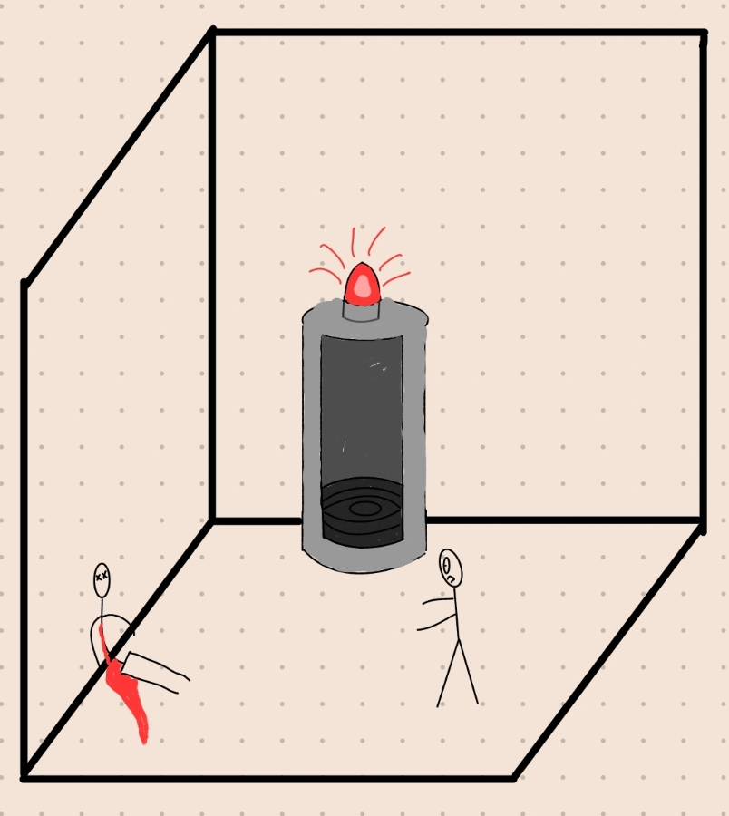
Sketches

Slide 13
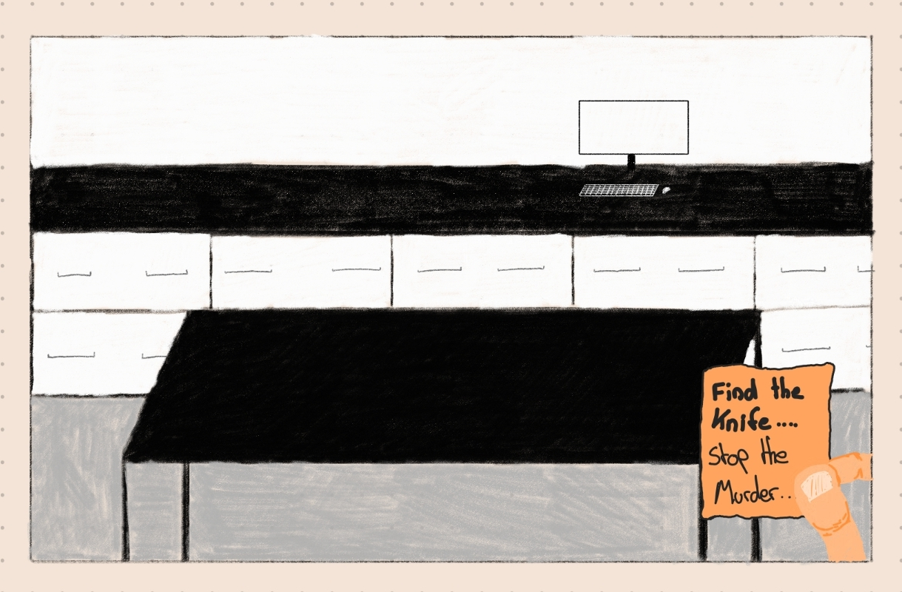
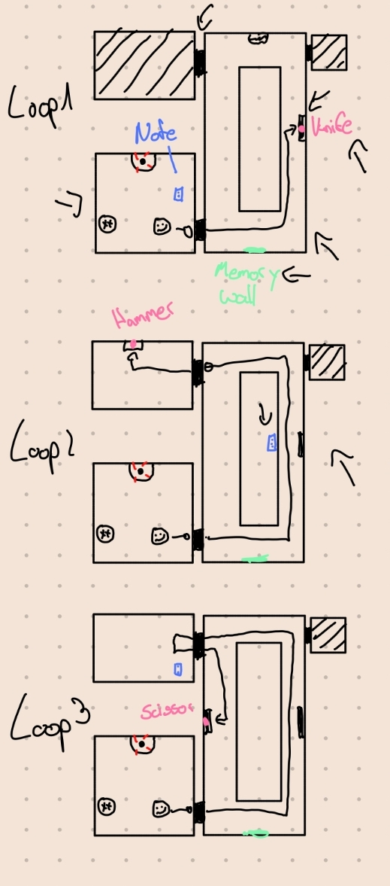
Sketches

