Slide 1
The Memory Chamber
Team XY
Jasmina Vulovic
Aleksandar Arnaudov
Louis Sajuk
Muhammed Bayram
2025/26
WS

Slide 2
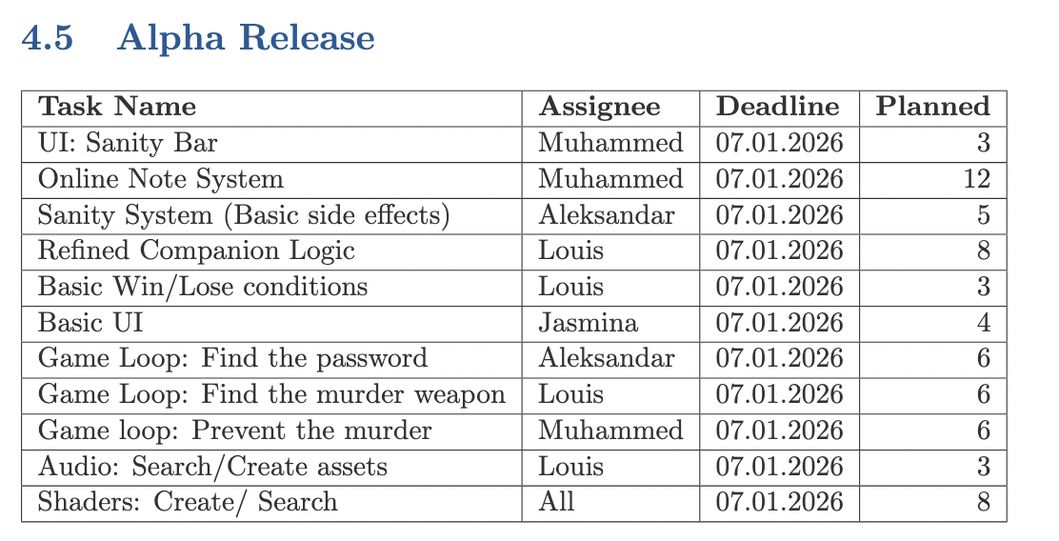
Targets
Targets

Slide 3
Progress
Current progress
What we have completed:
Environment mechanics
Online Note system
Game state management

Slide 4
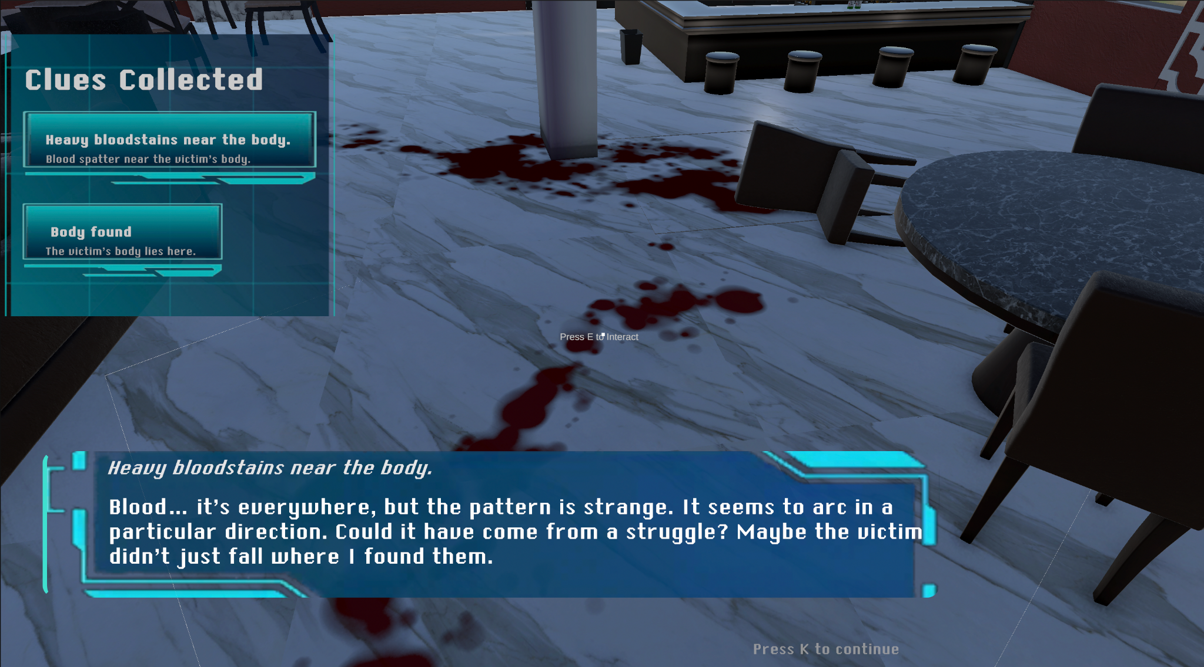
Scene Reconstruction
Explore the room and inspect clues
Each clue reveals an internal monologue
Found clues appear in the clue log
Collect all clues to unlock the puzzle
Arrange clues chronologically
Correct order opens the next area

Slide 5
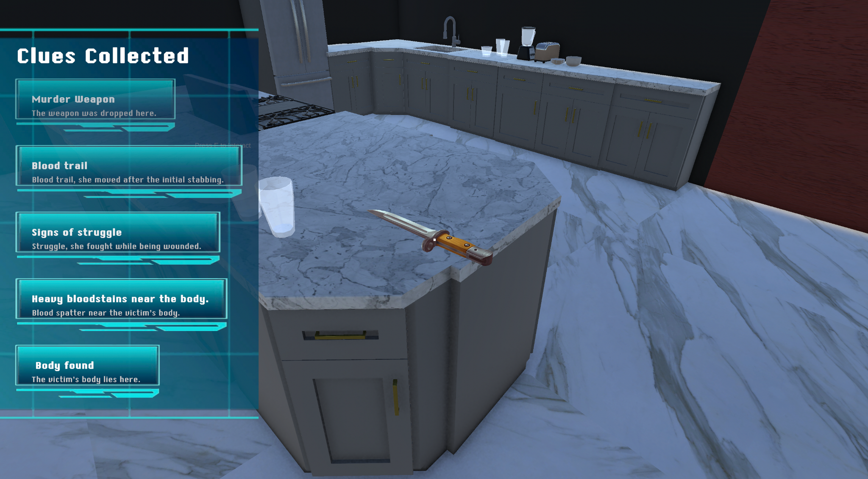
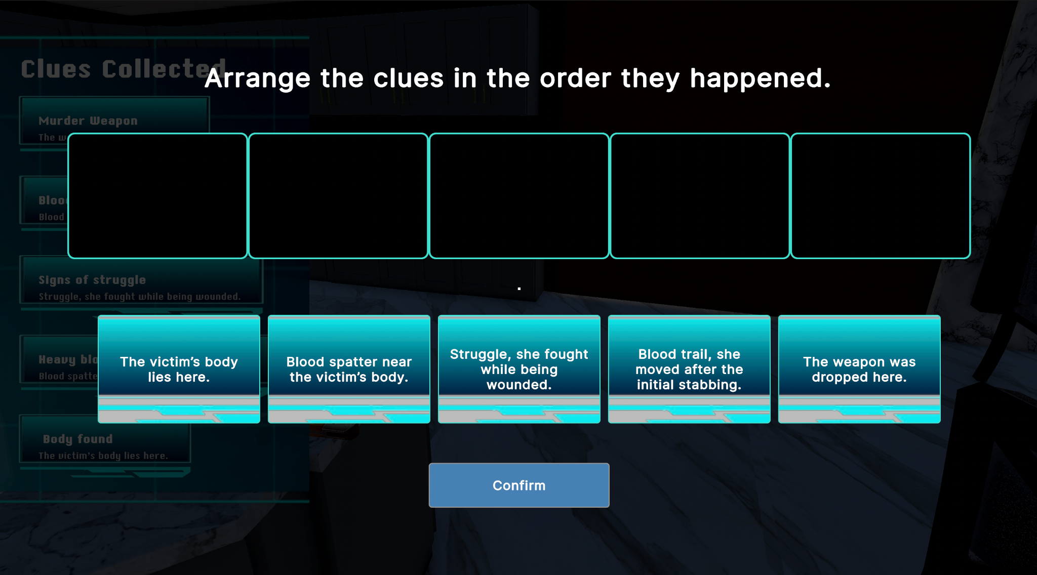
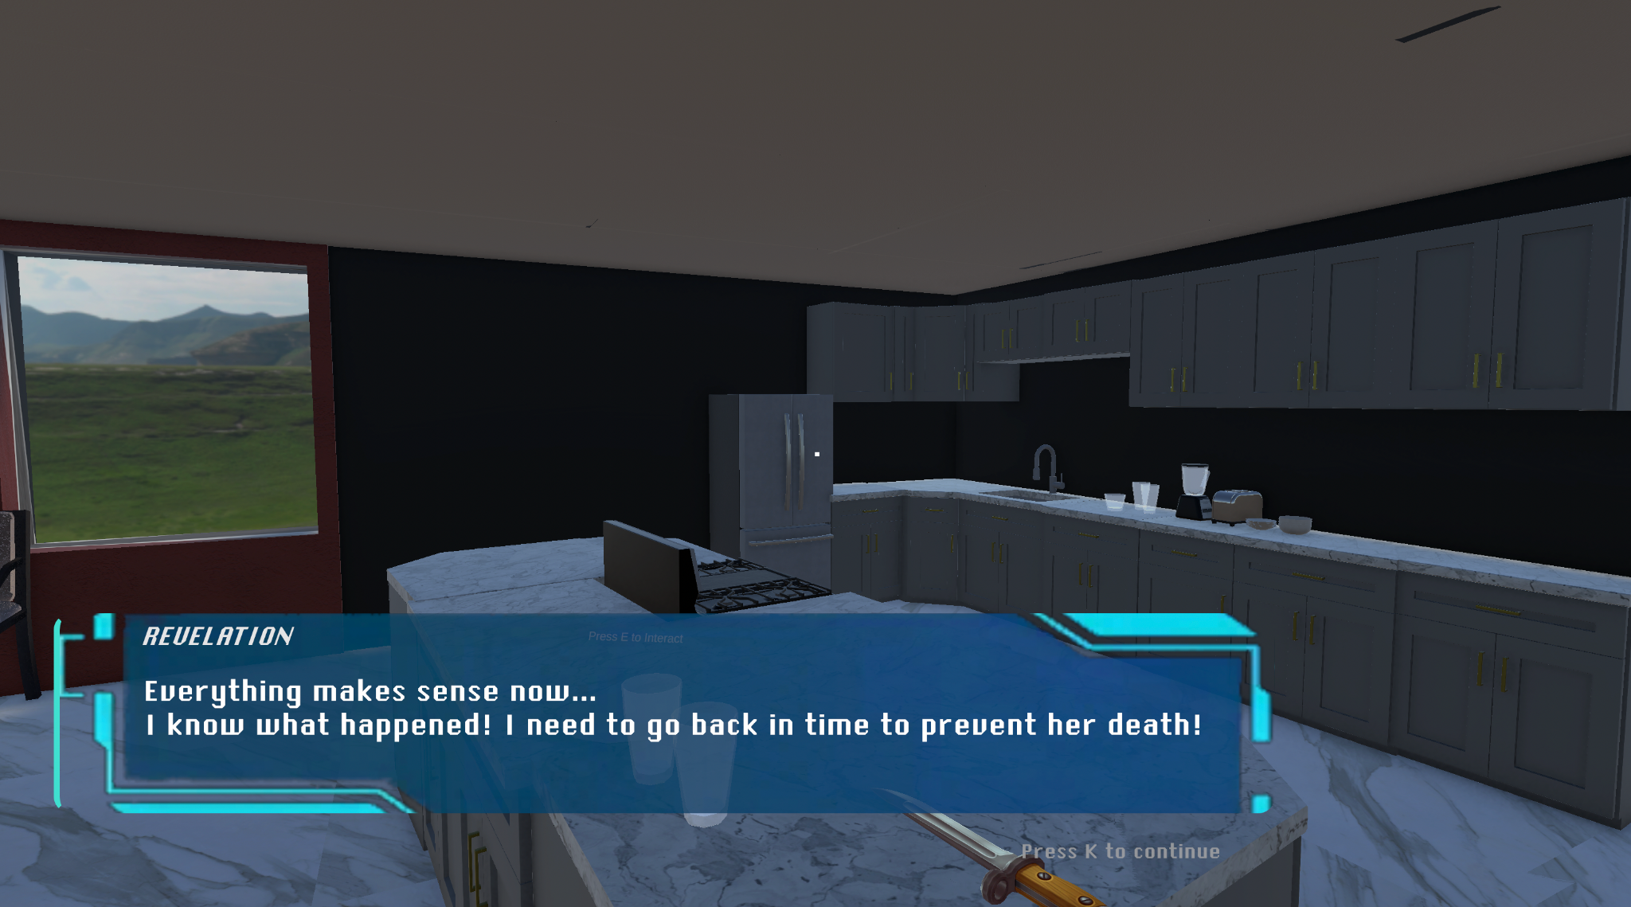
Scene Reconstruction
Inspecting
All clues collected
Reconstructing
Next room unlocked

Slide 6
Memory Wall System
Cloud-backed memory board where players can read, create, and delete notes.
Notes persist across loops and across game sessions, stored on a remote database.
Player Interaction: Approaching the wall shows “Press E” to open the UI (unchanged).
UI Features:
  View past notes per loop (server-filtered).
  Double-click to read full message
  Add new notes using word-category system
  Delete only your own notes (server-validated).
  UI layout and interactions remain identical to the previous version.
  Players can create messages with a maximum of 10 words.
Technical:
  Fully migrated from local JSON storage → Supabase PostgreSQL backend.
  All notes retrieved, inserted, and deleted via RESTful API calls.
  Cloud-hosted database ensures persistent, scalable, multi-session data.
  Improved data integrity: deletion restricted by player name on server

Slide 7
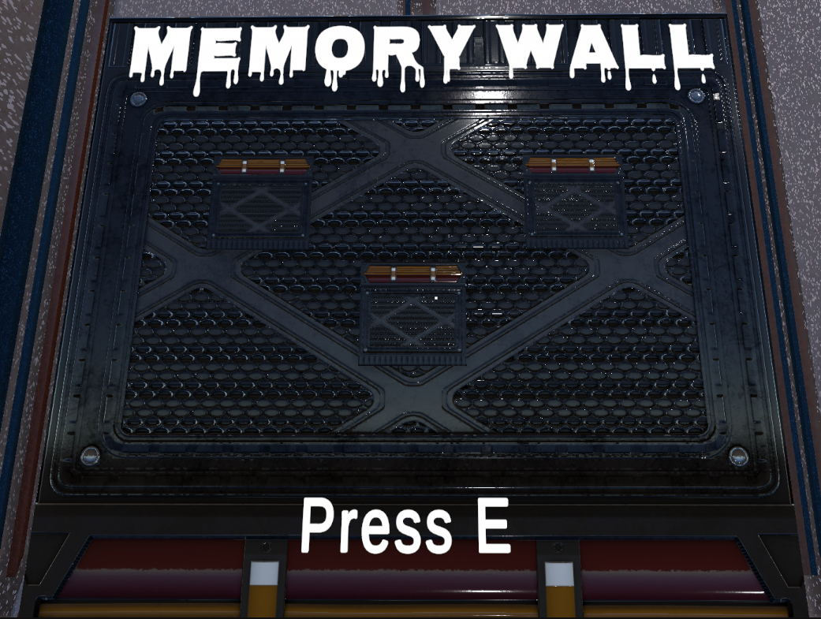
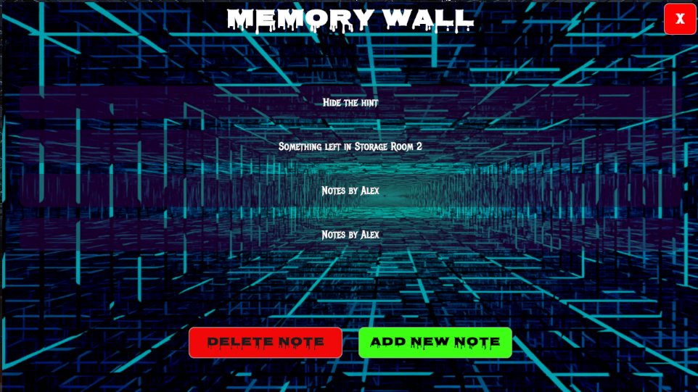
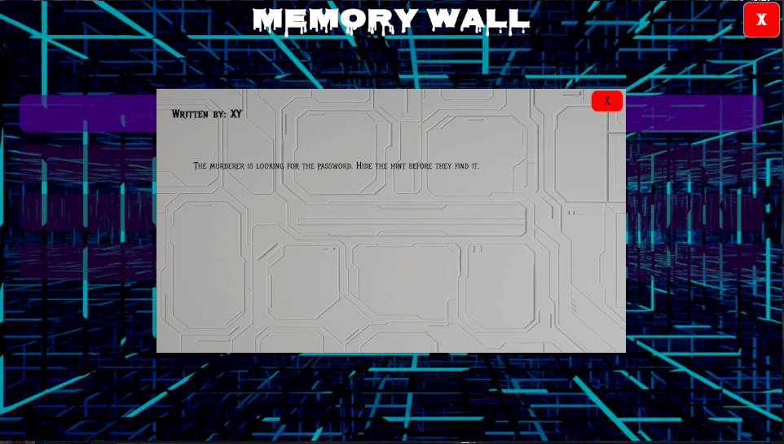
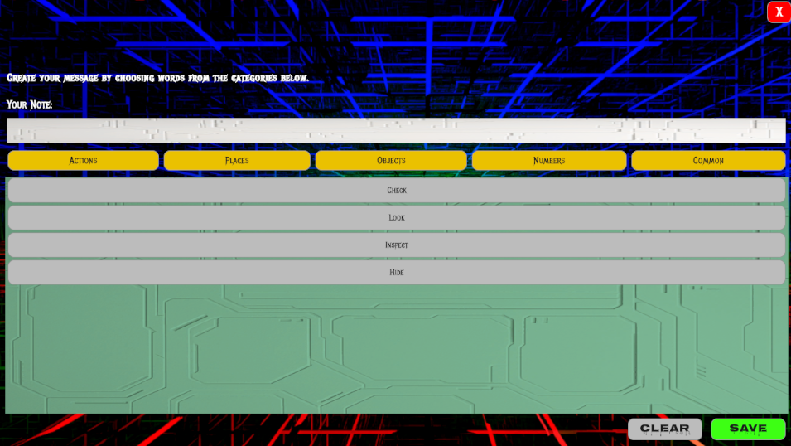
Memory Wall
3D Model
Notes Overview Page
Detailed Note View
Add Note Panel

Slide 8
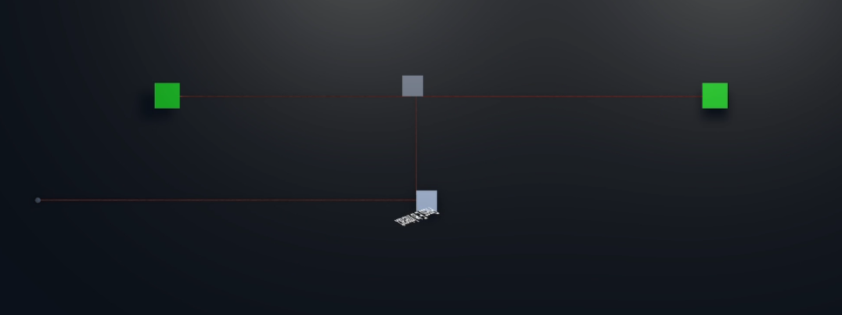
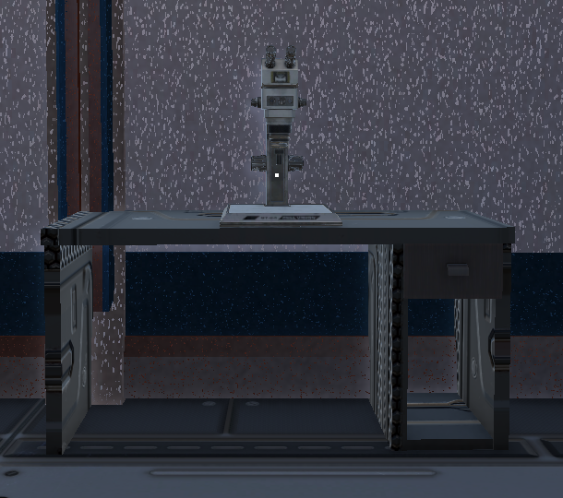
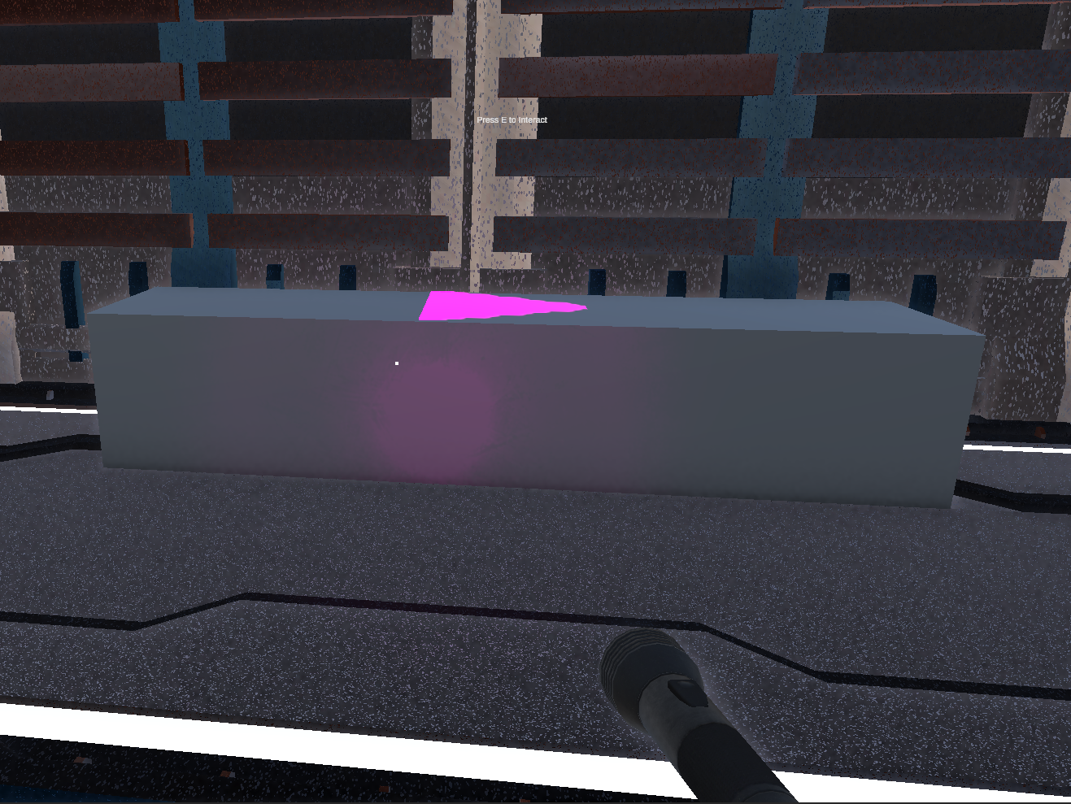
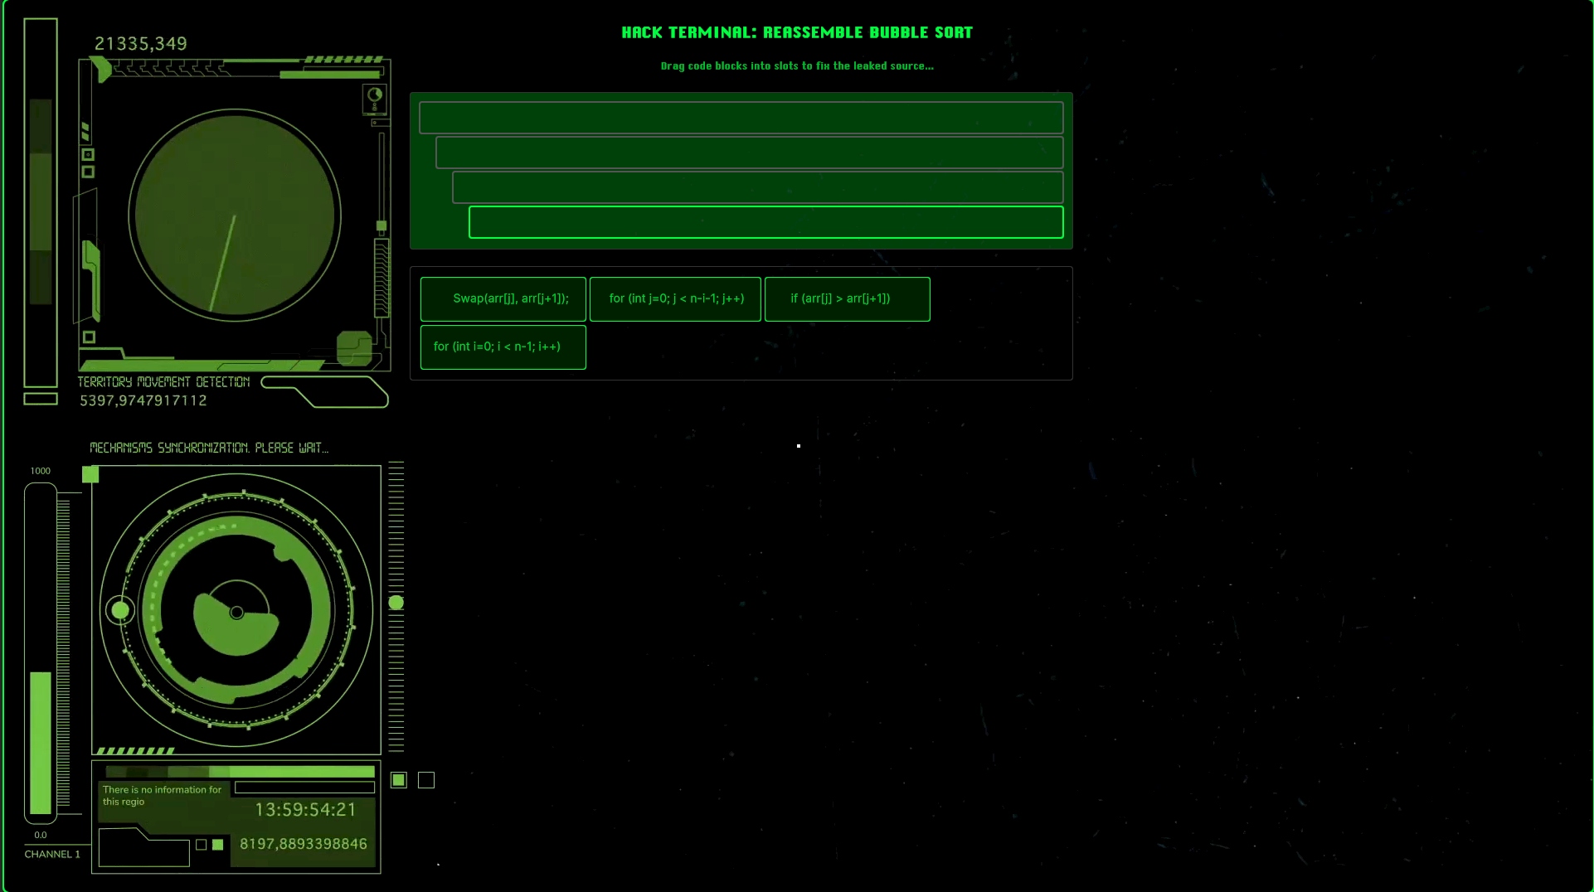
Puzzles
Computer Science
Physics
Biology

Slide 9
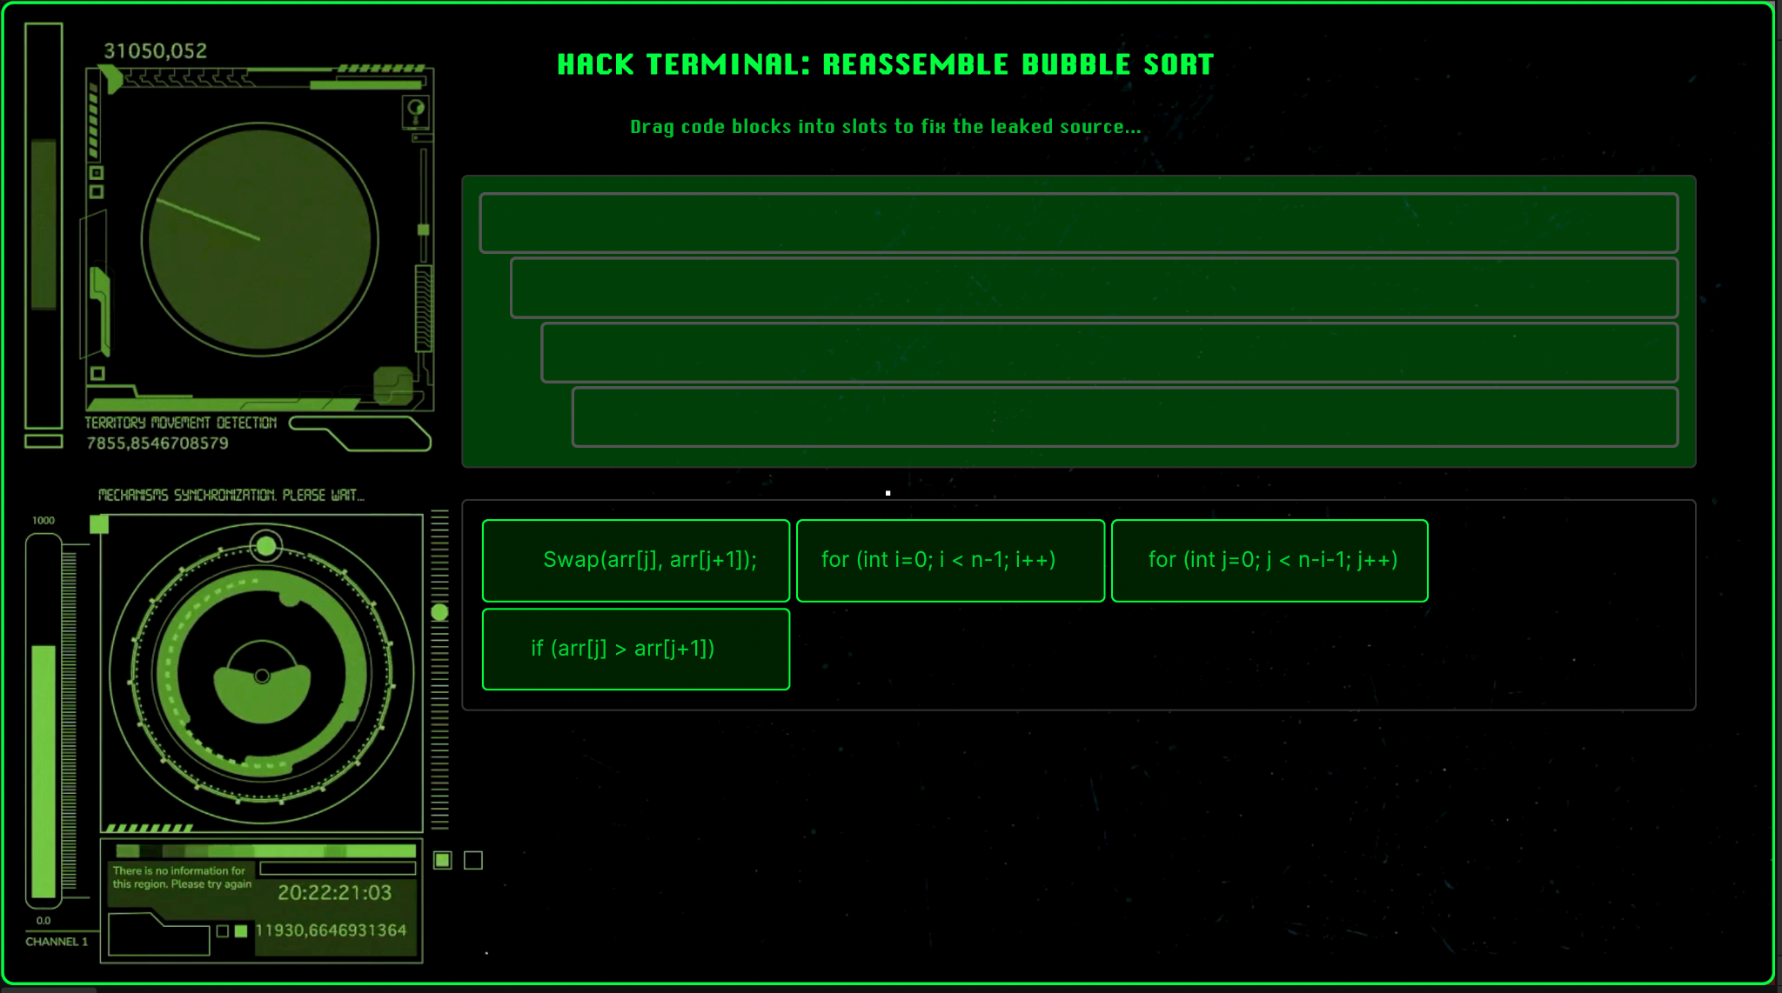
Computer Game Puzzle
Interact with a computer terminal to Open a corrupted Bubble Sort
Drag & drop code blocks in correct slots
Rebuild the correct order
Earn a digit of the forgotten pincode

Slide 10
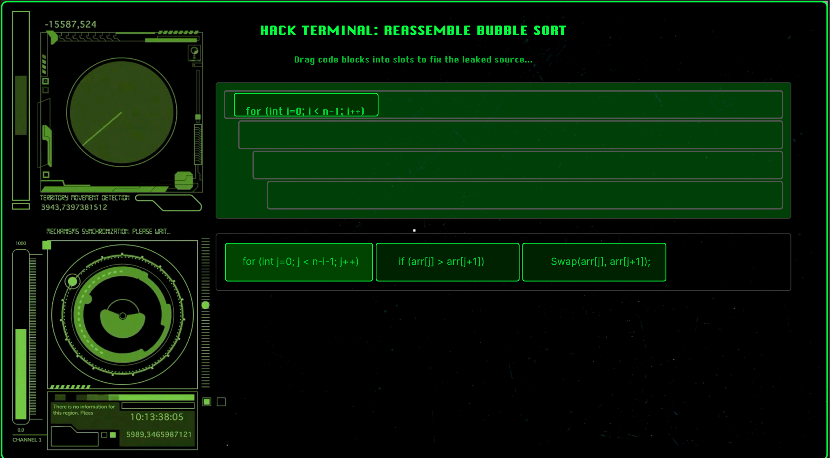
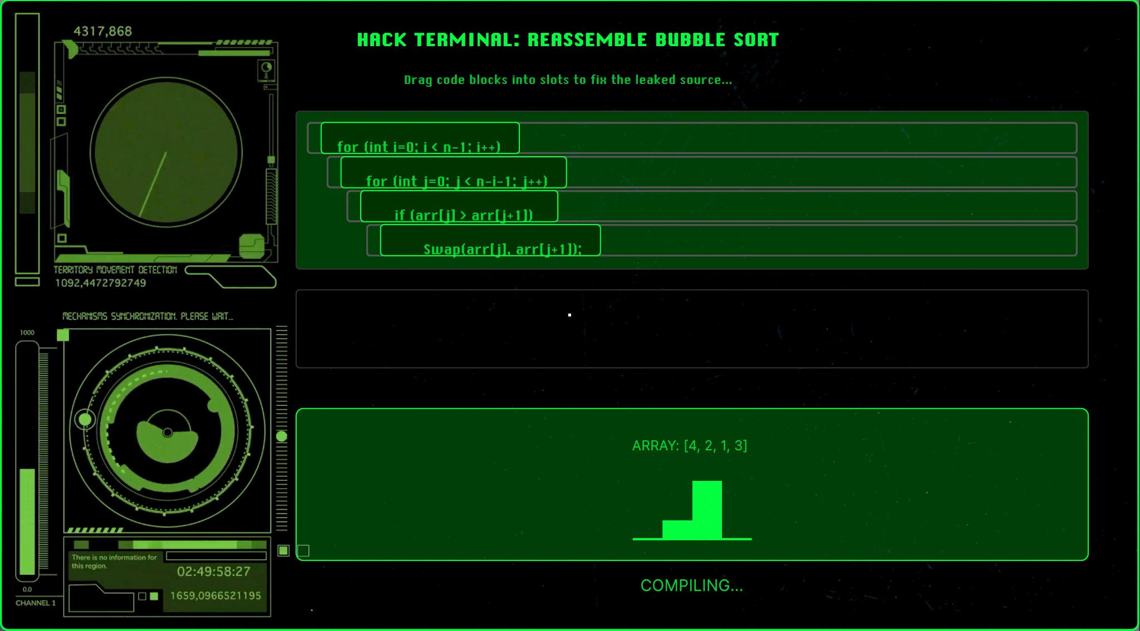
Computer Game
In progress…
Correct order…

Slide 11
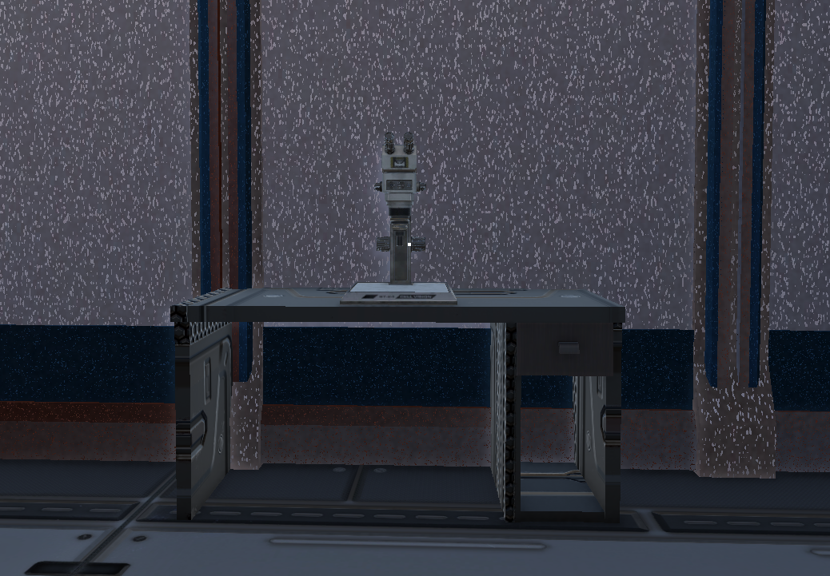
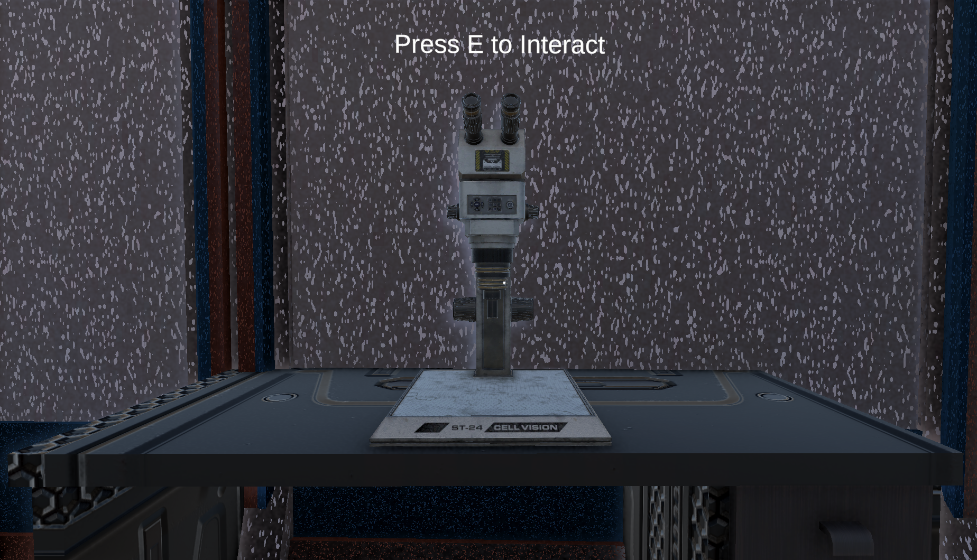
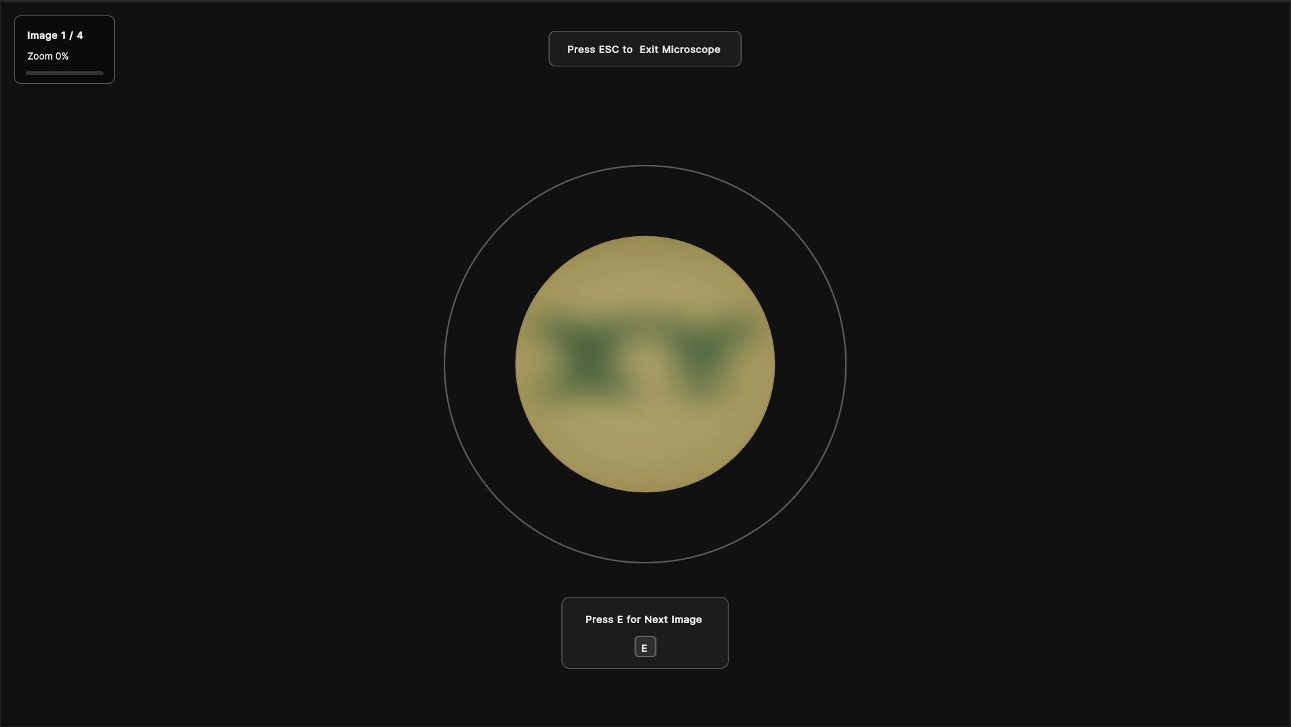
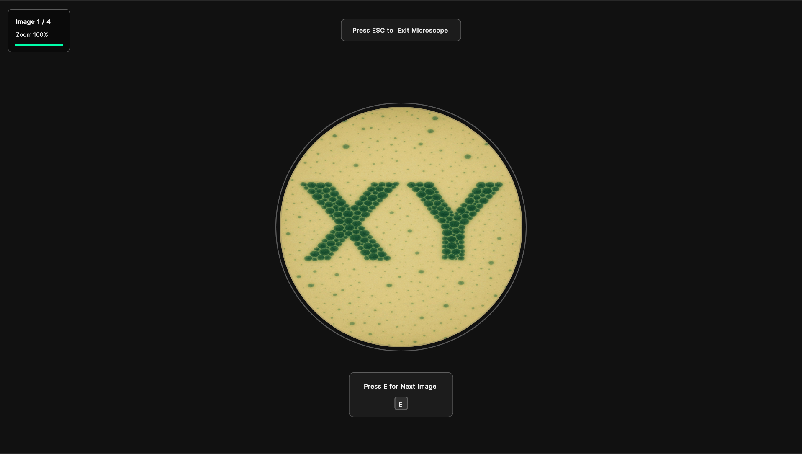
Microscope Puzzle

Slide 12
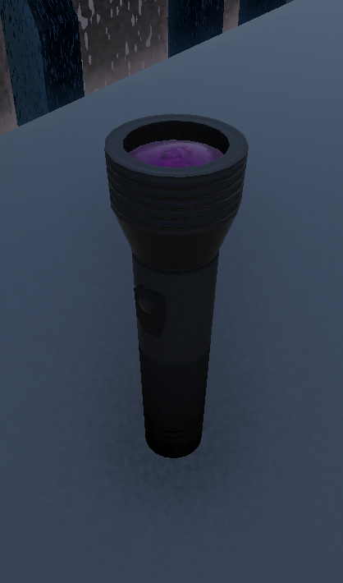
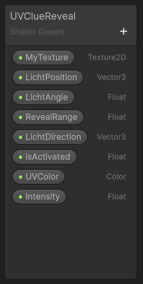
Flashlight Puzzle
Pick up flashlight and point around
Search hidden clues inside laboratory
Find final clue to identify pincode digit
Logic:
Shadergraph builds material
2 masks:
Distance mask
Checks for light range
Angle mask
Checks for flashlight orientation
Updates Alpha value of material
Flashlight provides material with information

Slide 13
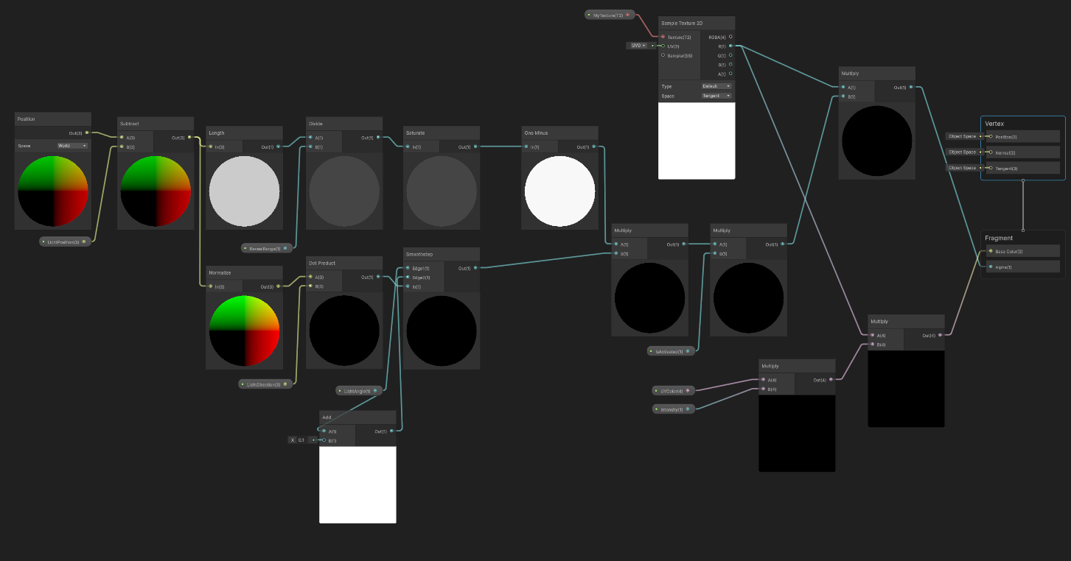
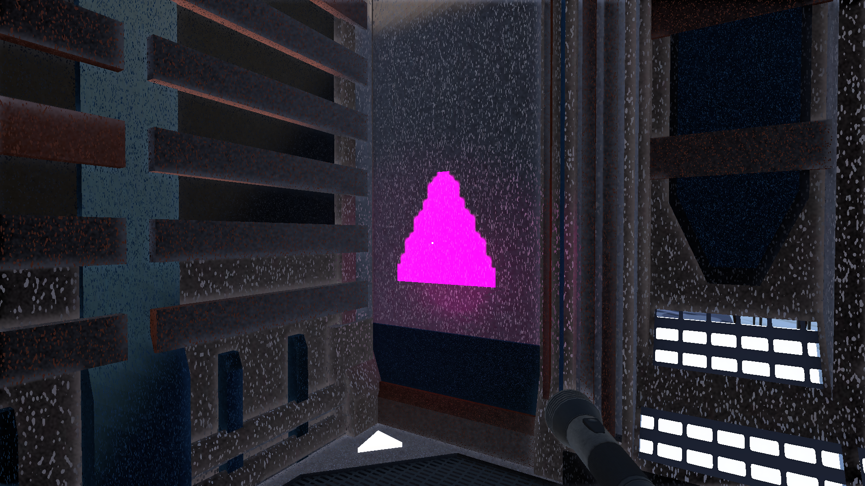
The Shadergraph
Hidden Clues

Slide 14
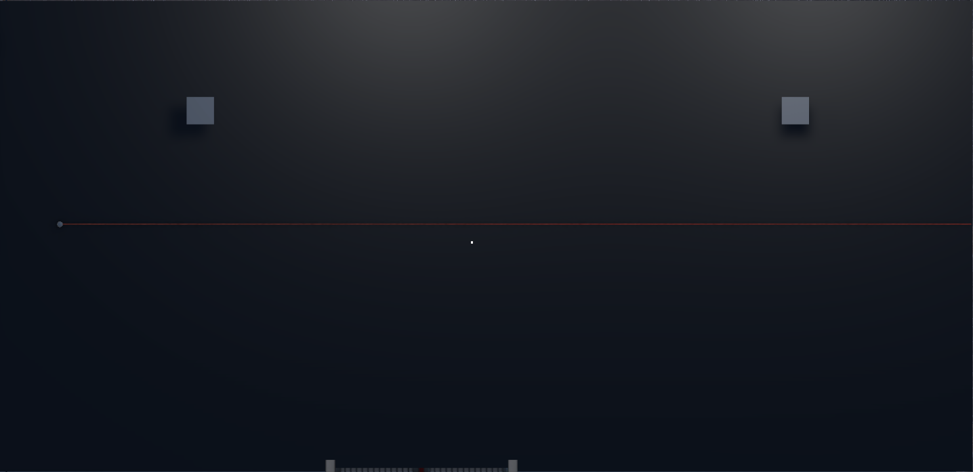
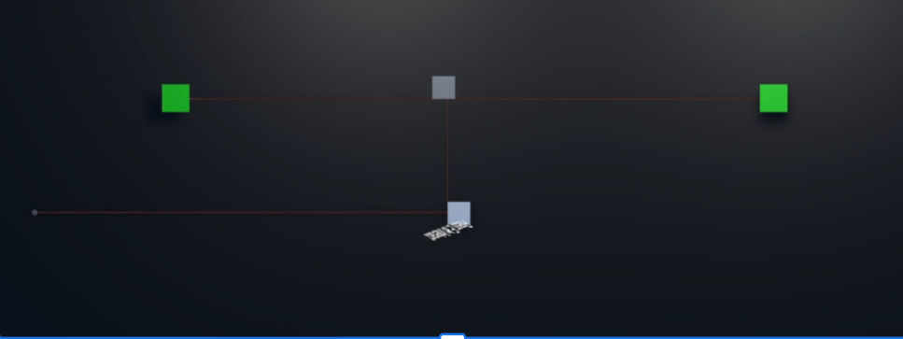
Laser Puzzle

Slide 15
Thank you!
Team XY

