Slide 1
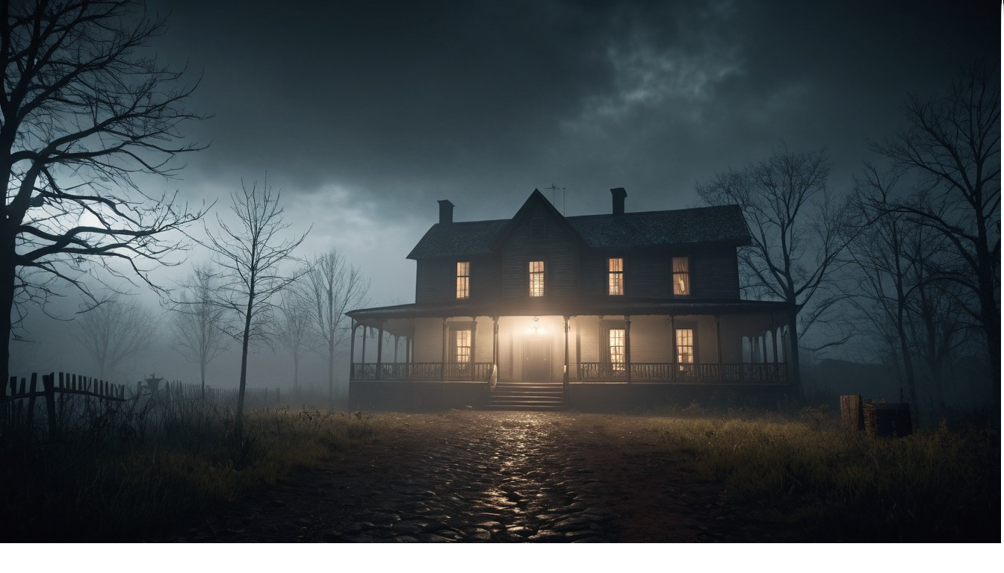
Echoes to Knowwhere
nowhere devs
Jasmina Vulovic
Ivan Rozhdestvenskii
Aleksandar Arnaudov

Slide 2
Feedback in 2 Words:
Injection system
Intro design
Incomplete narrative
Buggy gameplay
Simple puzzle
Unclear notes
Weapon pick-up
Narrative clues
Slow performance
Cool visuals

Slide 3
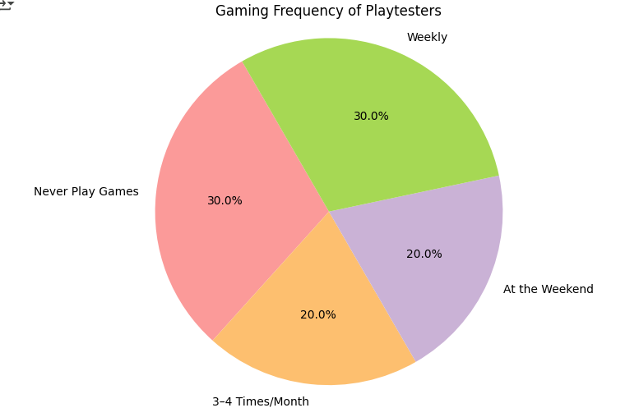
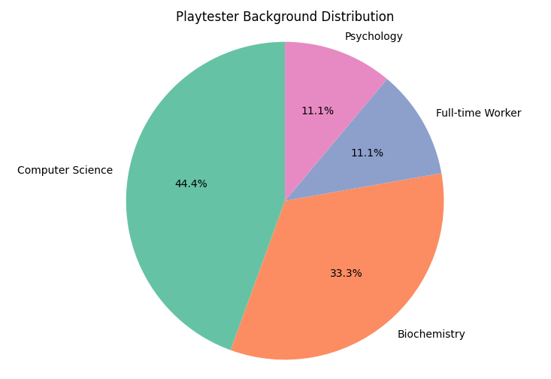
Demographics:
10 playtesters
Ages 21–25
Diverse academic and professional backgrounds
Varied gaming experience levels

Slide 4
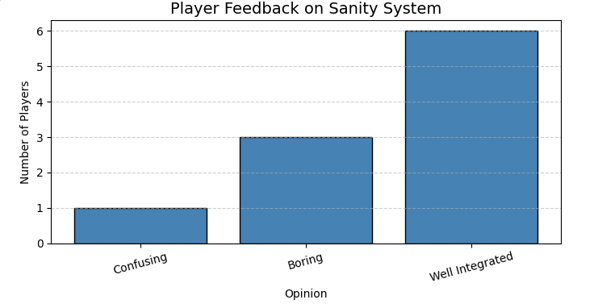
Sanity System:
Confusing: Black out, disabled movement
Boring: not noticeable impact on player performance

Slide 5
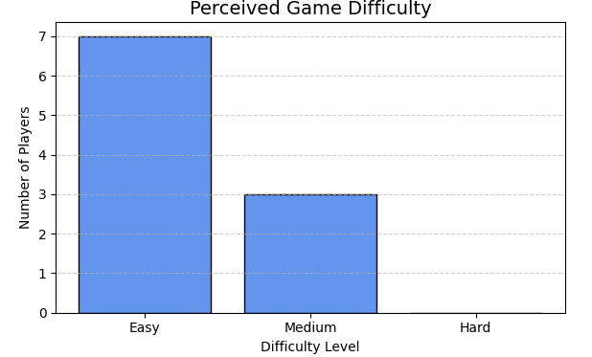
Difficulty:
Simple puzzle
Easy enemy avoidance
Strong boosts

Slide 6
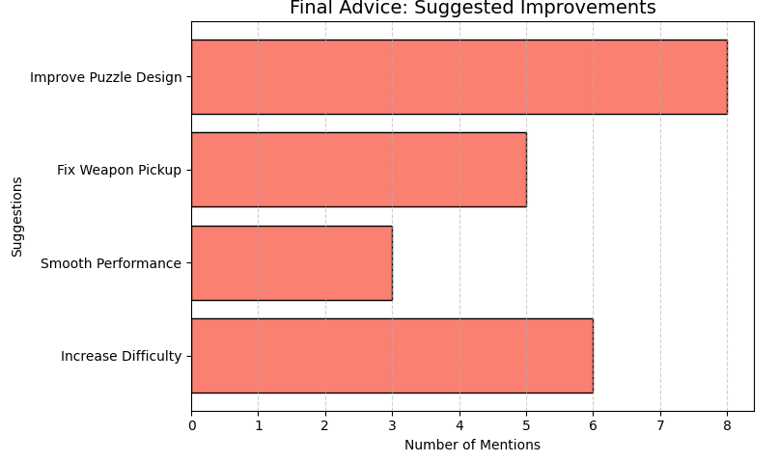
Players Feedback:

Slide 7
Planned Changes
Minor bug fixes
Adjust weapon pickup
Increase puzzle difficulty
Ensure smooth game performance
Clarify in-game notes
Add sound effects to the Outside area

Slide 8
Current Status
Functional Minimum
First Person Controller
Plain Intro Area
Static Enemies
Plain Outside Area
Low Target
Add Basic Serum System
Weapon Interaction (shooting)
Basic Audio and Visuals
Enemies move randomly
Narrative as Plain Text
Improved Level Design
Desirable Target
A working Low-Leveled Sanity System
Complete Intro Room
More Complex interactable Narrative Clues
Solvable puzzle
Complete Cave and Outdoors
Smart Enemies
Basic UI/UX
High Target
Audio Polish
Visual Effects (Hallucination, Hues, etc)
Polished UI/UX (tooltips, menus, feedback, transitions)
Fully functioning sanity system
Increase difficulty
Fix bugs

