Slide 1
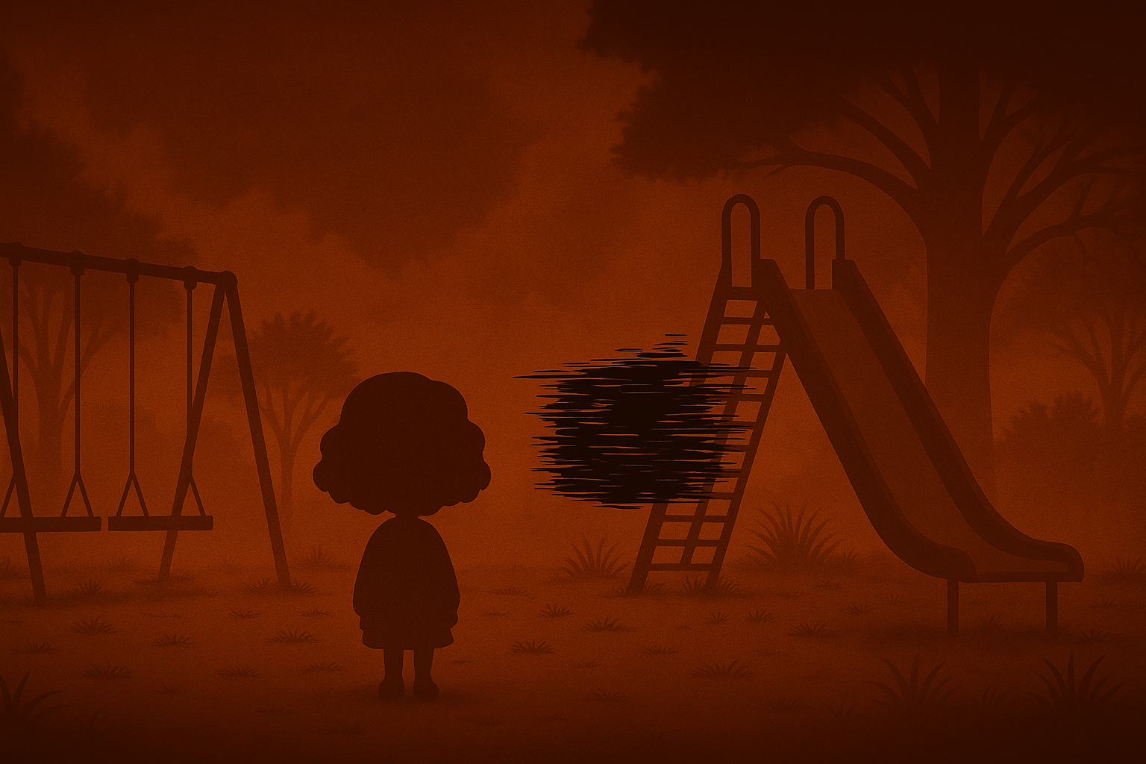
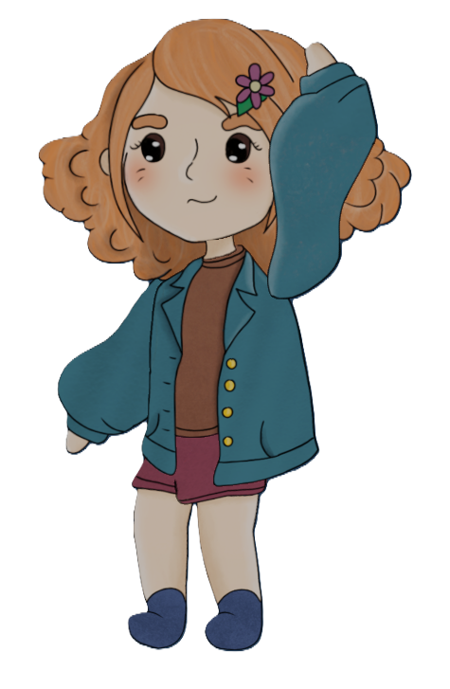
Psychground: Milestone 4
Baran Gürsoy
Giorgi Tsartsidze
Alexandra Colf
Notes:
Giorgi, Baran, Alexandra

Slide 2
Previous Progress Timeline
Layer 1: Functional Minimum
Layer 2: Low Target
Layer 3: Desirable Target
Layer 4: High Target
✅ Basic 2D movement in 3D Scene.
✅ Static Black Box entity
✅ One NPC with Dialogue
✅ First playground ready and playable.
✅ Sanity System with visual feedback
✅ Black Box Follwing
✅ Dialogue System
✅ Inventory System
✅ Item-based Sanity Recovery
✅ Simple Quests
✅ Multiple NPCs with quest-aware dialogue.
🔃 Three Playground Loops
✅ Fully Integrated Sanity System
✅ Crafting Mechanic
✅ Rigged & Animated 2D Sprites
✅ Dynamic Expression System
✅ Additional Puzzles
✅ Audio Implementation
🔃 Loop 3 Content
🔃 Enhanced Shader Effects
🔃 Storytelling Transition UIs
🔃 Refine NPC Movements
Notes:
Giorgi, Baran, Alexandra

Slide 3
Current Progress Timeline
Layer 1: Functional Minimum
Layer 2: Low Target
Layer 3: Desirable Target
Layer 4: High Target
✅ Basic 2D movement in 3D Scene.
✅ Static Black Box entity
✅ One NPC with Dialogue
✅ First playground ready and playable.
✅ Sanity System with visual feedback
✅ Black Box Follwing
✅ Dialogue System
✅ Inventory System
✅ Item-based Sanity Recovery
✅ Simple Quests
✅ Multiple NPCs with quest-aware dialogue.
✅ Three Playground Loops
✅ Fully Integrated Sanity System
✅ Crafting Mechanic
✅ Rigged & Animated 2D Sprites
✅ Dynamic Expression System
✅ Additional Puzzles
✅ Audio Implementation
✅ Loop 3 Content
✅ Enhanced Shader Effects
✅ Storytelling Transition UIs
✅ Refine NPC Movements
Notes:
Giorgi, Baran, Alexandra

Slide 4
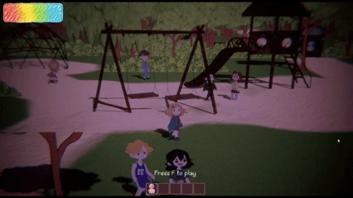
Progress
Updated NPC facial expressions and dialogue animations
The final cutscene ending with the “bad guy” reveal
Complete quest chains and dialogues for Playground 3
Bug fixes and polished patrol paths for NPCs
Triggers connecting animations to dialogue flow
Notes:
Giorgi, Baran, Alexandra

Slide 5
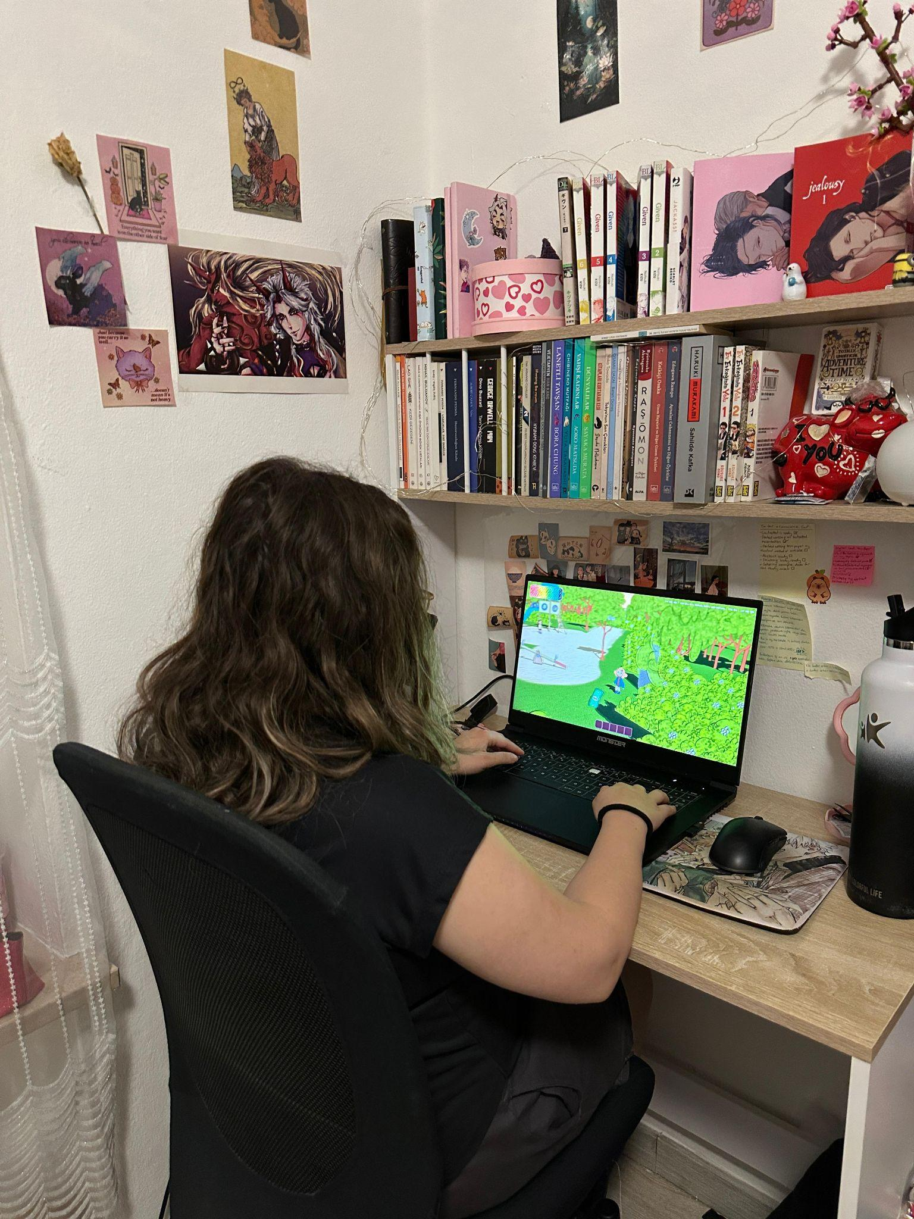
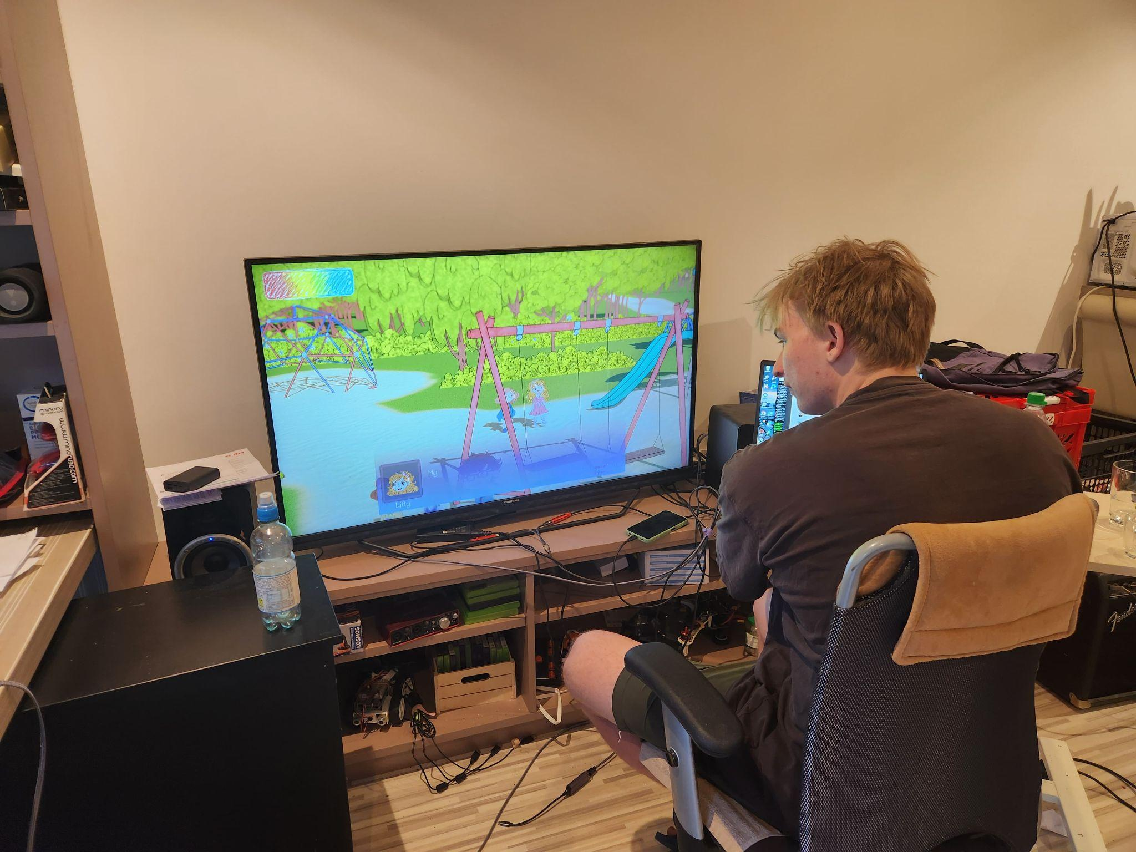
Playtesting
10 participants
Age range: 17–60 (mostly under 30)
Notes:
Giorgi, Baran, Alexandra

Slide 6
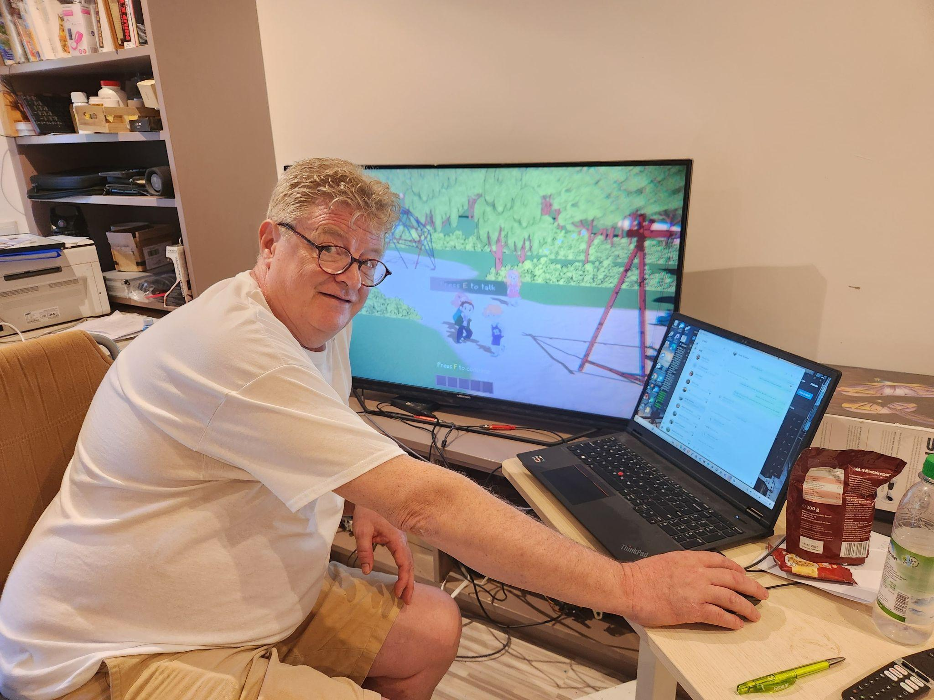
Player Feedback Highlights
Playground felt bright but unsettling
Black Box was “creepy” and intriguing
Loop 2 triggered real tension
Good Dialogue pacing
Age Exception: Jim
Notes:
Giorgi, Baran, Alexandra

Slide 7
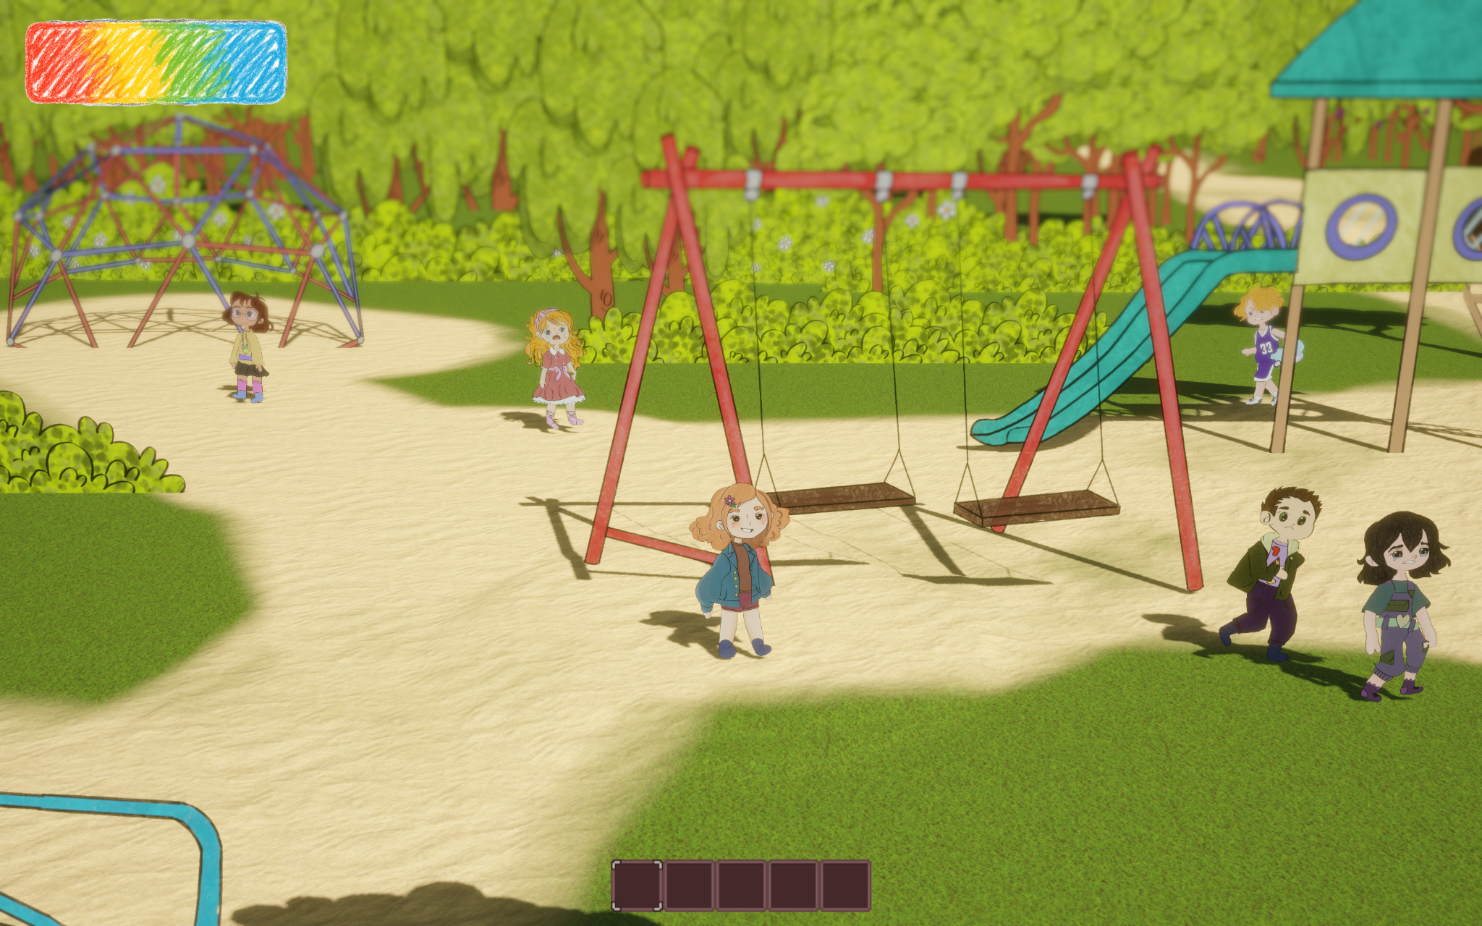
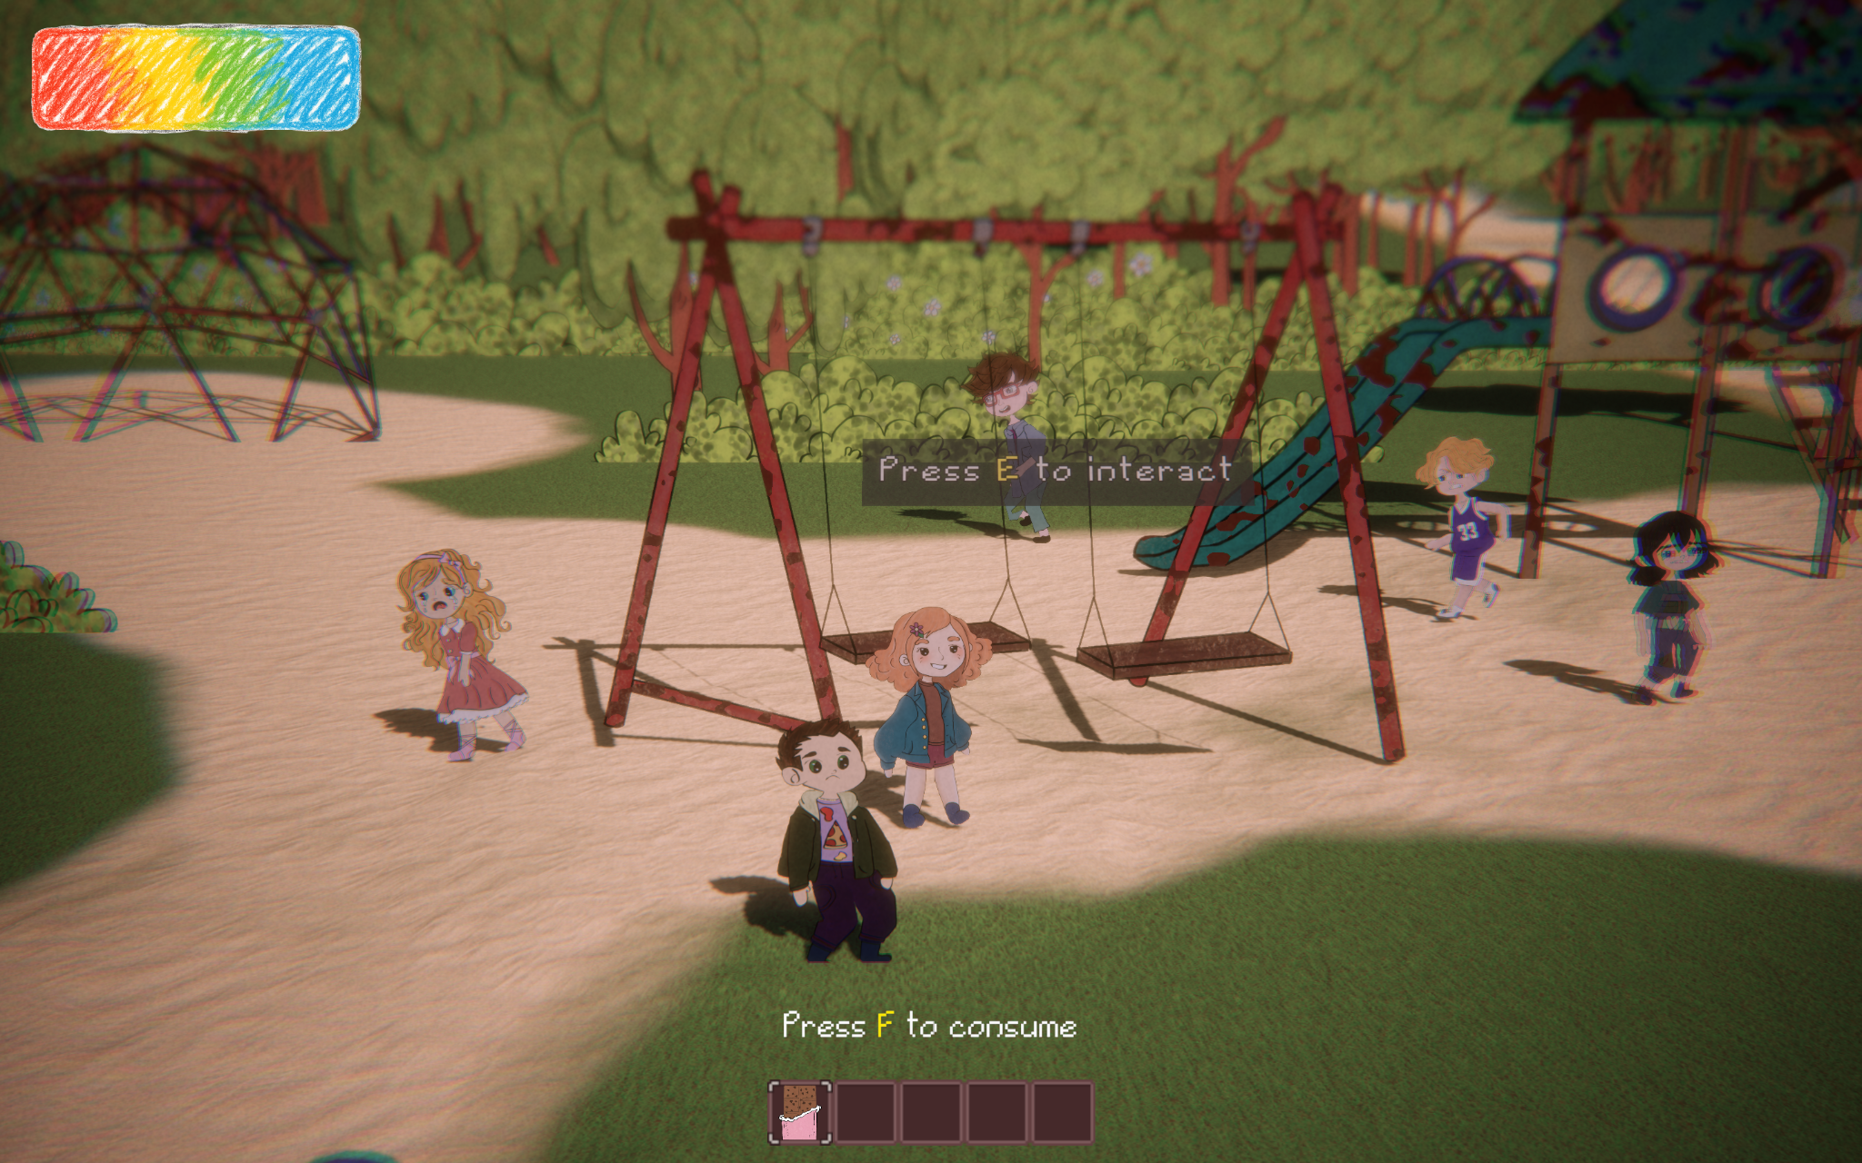
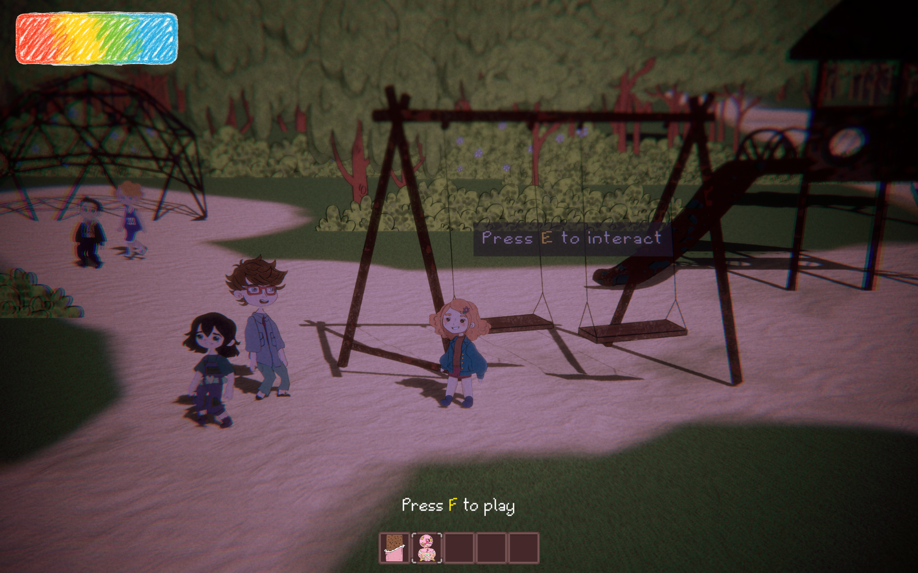
Puzzles and Core Loop
Playgrounds 1 & 2 puzzles felt natural and story-linked
Loop 3 puzzle was confusing
Loop resets understood, but rare
Notes:
Giorgi, Baran, Alexandra

Slide 8
Expert Psychological Feedback
Trauma theme compared to “Dark Chest” metaphor
Suggestions:
  Make trauma theme more explicit
  More nuanced villain (lure & choice)
  Broader scope of fears, if time allows
Notes:
Giorgi, Baran, Alexandra

Slide 9


Next Steps
Bug fixes
Polish and improve UI more
Notes:
Giorgi, Baran, Alexandra

Slide 10
Thank you for listening!

