Slide 1
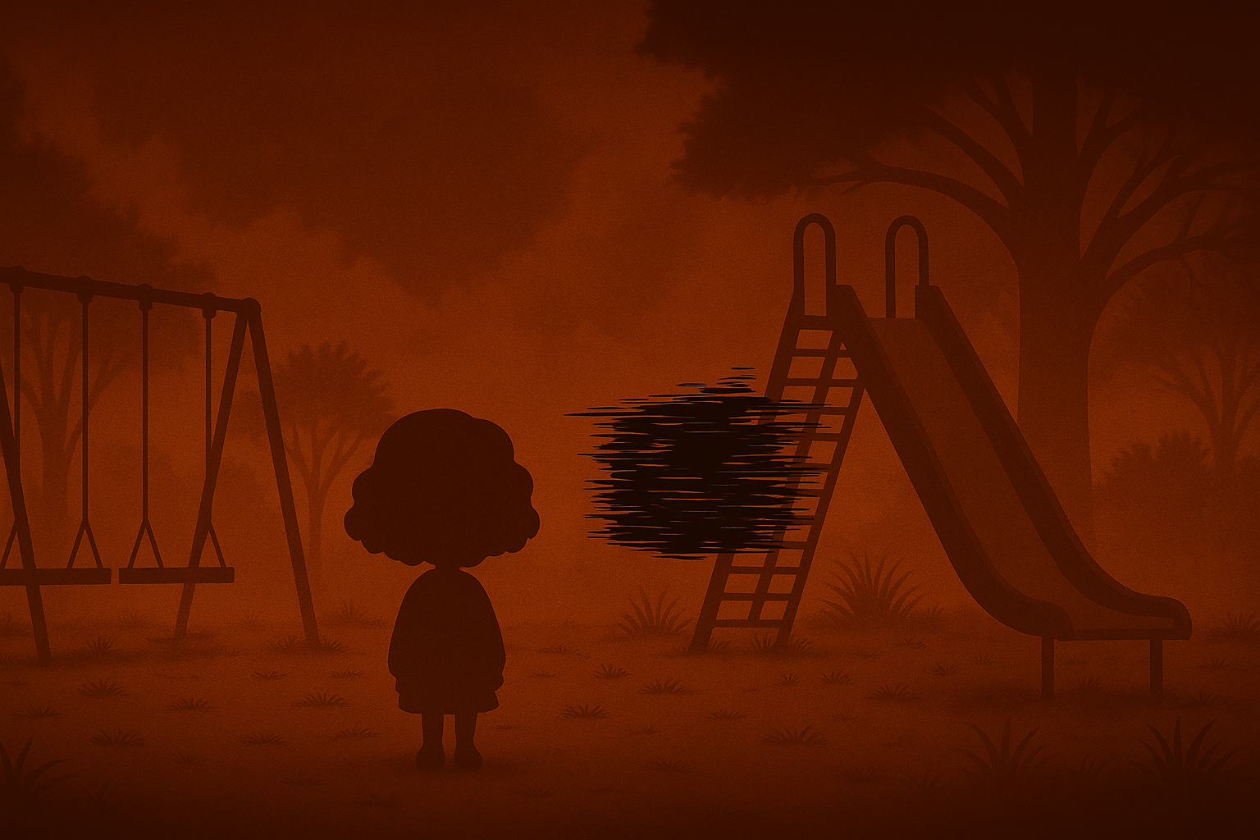
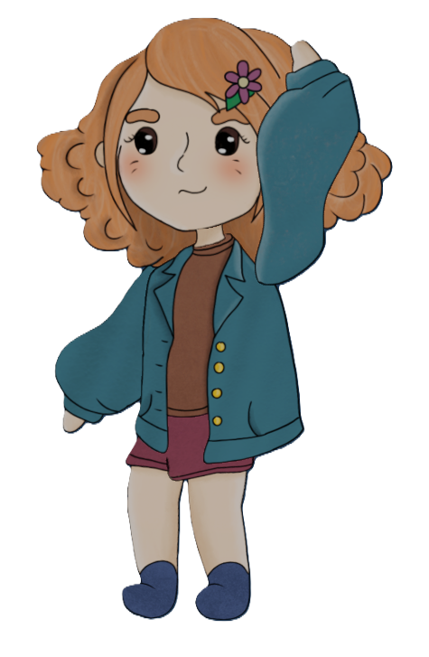
Psychground: Milestone 3
Baran Gürsoy
Giorgi Tsartsidze
Alexandra Colf
Notes:
Giorgi, Baran, Alexandra

Slide 2
Current Progress Timeline
Layer 1: Functional Minimum
Layer 2: Low Target
Layer 3: Desirable Target
Layer 4: High Target
✅ Basic 2D movement in 3D Scene.
✅ Static Black Box entity
✅ One NPC with Dialogue
✅ First playground ready and playable.
✅ Sanity System with visual feedback
✅ Black Box Follwing
✅ Dialogue System
✅ Inventory System
✅ Item-based Sanity Recovery
✅ Simple Quests
✅ Multiple NPCs with quest-aware dialogue.
🔃 Three Playground Loops
✅ Fully Integrated Sanity System
✅ Crafting Mechanic
✅ Rigged & Animated 2D Sprites
✅ Dynamic Expression System
✅ Additional Puzzles
✅ Audio Implementation
🔃 Loop 3 Content
🔃 Enhanced Shader Effects
🔃 Storytelling Transition UIs
🔃 Refine NPC Movements
Notes:
Giorgi, Baran, Alexandra

Slide 3
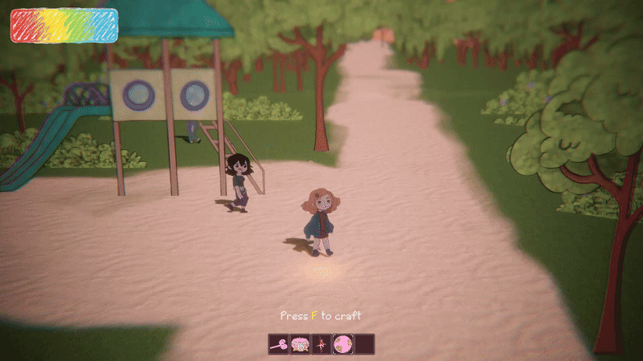
Guided Crafting System
Intuitive
Consistent control scheme
Dynamic
Notes:
Giorgi, Baran, Alexandra

Slide 4
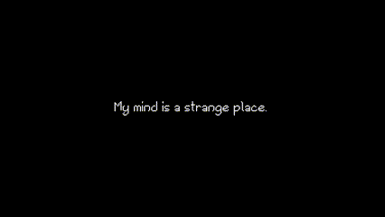
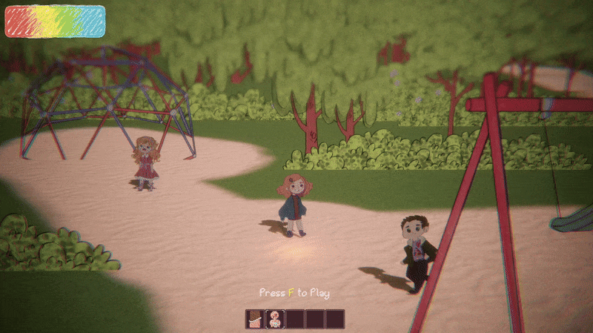
Cutscenes
2 main cutscenes implemented
1 to go
Notes:
Giorgi, Baran, Alexandra

Slide 5
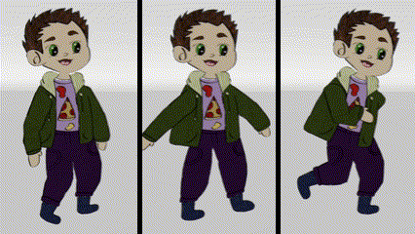
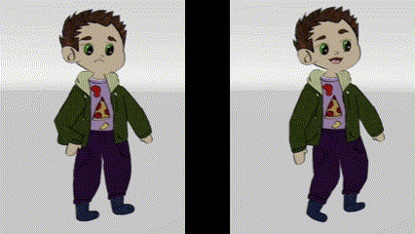
Animations
Multiple animators
Seperate animations
Same Triggers
Notes:
Giorgi, Baran, Alexandra

Slide 6
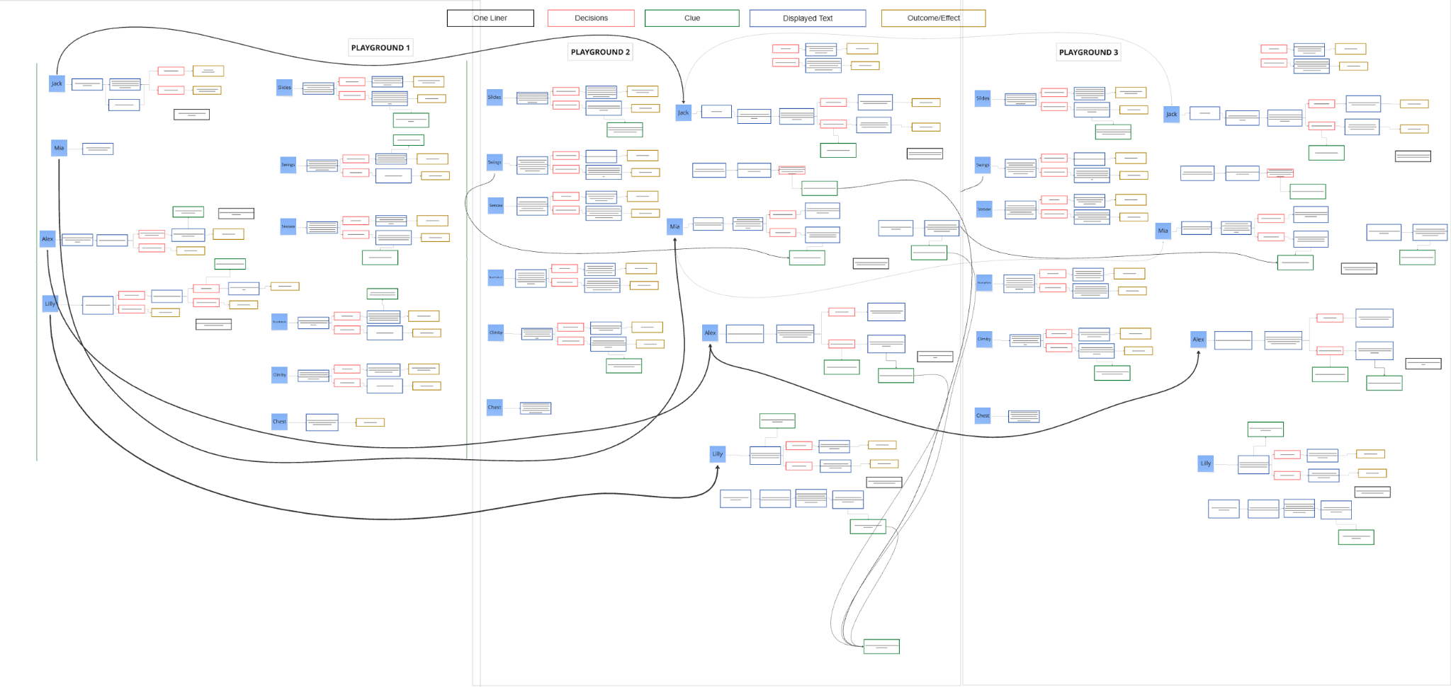
Dialogues
New dialogue focus
Focuses more on the story
System
Notes:
Giorgi, Baran, Alexandra

Slide 7
Next Steps
Finalize the Playground 3
Bug fixes
Polish and improve UI
Implement the EndGame
Notes:
Giorgi, Baran, Alexandra

Slide 8
Thank you for listening!

