Slide 1
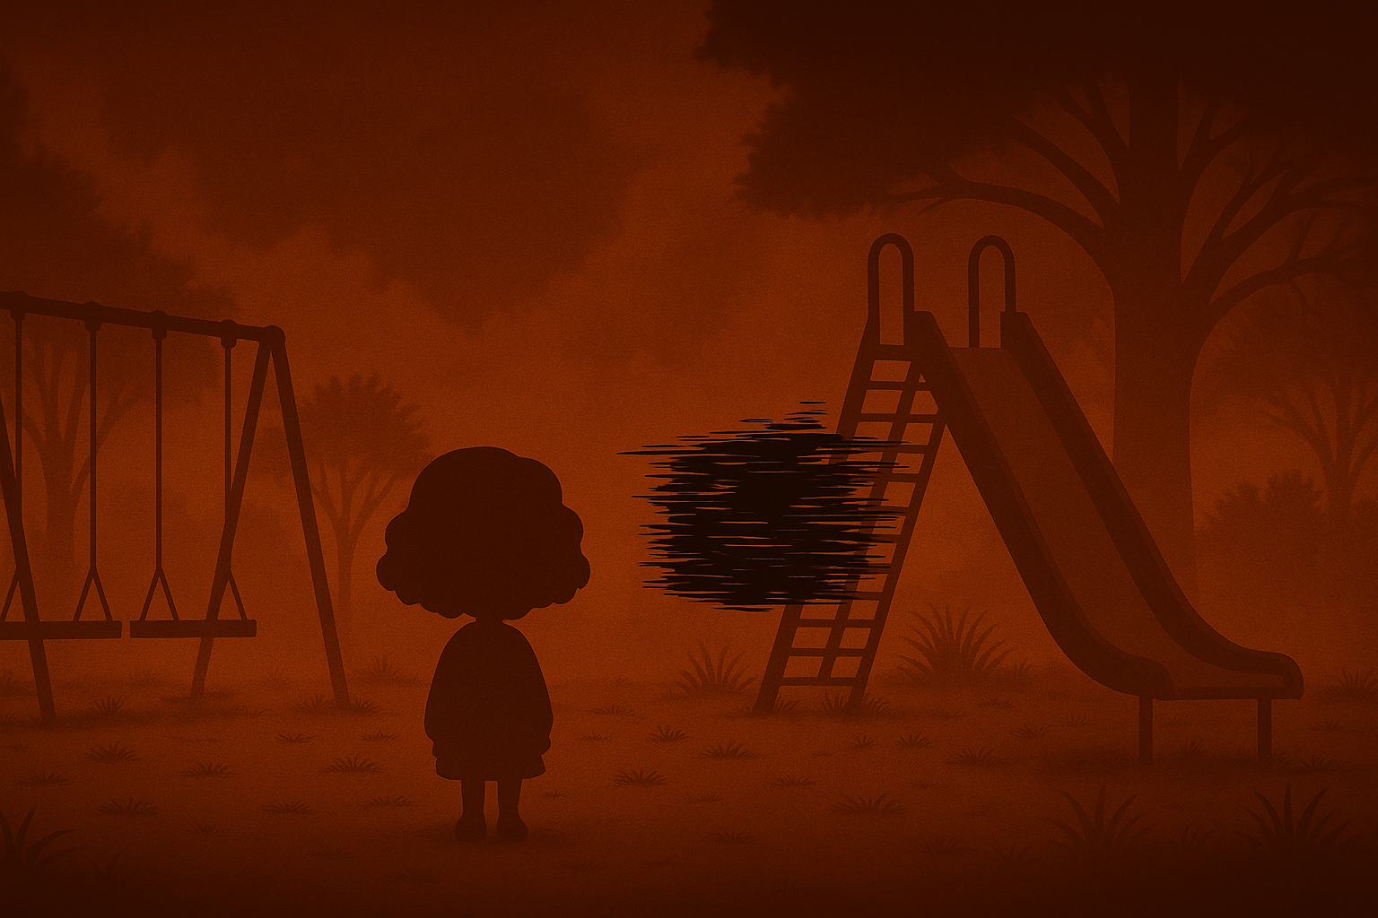
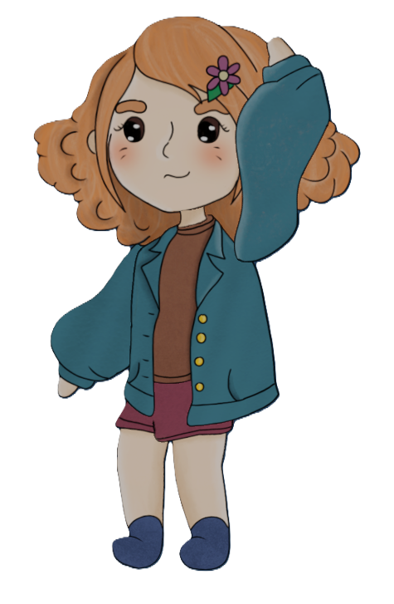
Psychground
Baran Gürsoy
Giorgi Tsartsidze
Alexandra Colf
Notes:
Giorgi, Baran, Alexandra

Slide 2
Goal
Conveying a strong message:
  Creating a safe environment for children
  Haunting emotional truth behind unresolved trauma
Create a meaningful and memorable experience
Tell a subtle story about childhood and vulnerability
Build a haunting, uneasy atmosphere
Leave players thinking after the game ends

Slide 3

Game Description
Psychological puzzle-adventure game
Main character: Emma
Trapped in a looping playground
Setting: A familiar playground; with one disturbing presence: the Black Box
Objective
?
Spoiler Alert: There is Kevin in that box

Slide 4
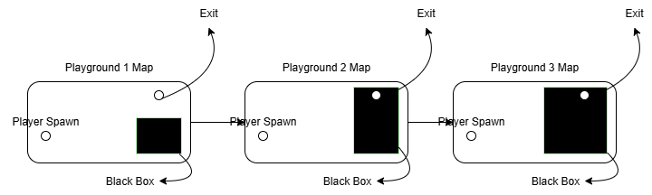
Game Loop

Slide 5
Theme: Road to Nowhere
Emma is trapped in a looping playground, each cycle more distorted than the last
The player progresses, but true resolution is never reached
The game ends where it begins: the Black Box is still there
Reflects the emotional truth of unresolved trauma. Sometimes, there’s no clear way out

Slide 6
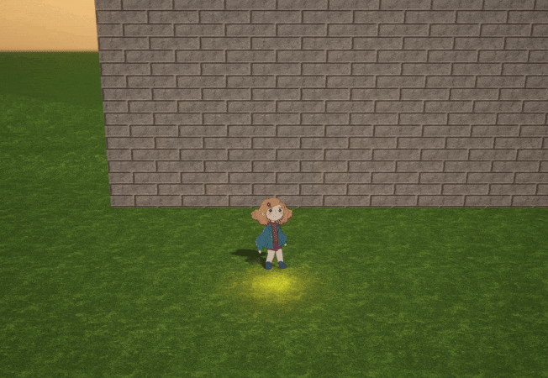
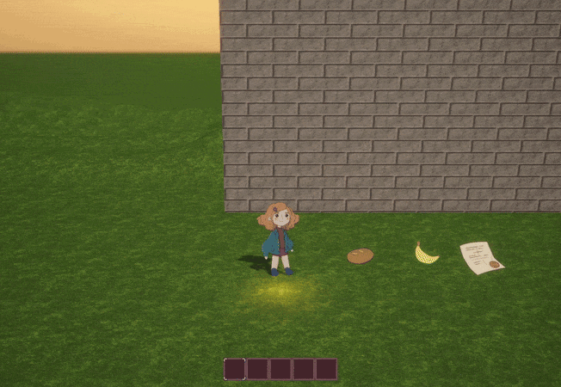
Technical Achievements
2.5D World & Animation System
Sanity-Based Gameplay & Feedback System
Inventory System for Item Collection & Use
2.5D Setup —> 2D Character movement in 3D world with interactions
Inventory System
Note: Very very VERY early stage footages

Slide 7
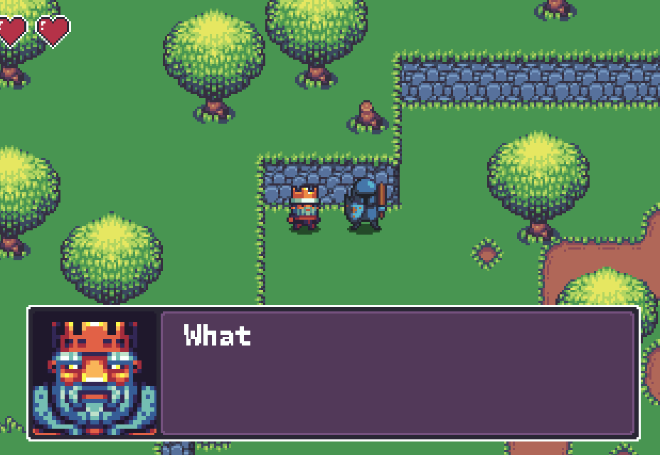
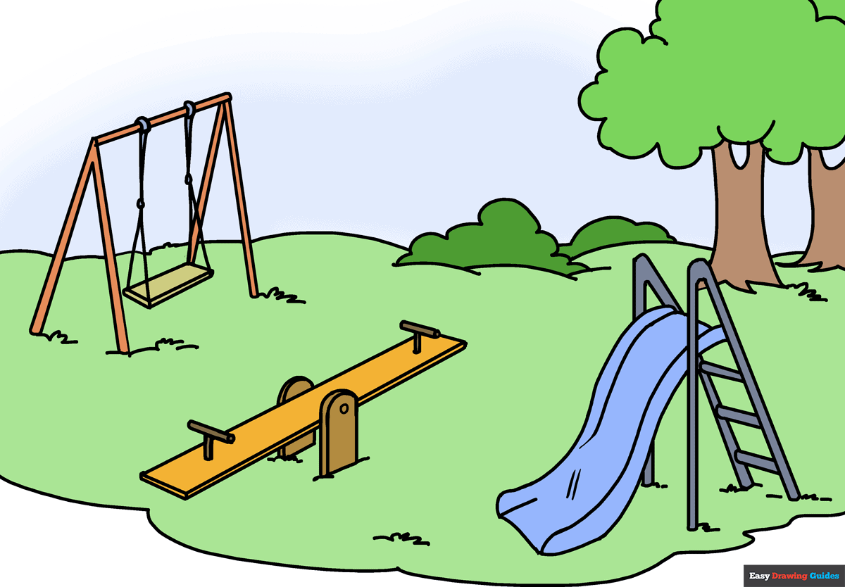

Technical Achievements 2.0
Dialogue System with Small Choice-Based Consequences
Looping Playground Environment Progression
Optional/Extra: Natural NPC Movement & Playground Routines
Reference: Dialogue System by friendlycosmonaut
Unnecessary Visual for Looping Playground System

Slide 8
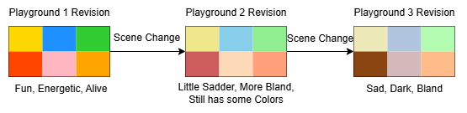
Technical Innovation
(Dynamic Level Atmosphere Changer)

Slide 9
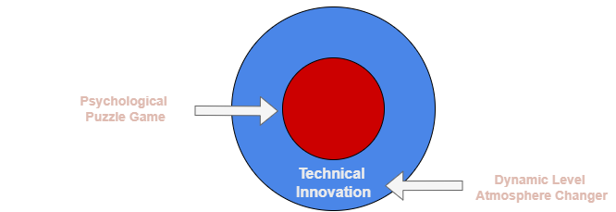
“Big Idea” Bullseye

Slide 10
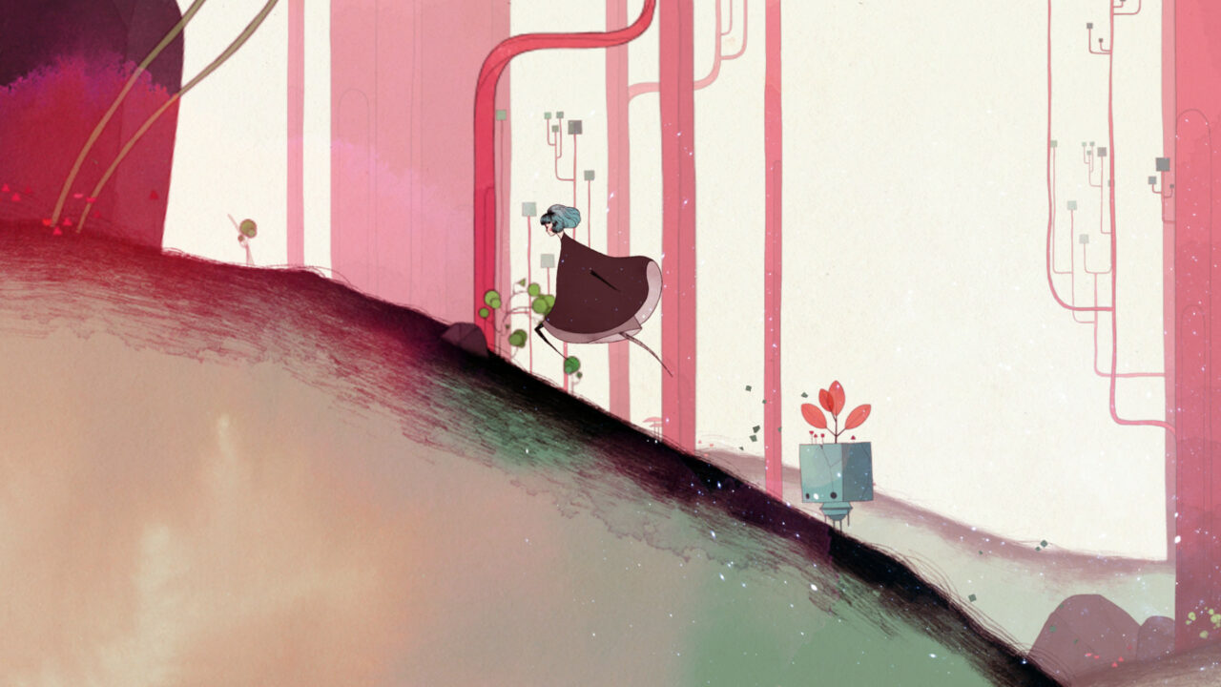

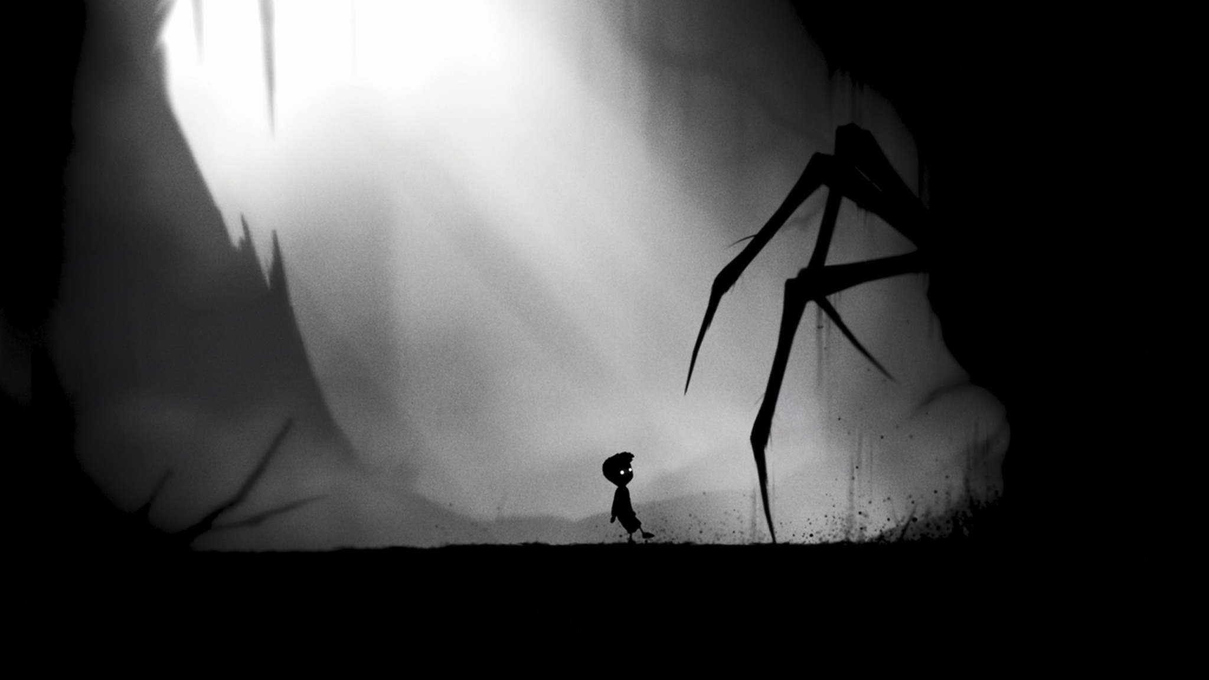
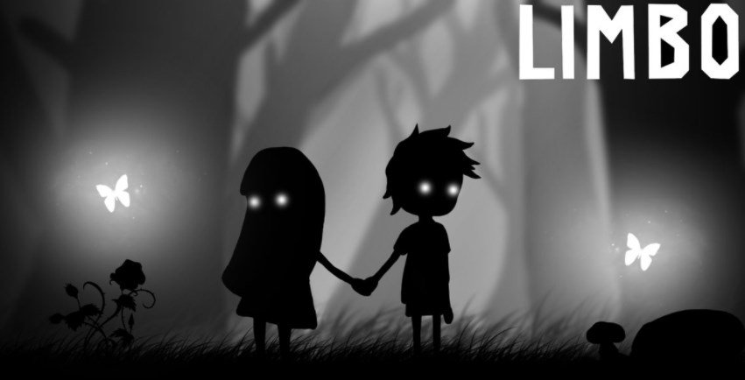
Inspiration

Slide 11
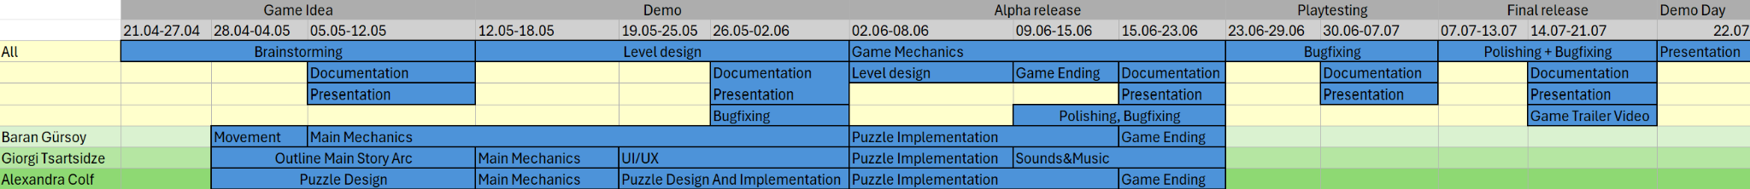
Timeline

Slide 12
Thank you for listening!
Do you have any questions?

