Slide 1
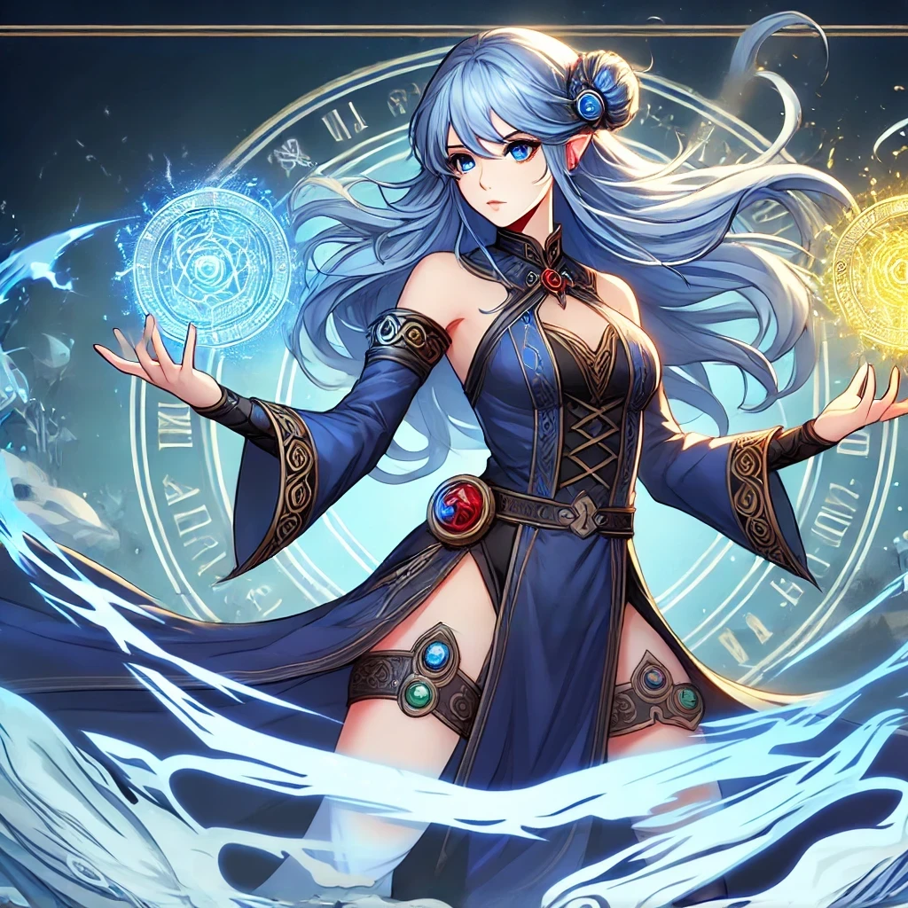
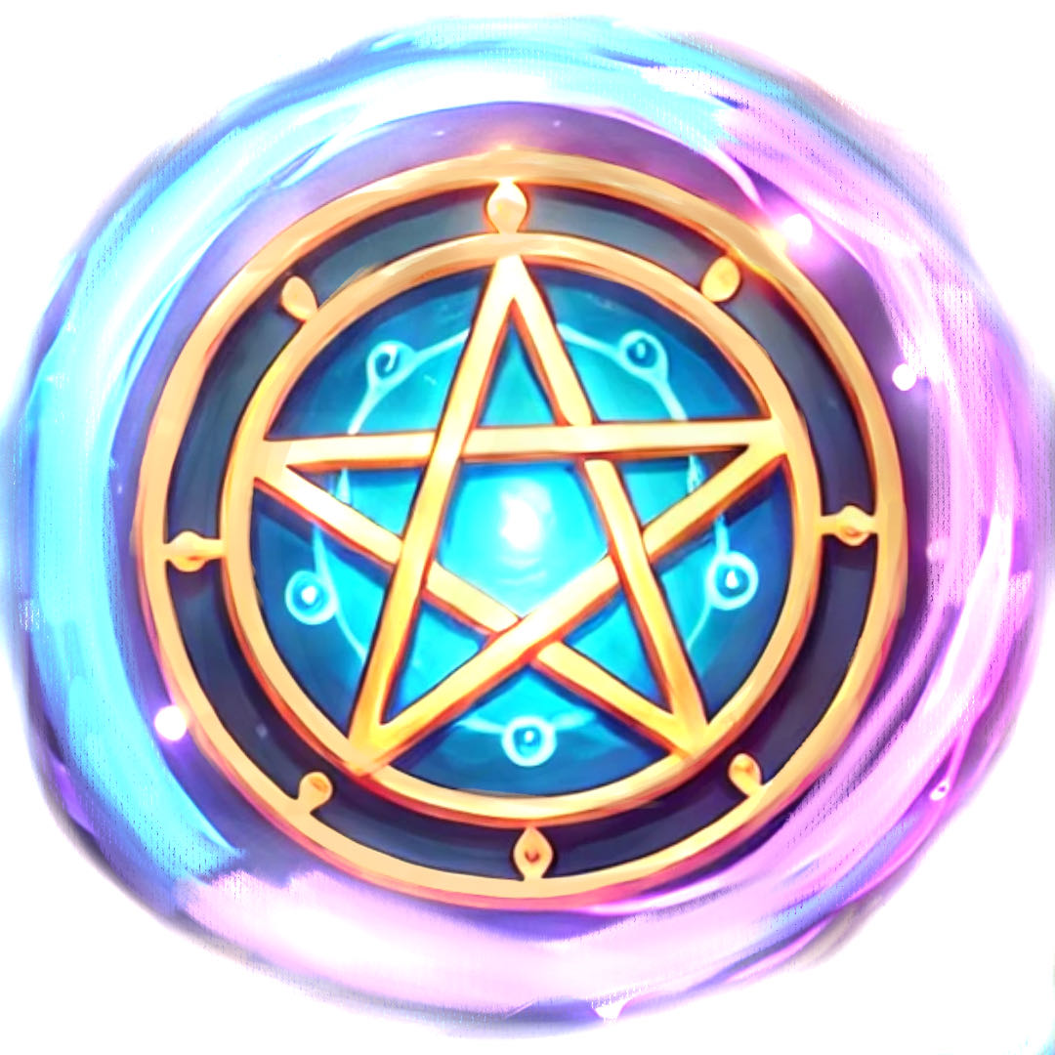
DemoDay WS2425
Computer Games Laboratory | Chain Reaction | IN710615
Cataclysm Cards
Fast-paced bullet hell game about elemental reactions.
Card Maker, the game's protagonist, is testing a new card that triggers elemental trails left after magic cards and prevents them from collapsing.
Andrey Roytman Cynthia Drews Haorui Tan Yifei Liu

