Slide 1
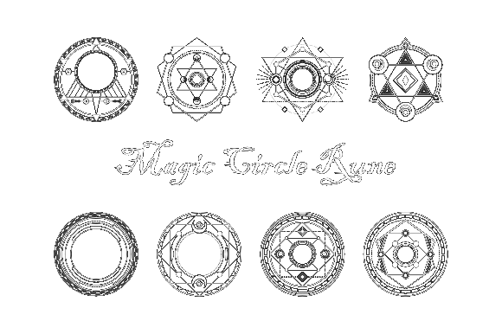
Milestone 5
Chain Reaction
Team Zoo:
Andrey Roytman
Cynthia Drews
Haorui Tan
Yifei Liu

Slide 2
What have we accomplished
1 GameOVER UI
2 Boss
3 Player HP UI
4 More skills and big VFX

Slide 3
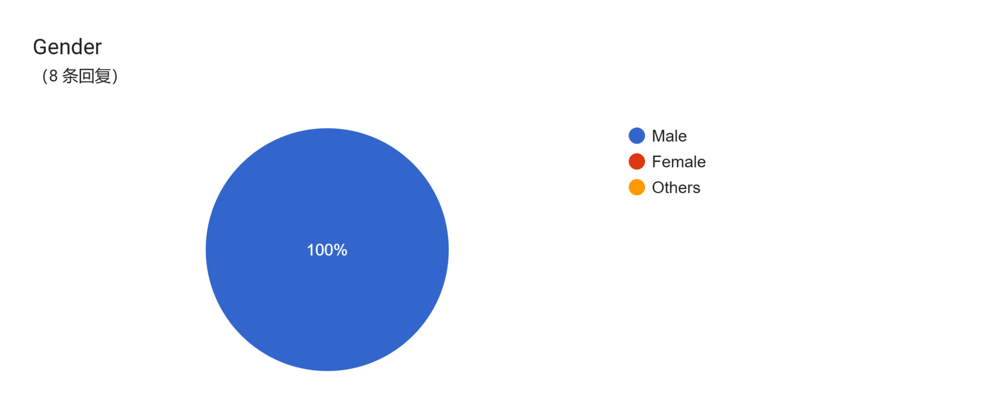
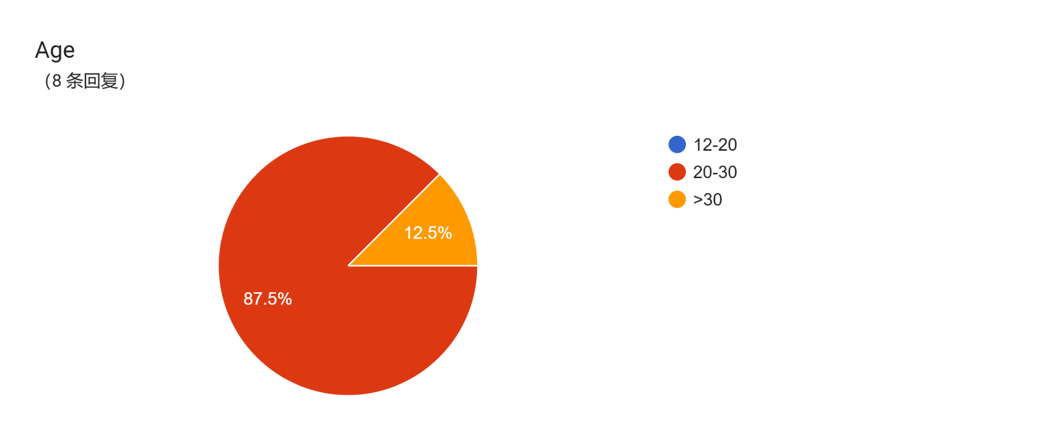

Slide 4


Slide 5
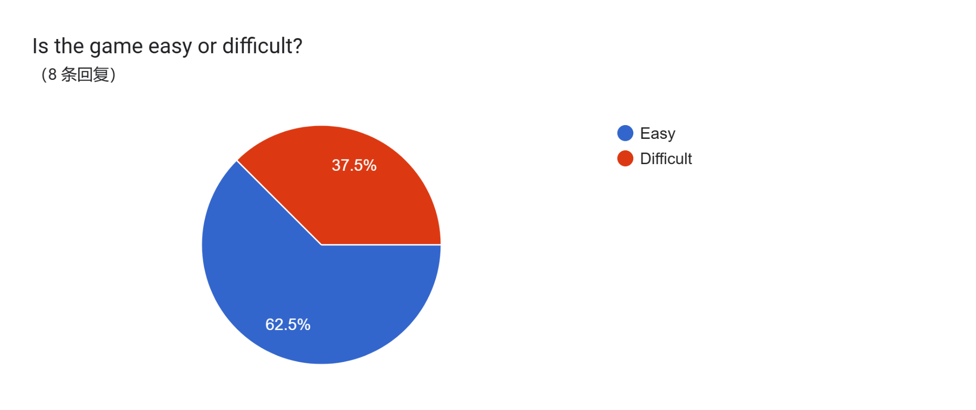

Slide 6
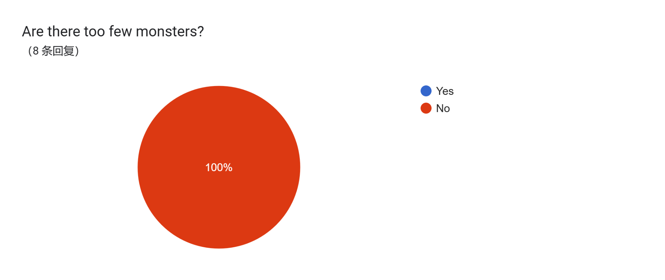

Slide 7
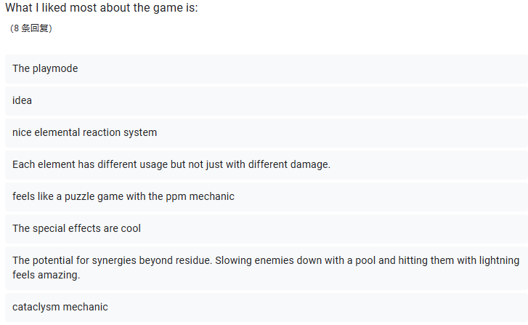

Slide 8
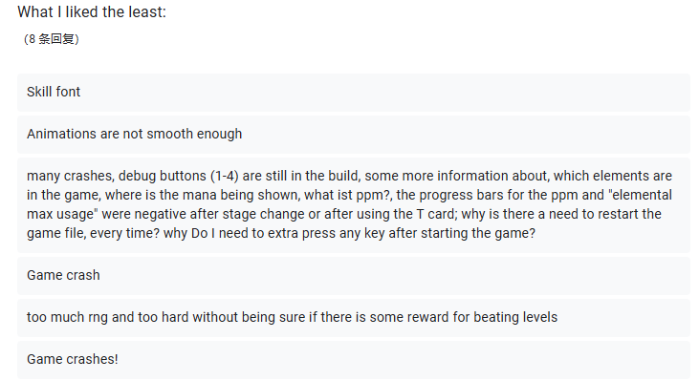

Slide 9

Problems of the Feedback
The game crashes easily!

Slide 10

Problems of the Feedback
But why?
End of last wave
Or game over screen
Probably problems with
loading of the data or
transfer between
scenes/instances

Slide 11
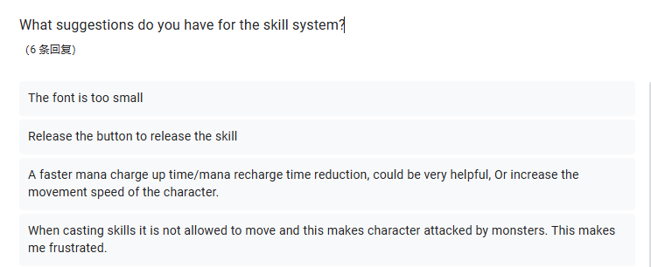
Suggestions

Slide 12
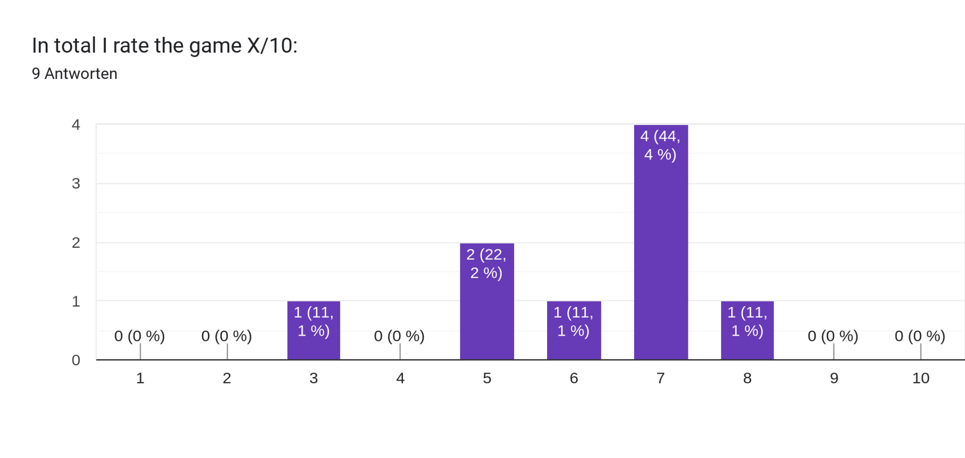
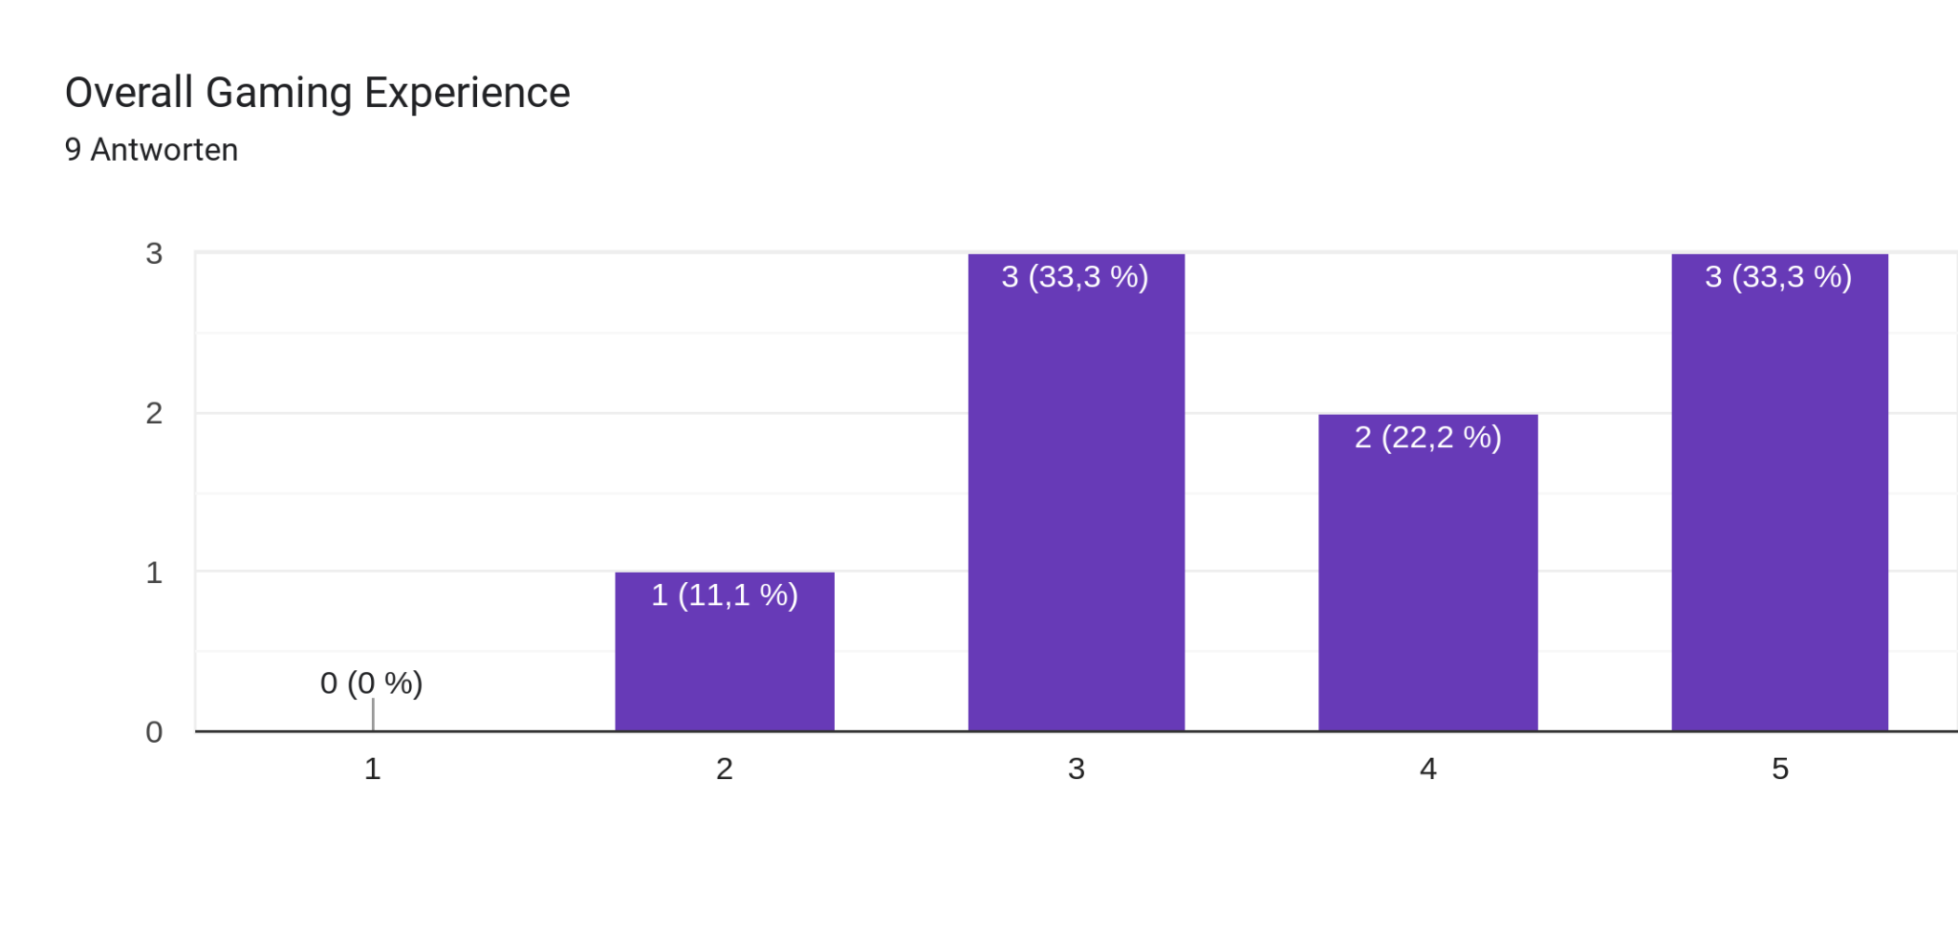
A solid 6/10 rating and a 3.5/5 for game experience
- Just goes up from here ;)

Slide 13
What else needs to be done
General
Optimize the game !!!
Another Map
More skills
SFX are still in progress
Remove Debug elements in the final build
Usability
A detailed and accessible tutorial with description of possible elemental interactions
Make reading cards descriptions easier
Improve UI style and accessibility of keys
“Pacing” of the walking animation
=> Feels slow and clunky
Add quick-cast to abilities that do not require aiming

Slide 14
THANK YOU

