Slide 1
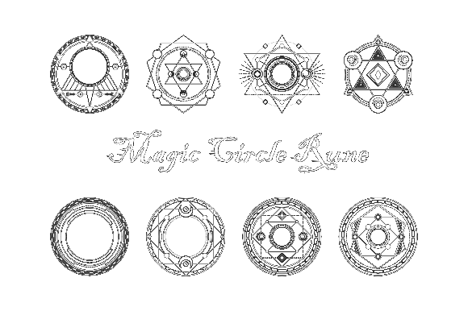
Milestone 4
Chain Reaction
Team Zoo:
Andrey Roytman
Cynthia Drews
Haorui Tan
Yifei Liu

Slide 2
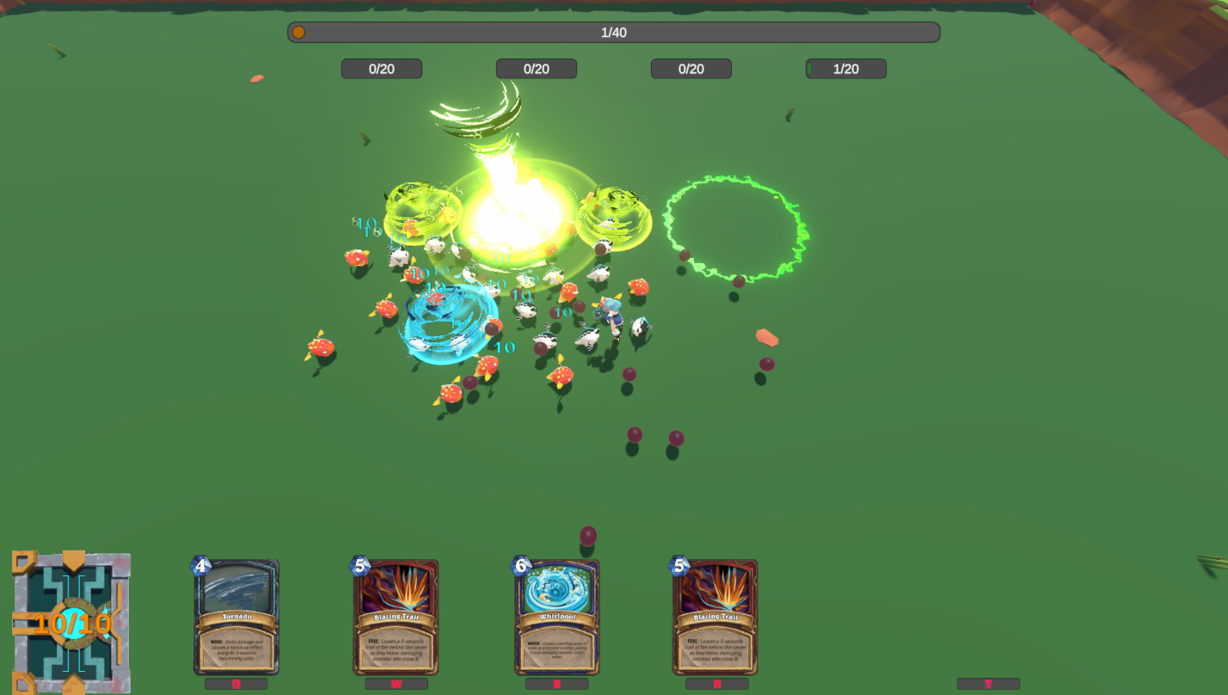
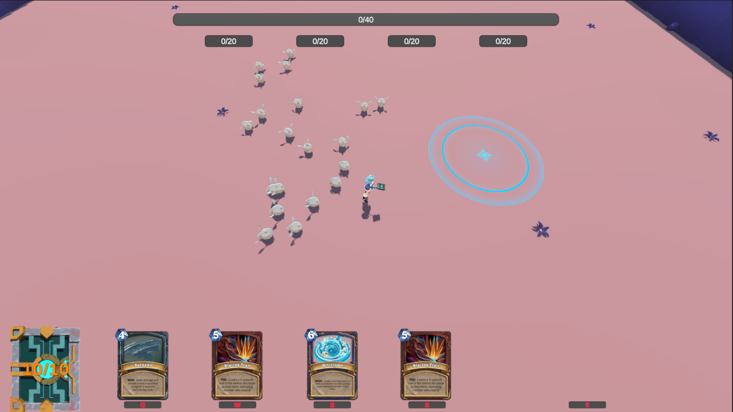
Overview of the game
Demo

Slide 3
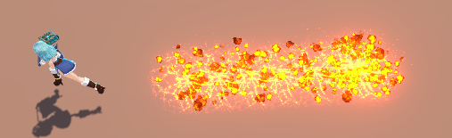
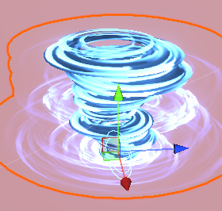
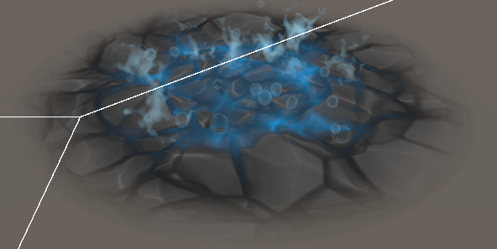
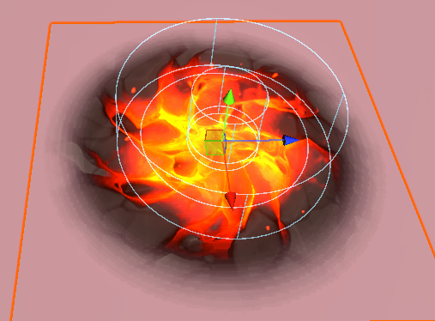
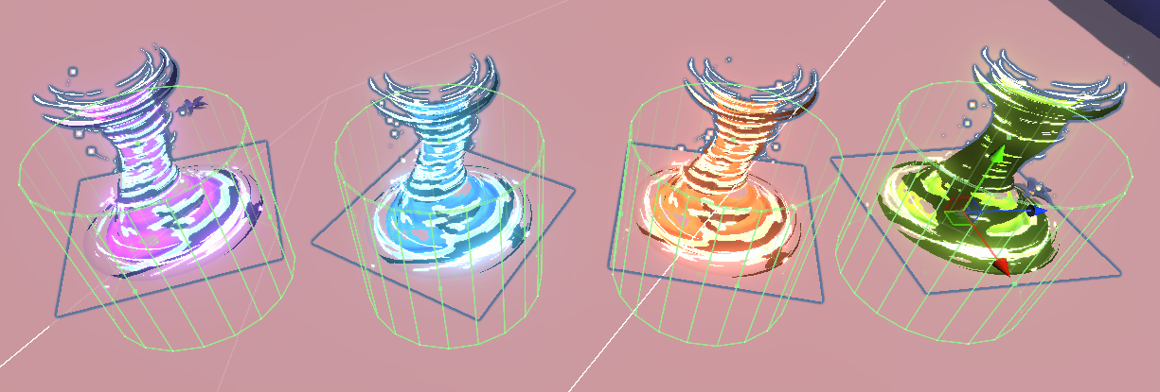
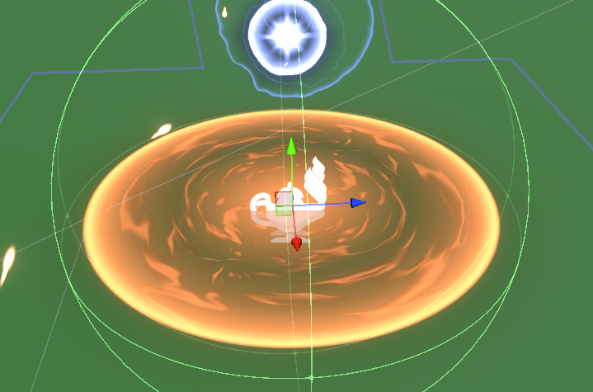
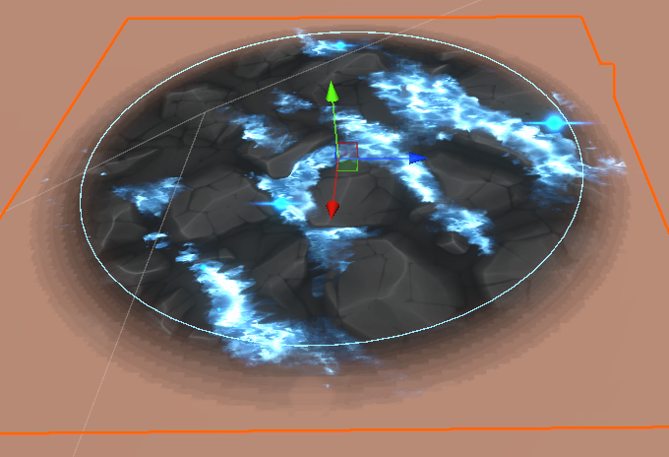
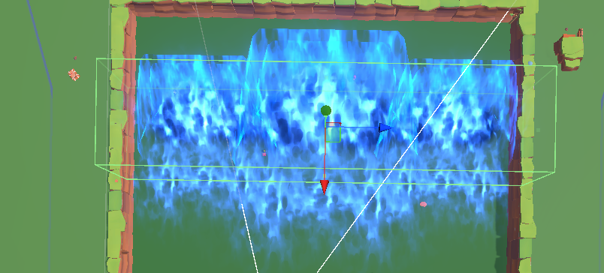
Effects
Skills
Casted Skill
Triggered Skill
Auto Triggered Skill

Slide 4
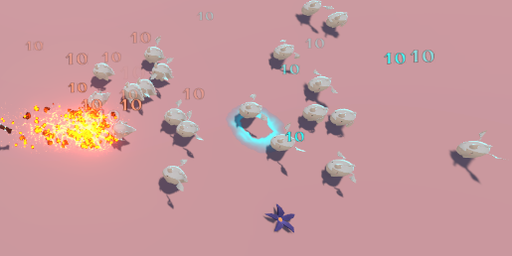
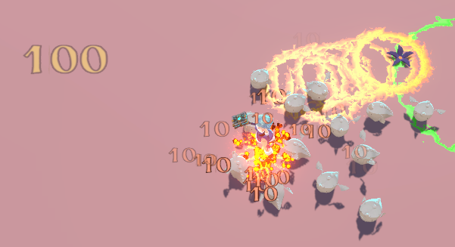
Effects
Damage calculation is based on element resistance and damage value.
Damage Value Effects
Color based on elements
  Fire/Water/Lightning/Wind
  True Damage
Size based on value of damage

Slide 5
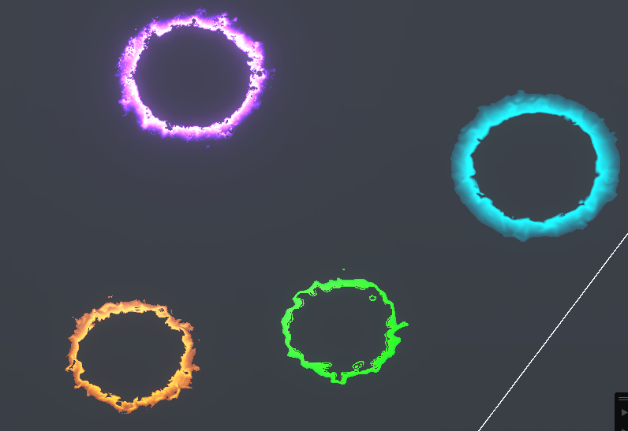
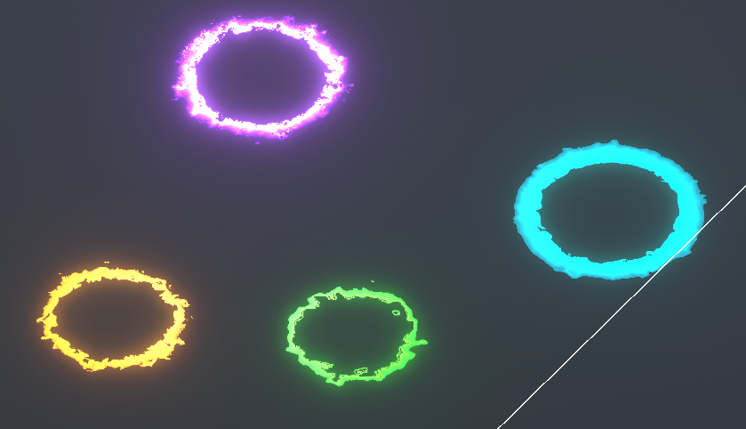
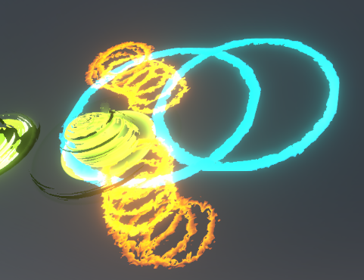
Effects
Residue
Normal, Emission, Dynamic
Trigger by overlapping check
Size based on skill size
Triggered skill size based on the Min Circle of two residues.

Slide 6
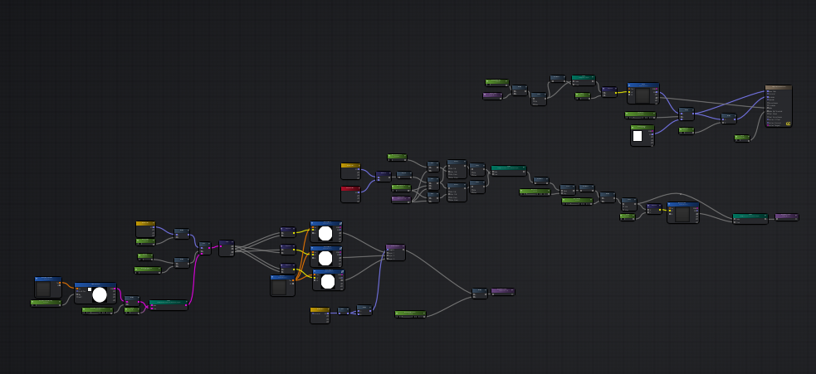
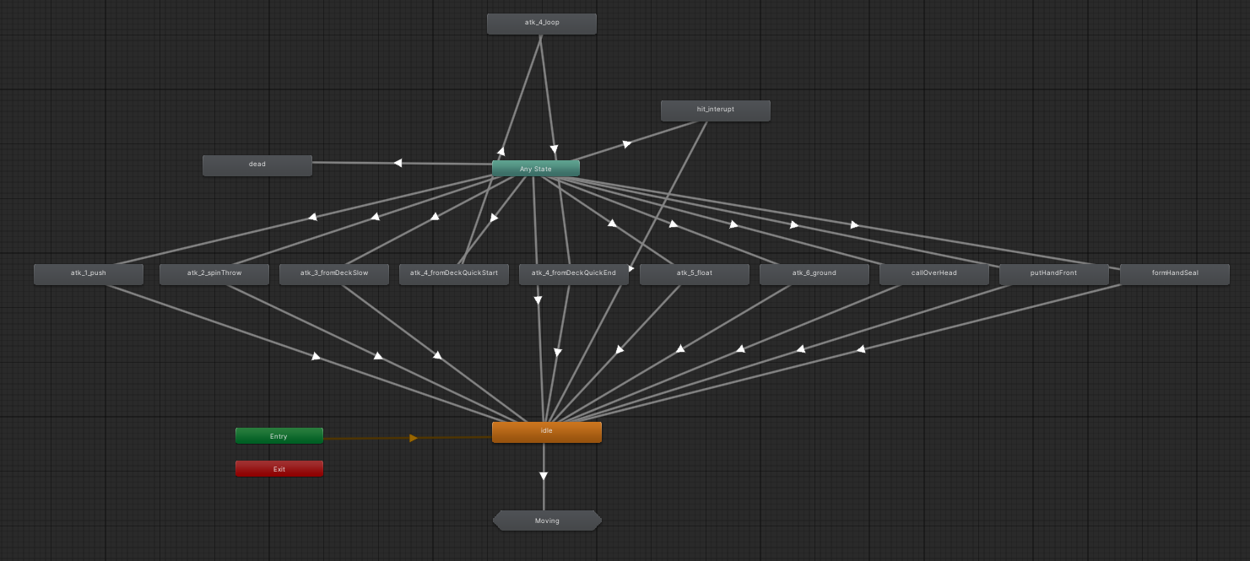
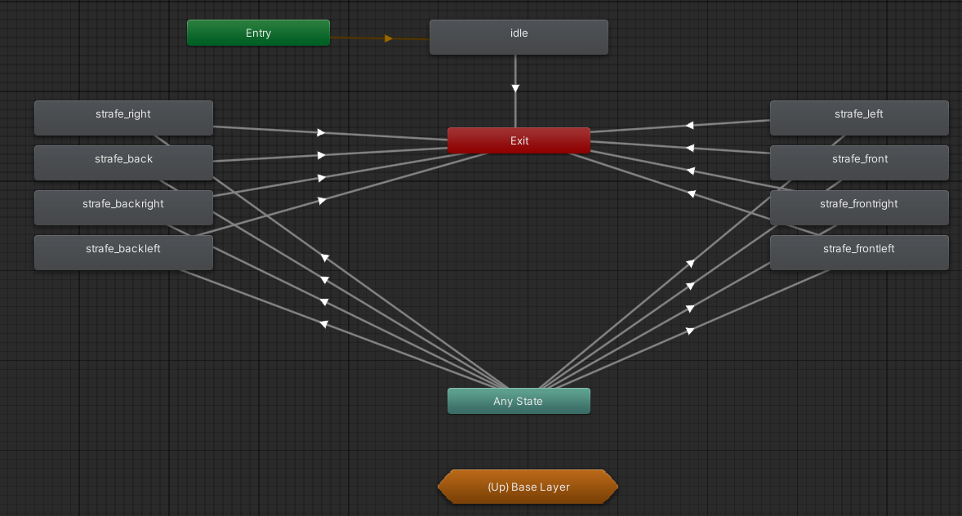
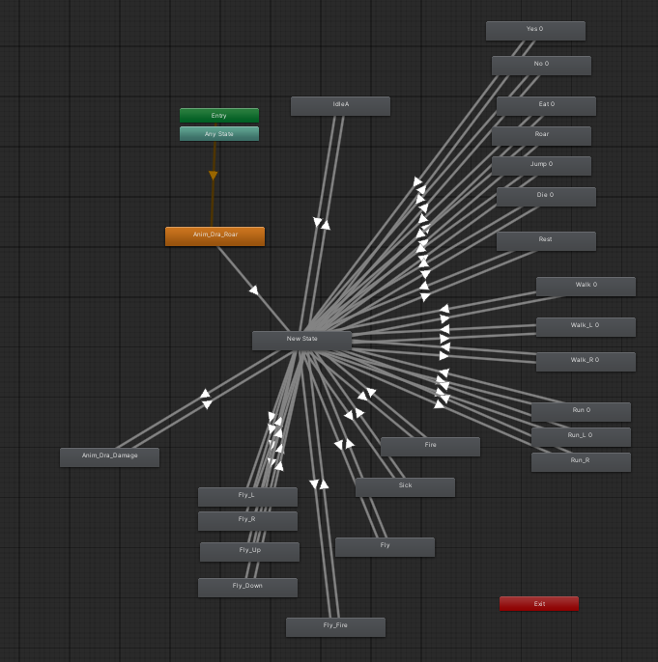
DOTS
Shader
Shader for residue
Also adjust skills’ and model’s shader to let it can work in Rukhanka Animation System in DOTS.
Animation
Player: State machine and its sub-state machine. Monster

Slide 7
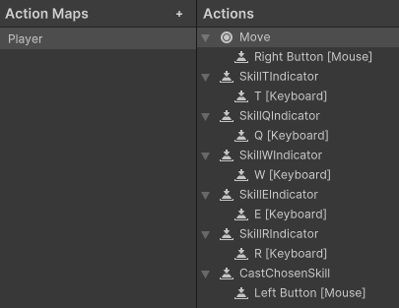
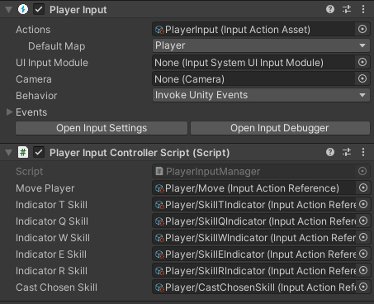
Controls
Skills are chosen by pressing QWERT keys
Movement is done with right mouse click
Casting is done with left mouse click if the skill is chosen

Slide 8
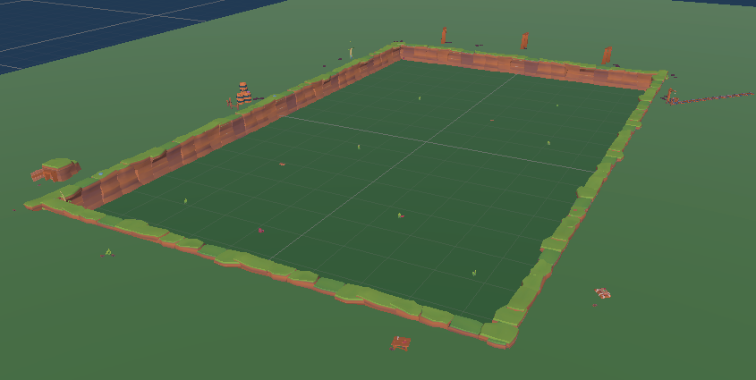
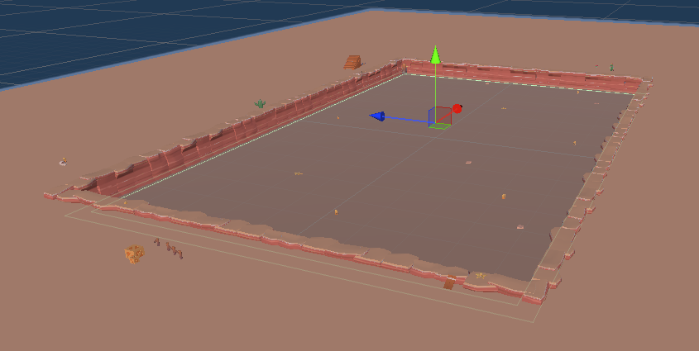
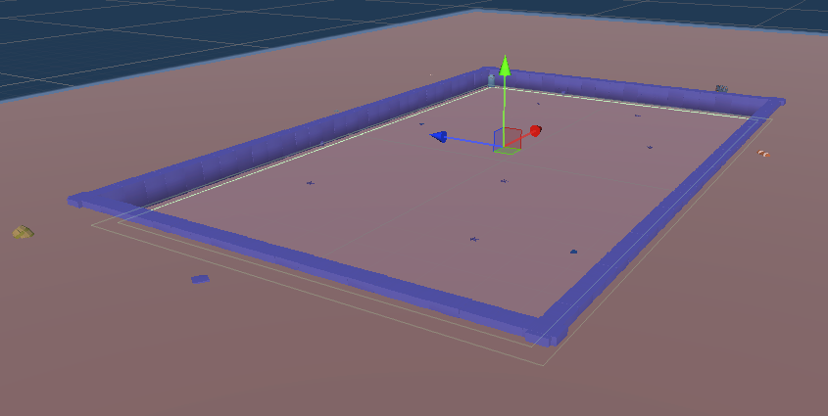
Maps
3 different locations, each reflect the enemies player fights

Slide 9
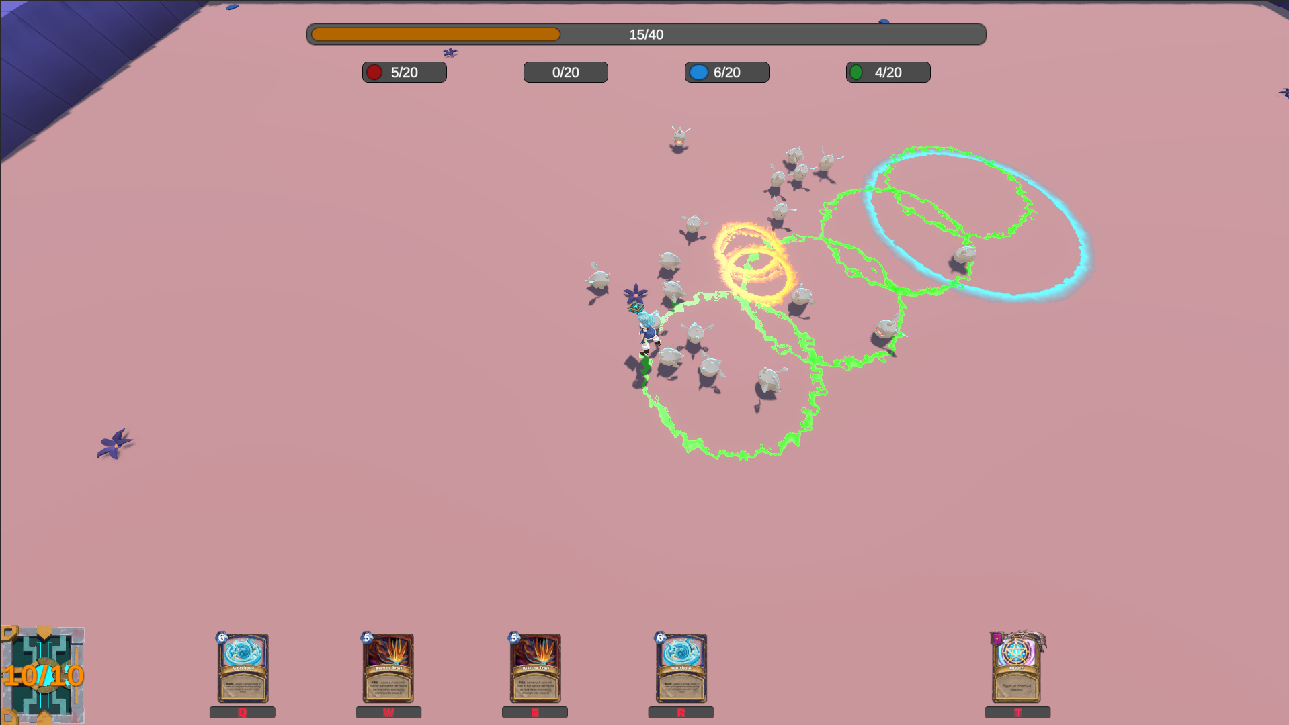
UI
Deck displays mana generation
Top shows current PPM levels
Cards can be selected with QWER
Trigger card with T

Slide 10
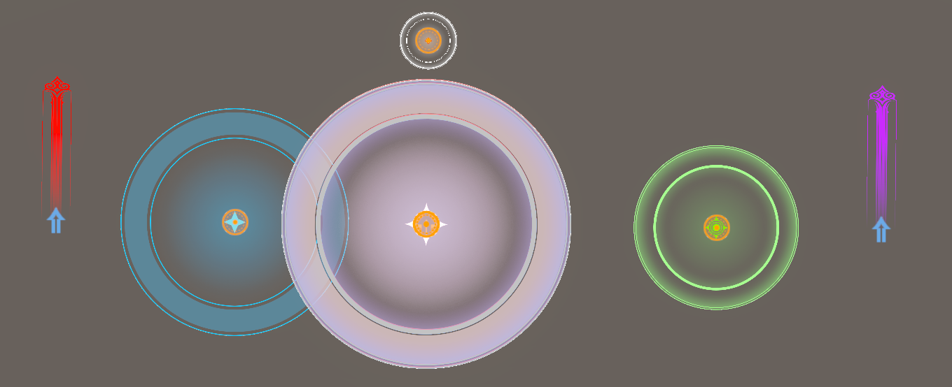
Indicators
Circle skills:
  Large White: Trigger
  Medium Red/Purple/Blue/Green:
  Elemental skill
  Small Green: Self cast
Direction skills:
  Red/Purple/Blue/Green:
  Elemental skill

Slide 11
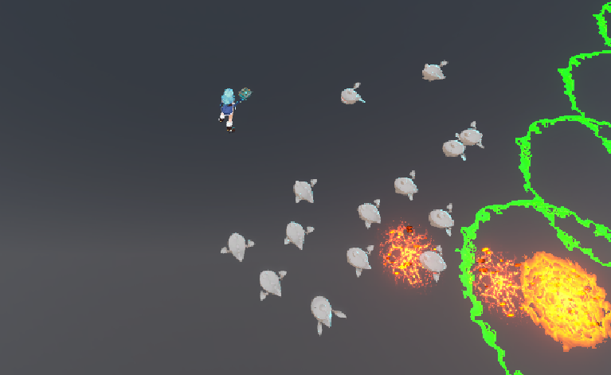
Monster
Wave 1

Slide 12
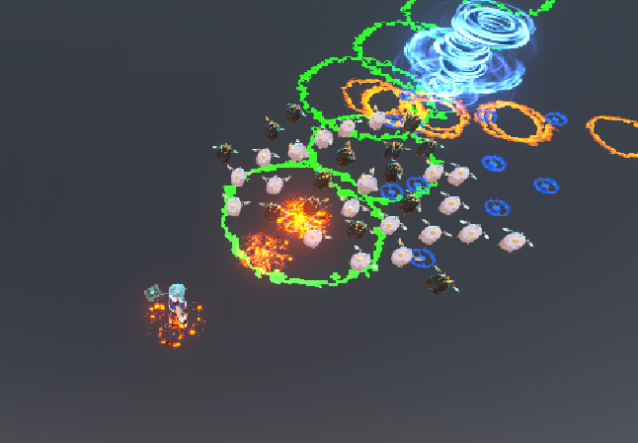

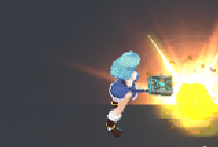
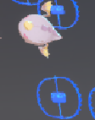
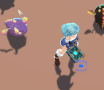
Wave 2 fire resistance 20%, water resistance -20%

Slide 13
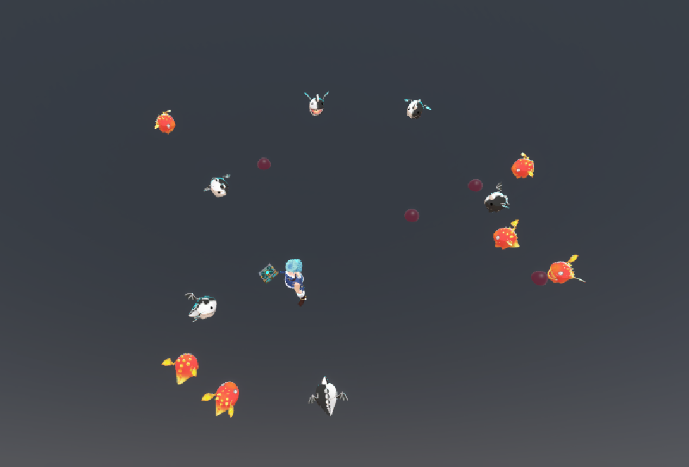


Wave 3 wind resistance 20%, lightning resistance -20%

Slide 14
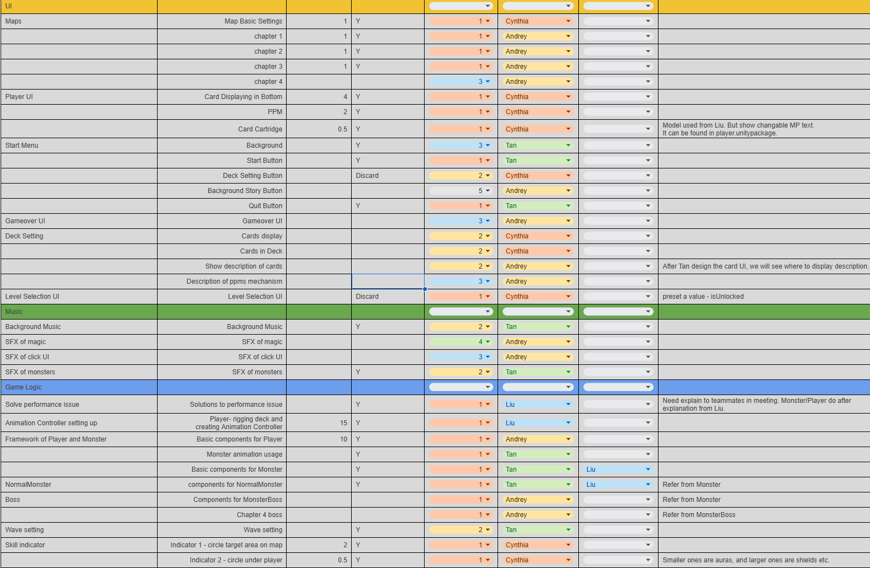
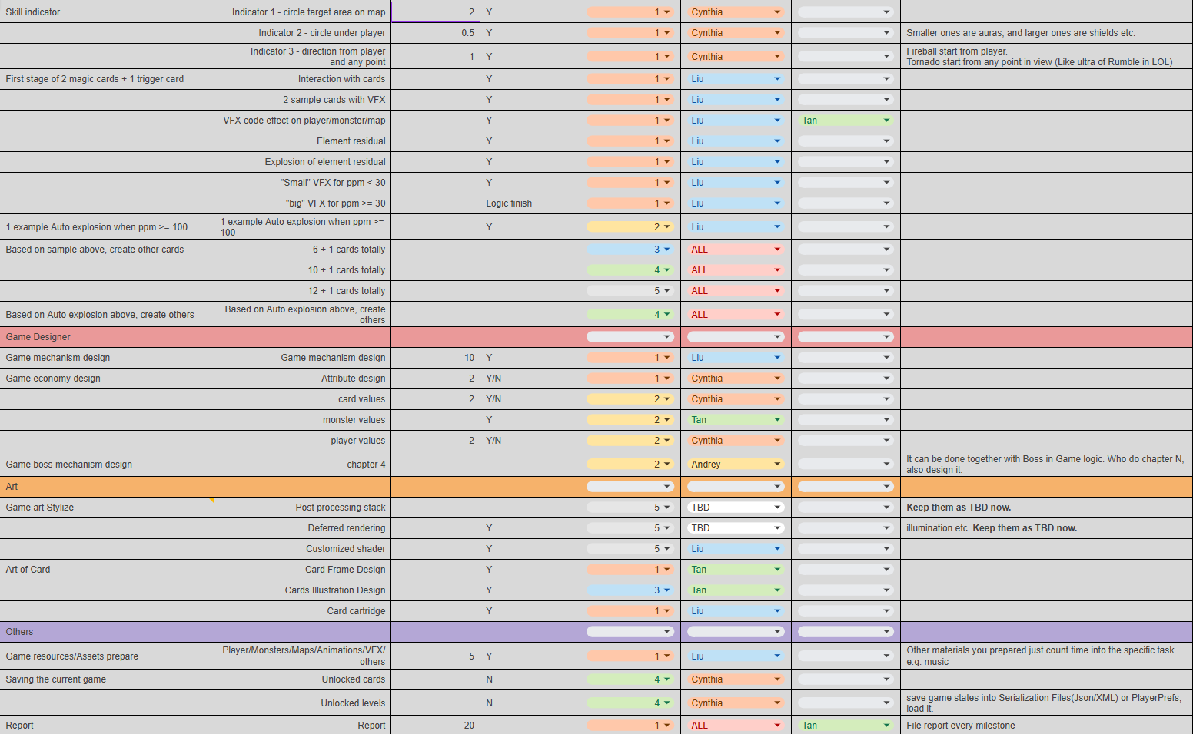

Slide 15
What else needs to be done
Wave auto start (Maybe still remain 1 2 3 button)
Boss
More UI
More skills
Sound effects and SFX

Slide 16
THANK YOU

