Slide 1
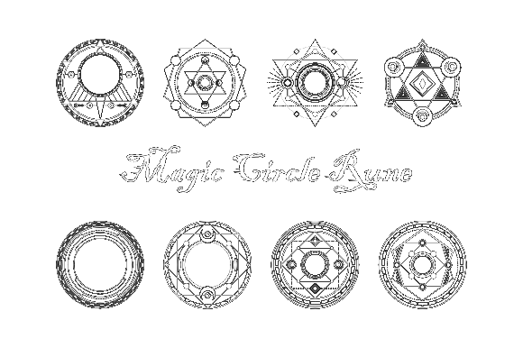
Milestone 3
Chain Reaction
Team Zoo:
Andrey Roytman
Cynthia Drews
Haorui Tan
Yifei Liu

Slide 2
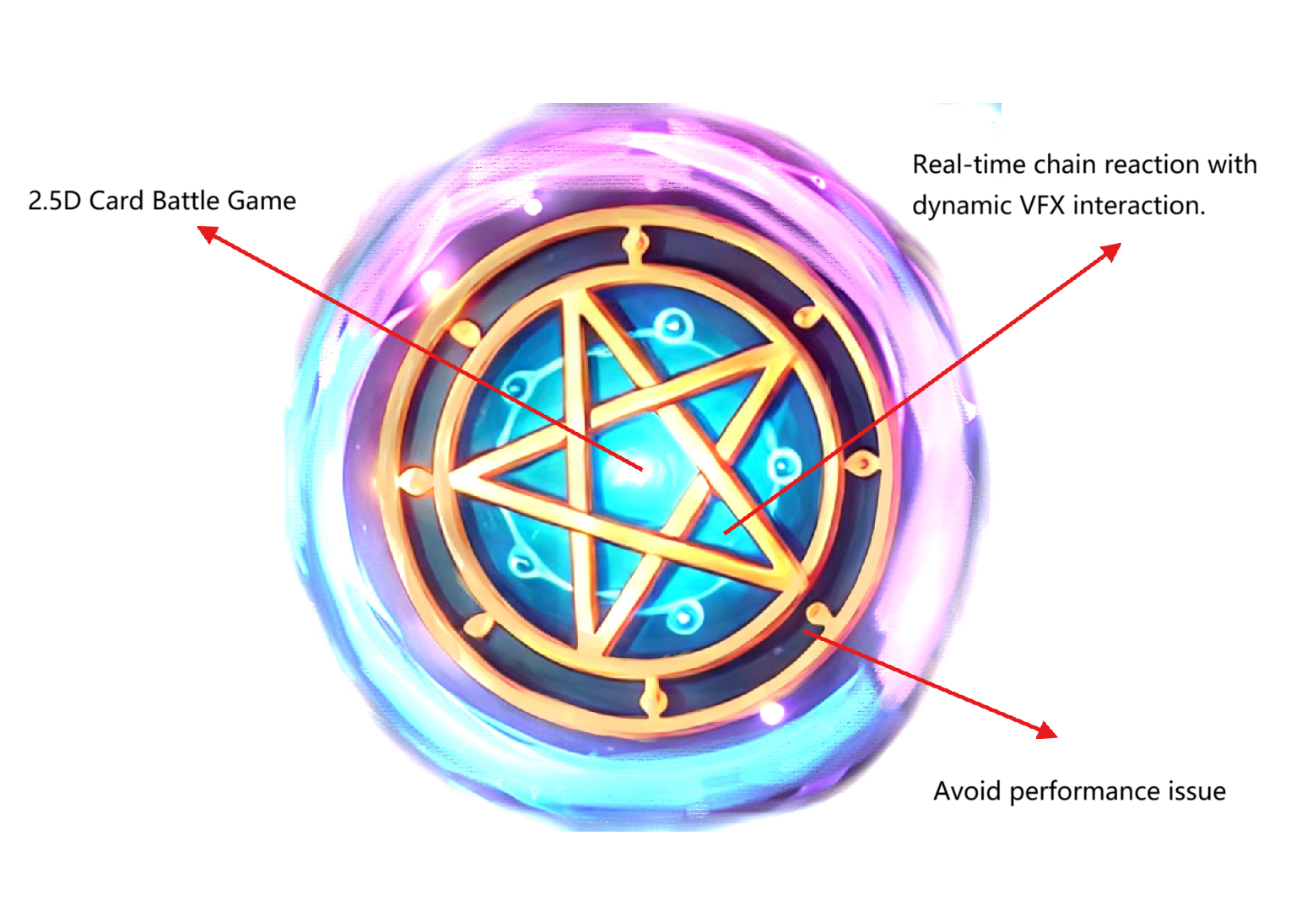
BULLSEYE

Slide 3
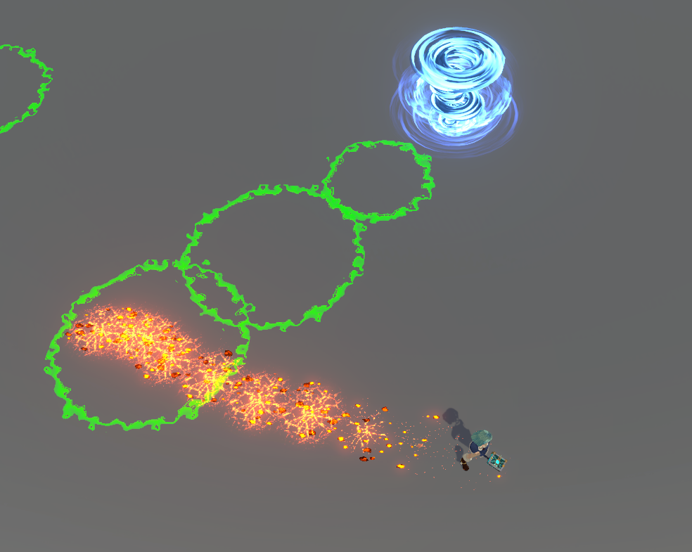
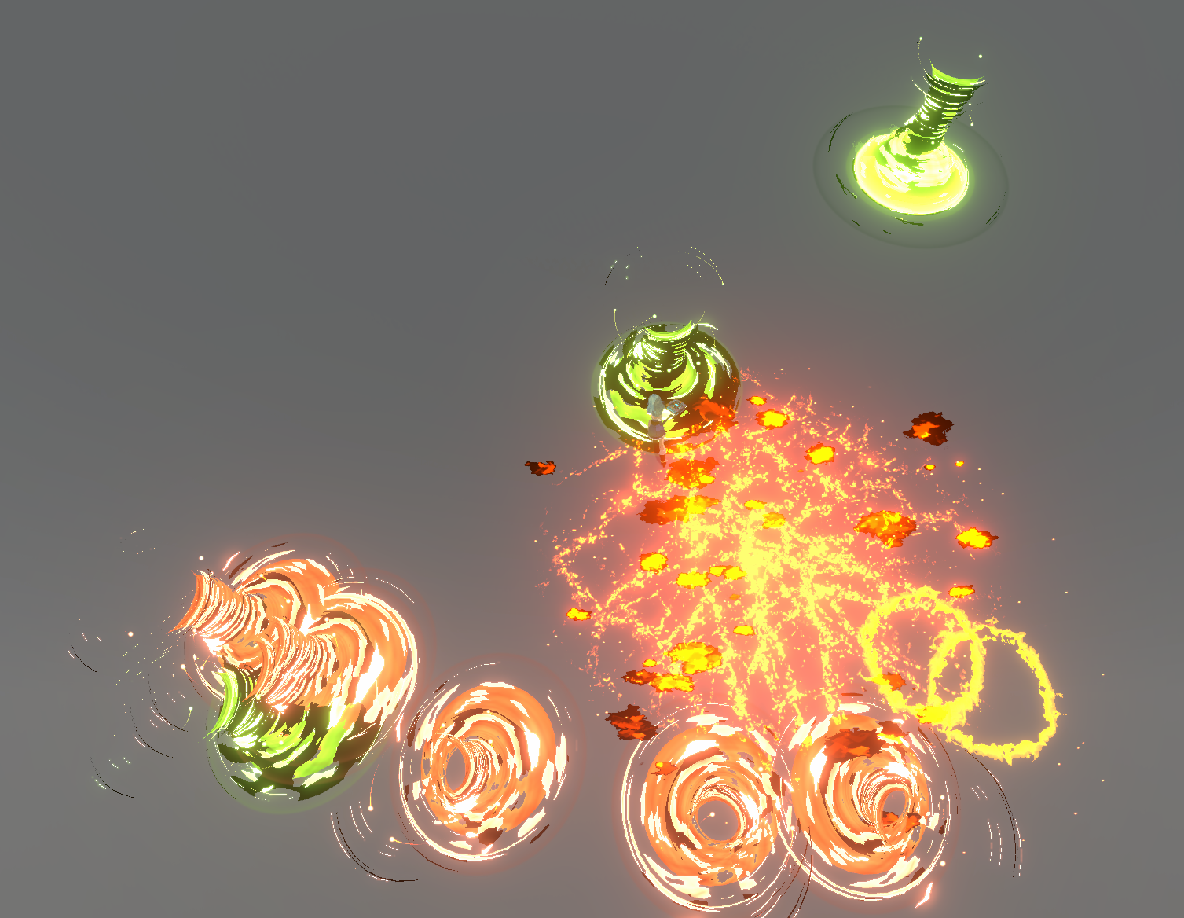
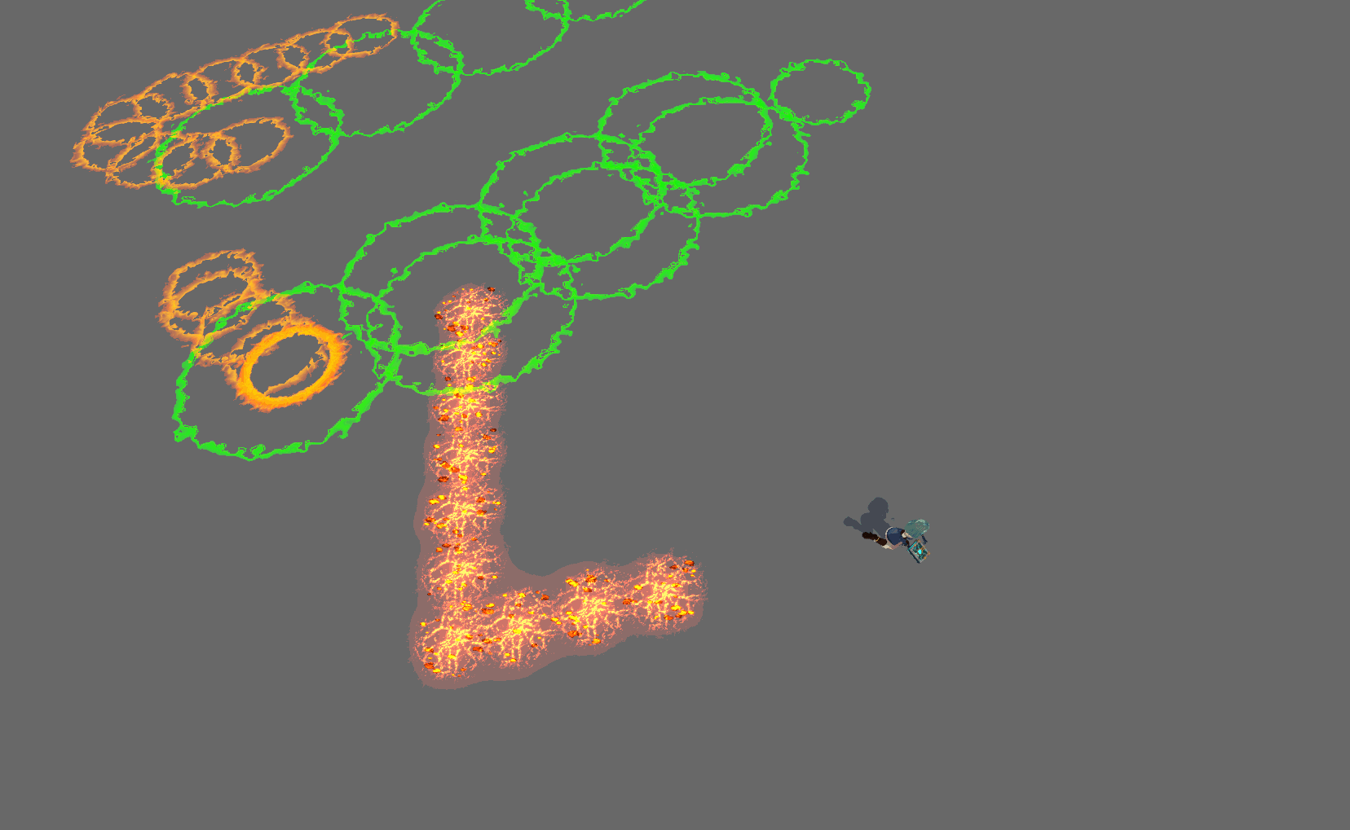
Overview of the game

Slide 4
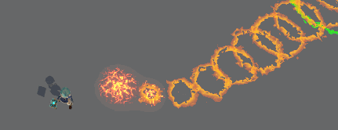
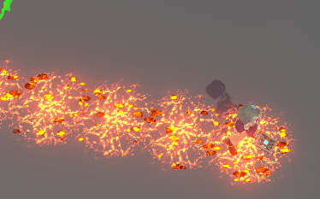
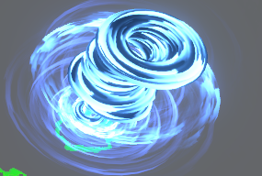
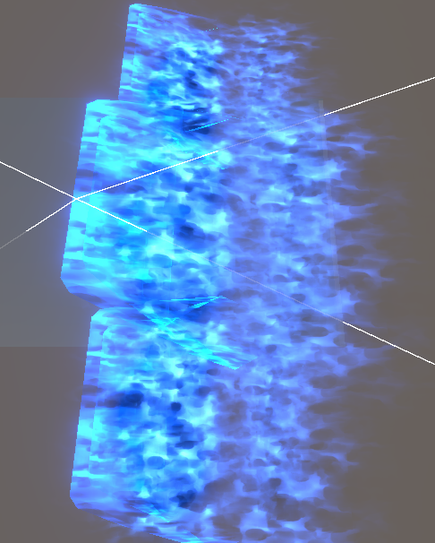
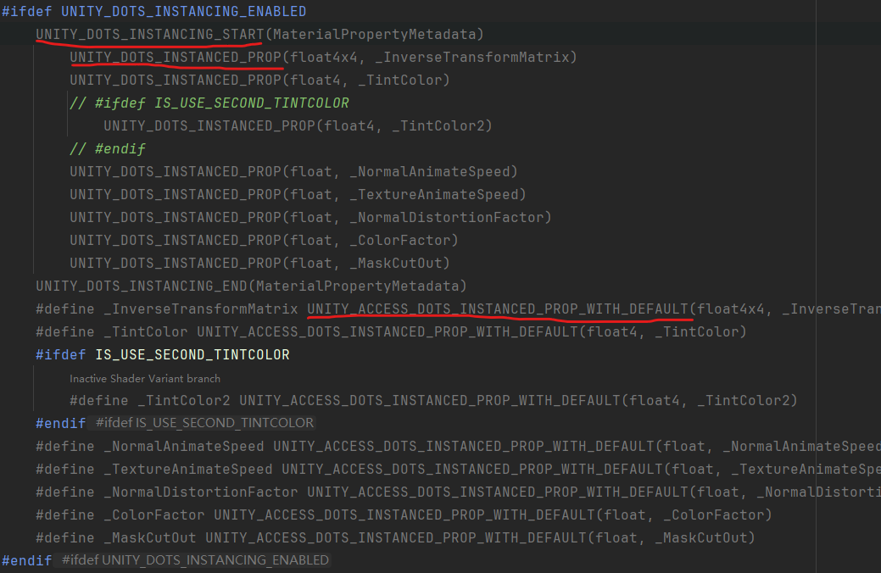
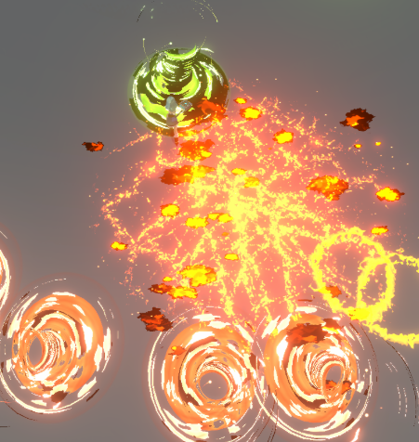
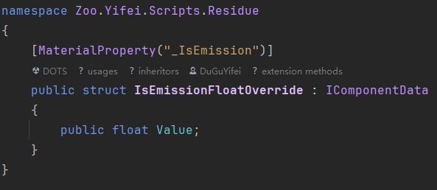
Toon shader for Rukhanka - compute the deformation for skin mesh
Element residue VFX and shader - silence / activation mode, activation diffusion
2 Skill - Blazing Trail / Small Tornado
3 triggered combination VFX and calculate
size of it by two nearby residue circle.
1 Auto explosion VFX - Tsunami
DOTS GPU instancing shaders (without creating material)
  UnityPerMaterial CBuffer
  Unity_DOTS_INSTANCED_PROP
Fix player mesh skin root and rig of humanoid
Post-Processing volume of Bloom for skill vfx.

Slide 5
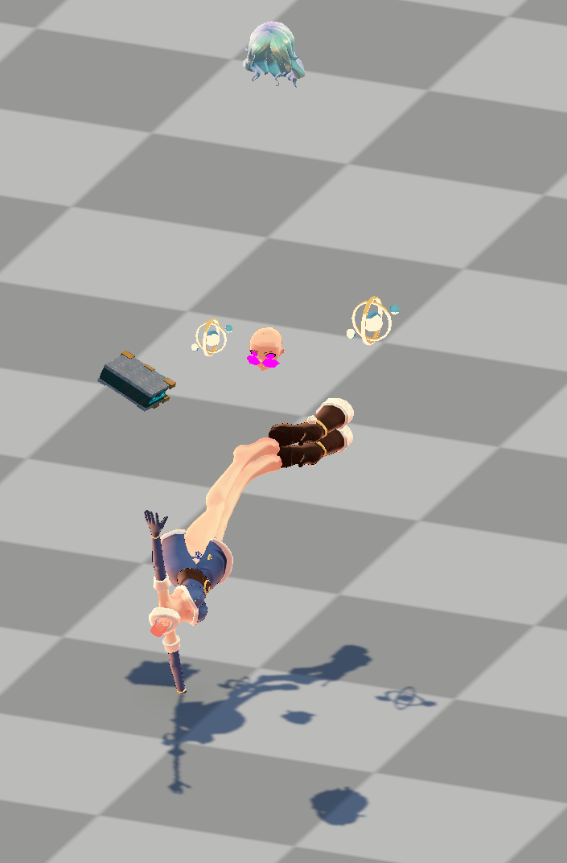
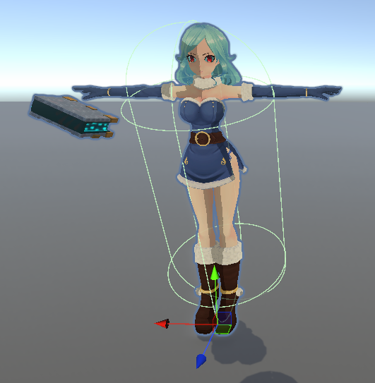

Slide 6
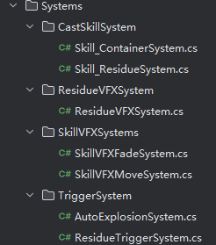
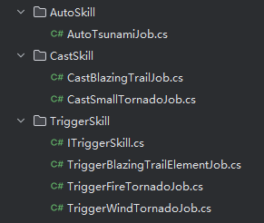
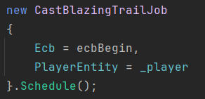
Skill - Residue - Trigger Architecture
A good structure will help us build VFX together at later stage, because we have too many skills need to implement.
Skill classification
  Still skill - windshield
  Movable skill - tornado
  Period interval skill - blazing trail
Structure
  Skill container - Control different skill and Residue container
  Residue container - Control residue elements

Slide 7
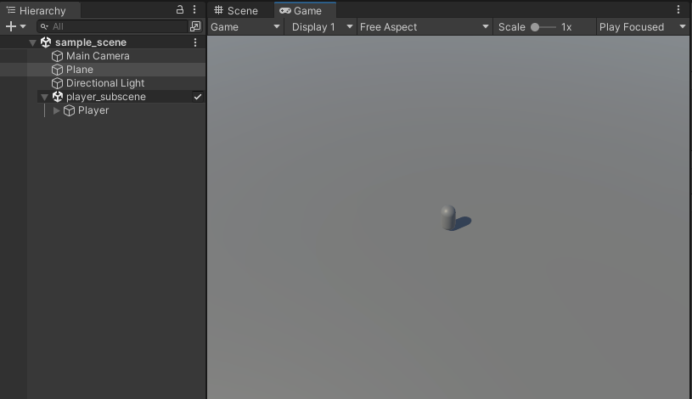
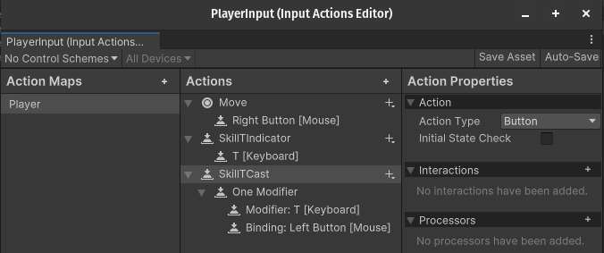
Player Controls
Implementation of basic player controls in ECS
Player prefab.
Making the connection between Monobehaviour and ISystem to communicate controls to the player character.
Integration of mouse and keyboard input for movement and triggering the residues

Slide 8
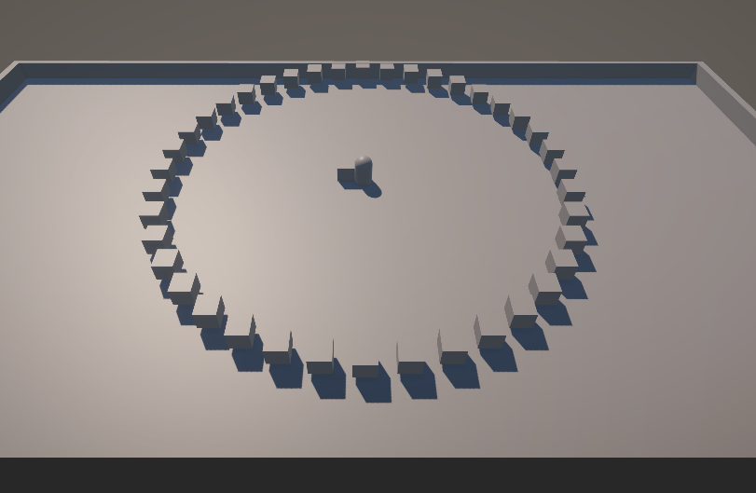
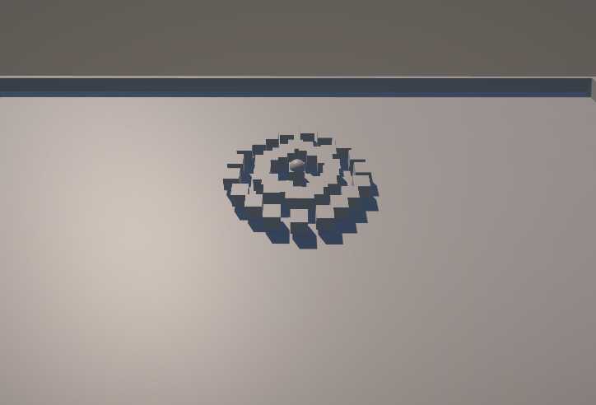
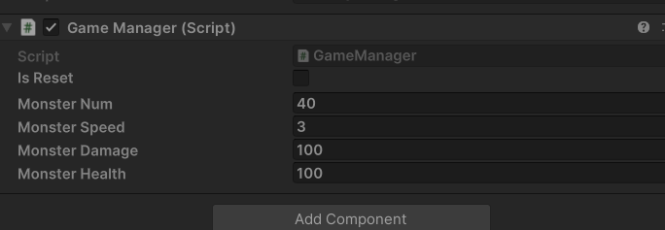
Monster

Slide 9
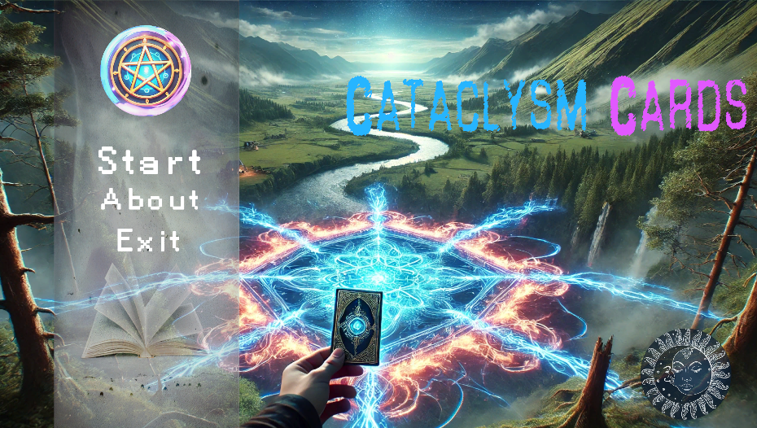
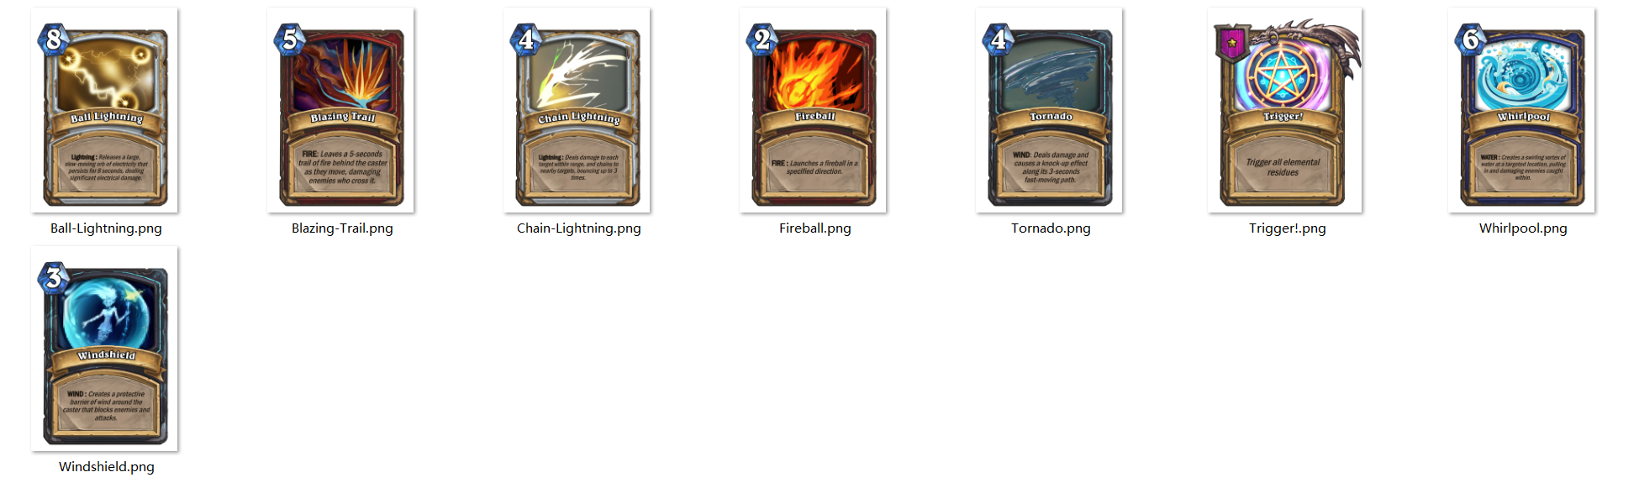
UI

Slide 10
Others has been implemented
UI of PPM
Game Economy Design

Slide 11
What else needs to be done
Monster animation
Merge UI of PPM into game
UI of cards deck
Triggering the abilities through keyboard input
Smooth player character rotation
Map visuals
SFX for skills
Other skills
Collision check for skills with monsters and player
Boss setup

Slide 12
THANK YOU

