Slide 1
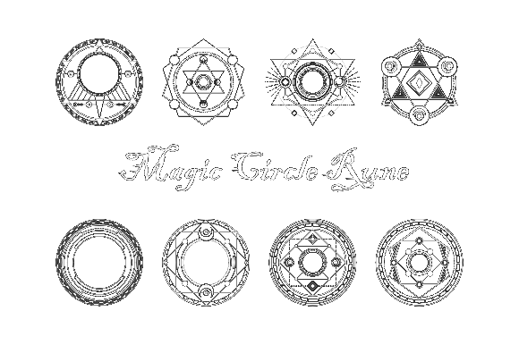
Milestone 2
Chain Reaction
Team Zoo:
Andrey Roytman
Cynthia Drews
Haorui Tan
Yifei Liu

Slide 2
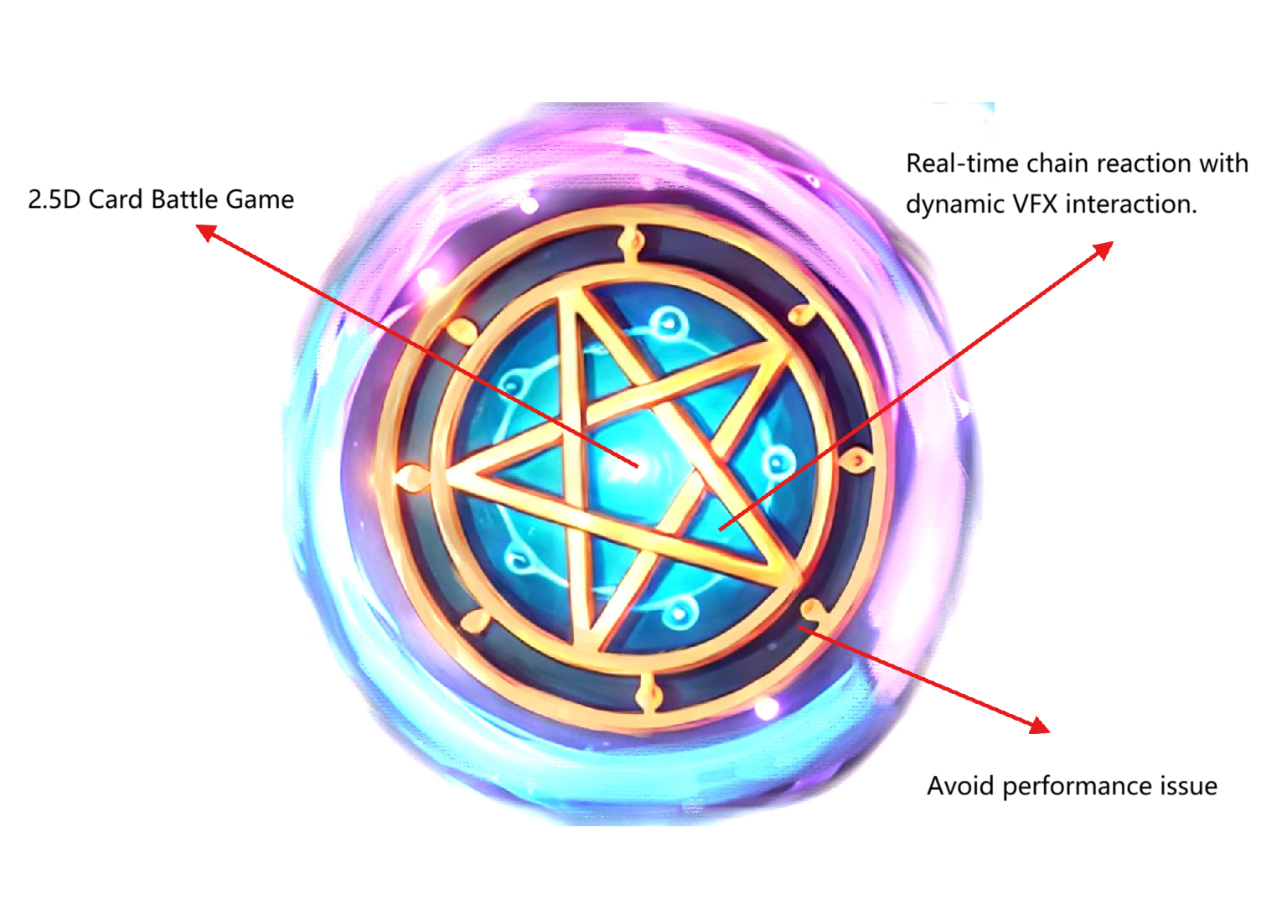
BULLSEYE

Slide 3
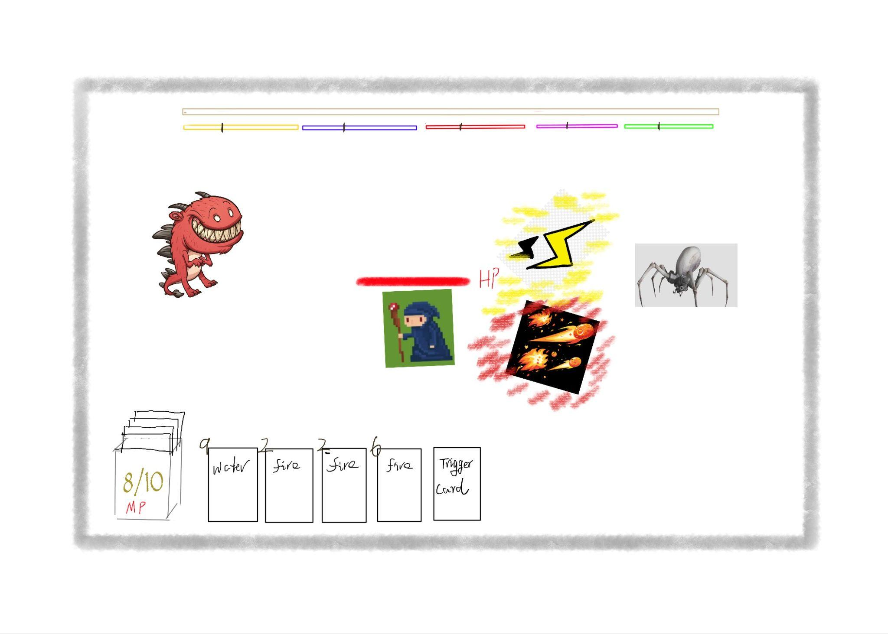
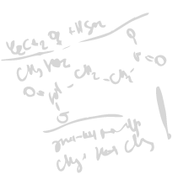
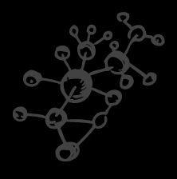
Cataclysm Cards
Looks like…

Slide 4
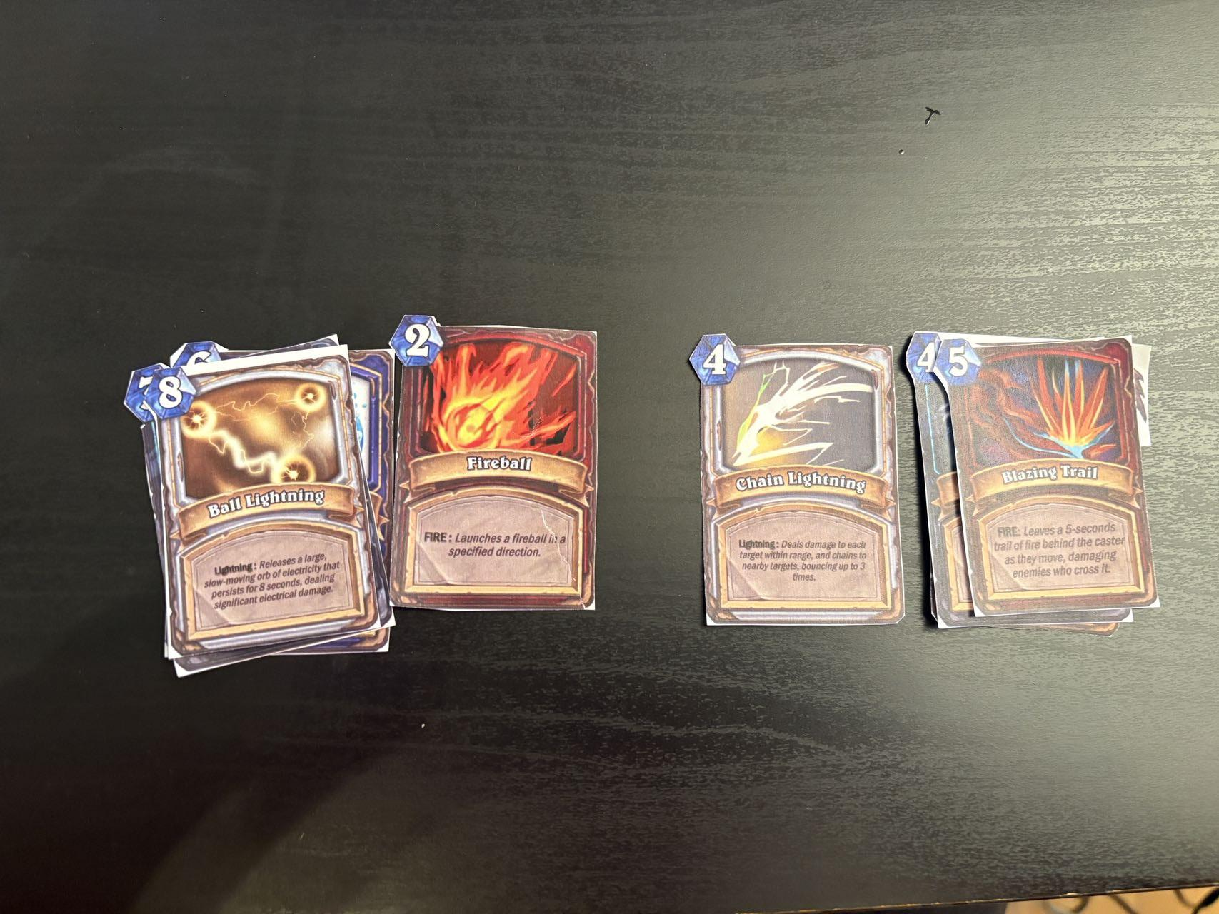
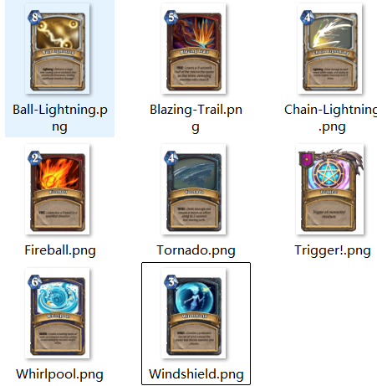

Slide 5
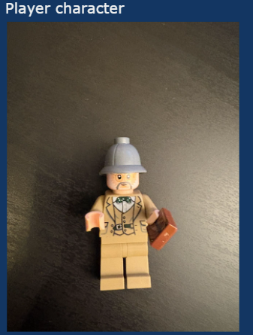
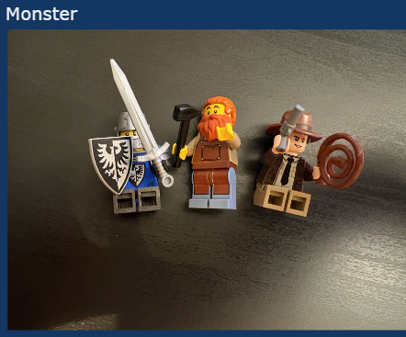

Slide 6
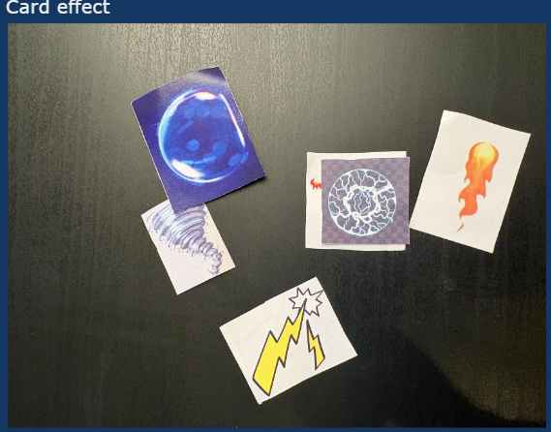

Slide 7
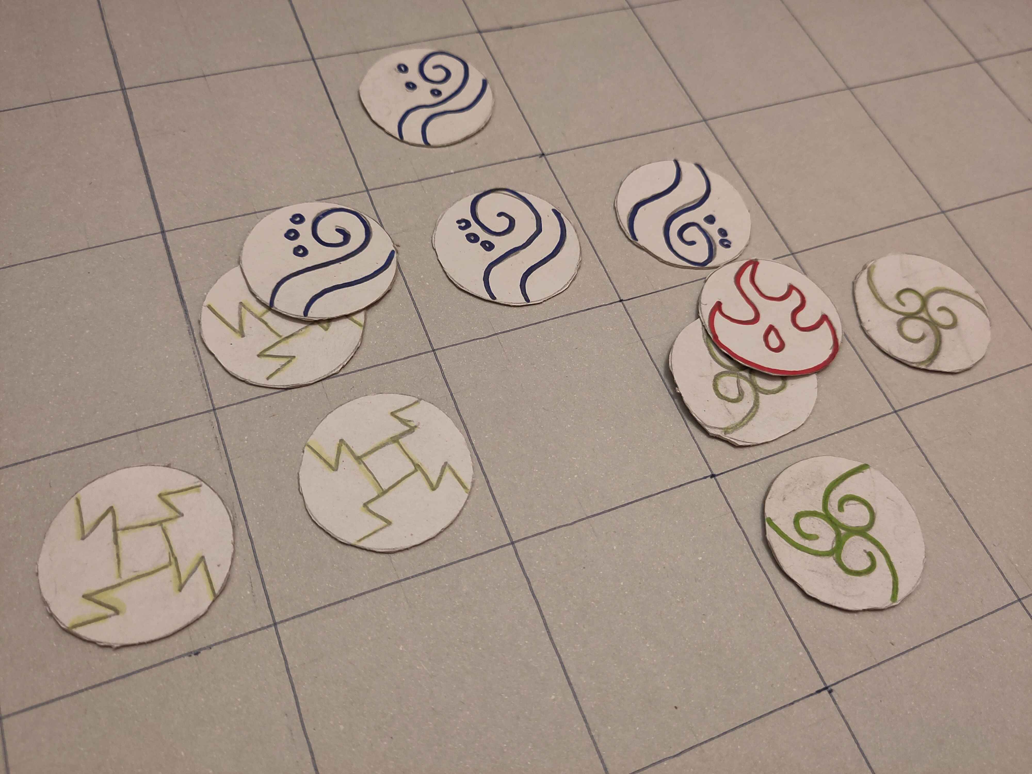
ELEMENT RESIDUE

Slide 8
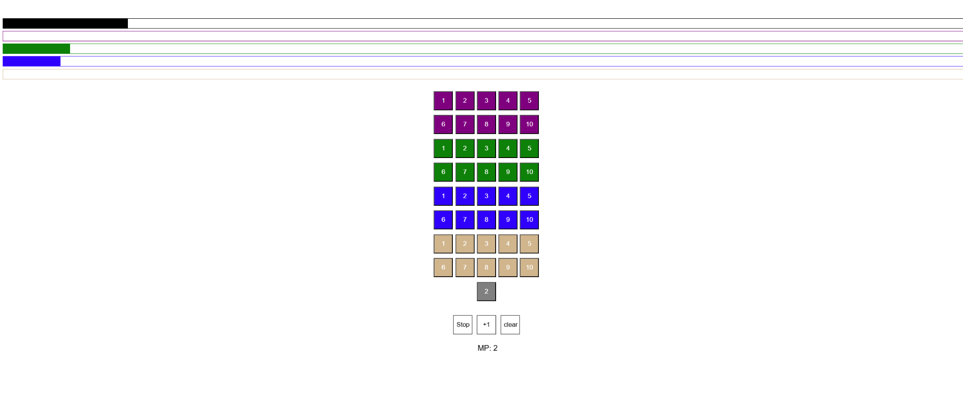
Counters for turn-based prototype
https://github.liuyifei.tech/slidev/

Slide 9
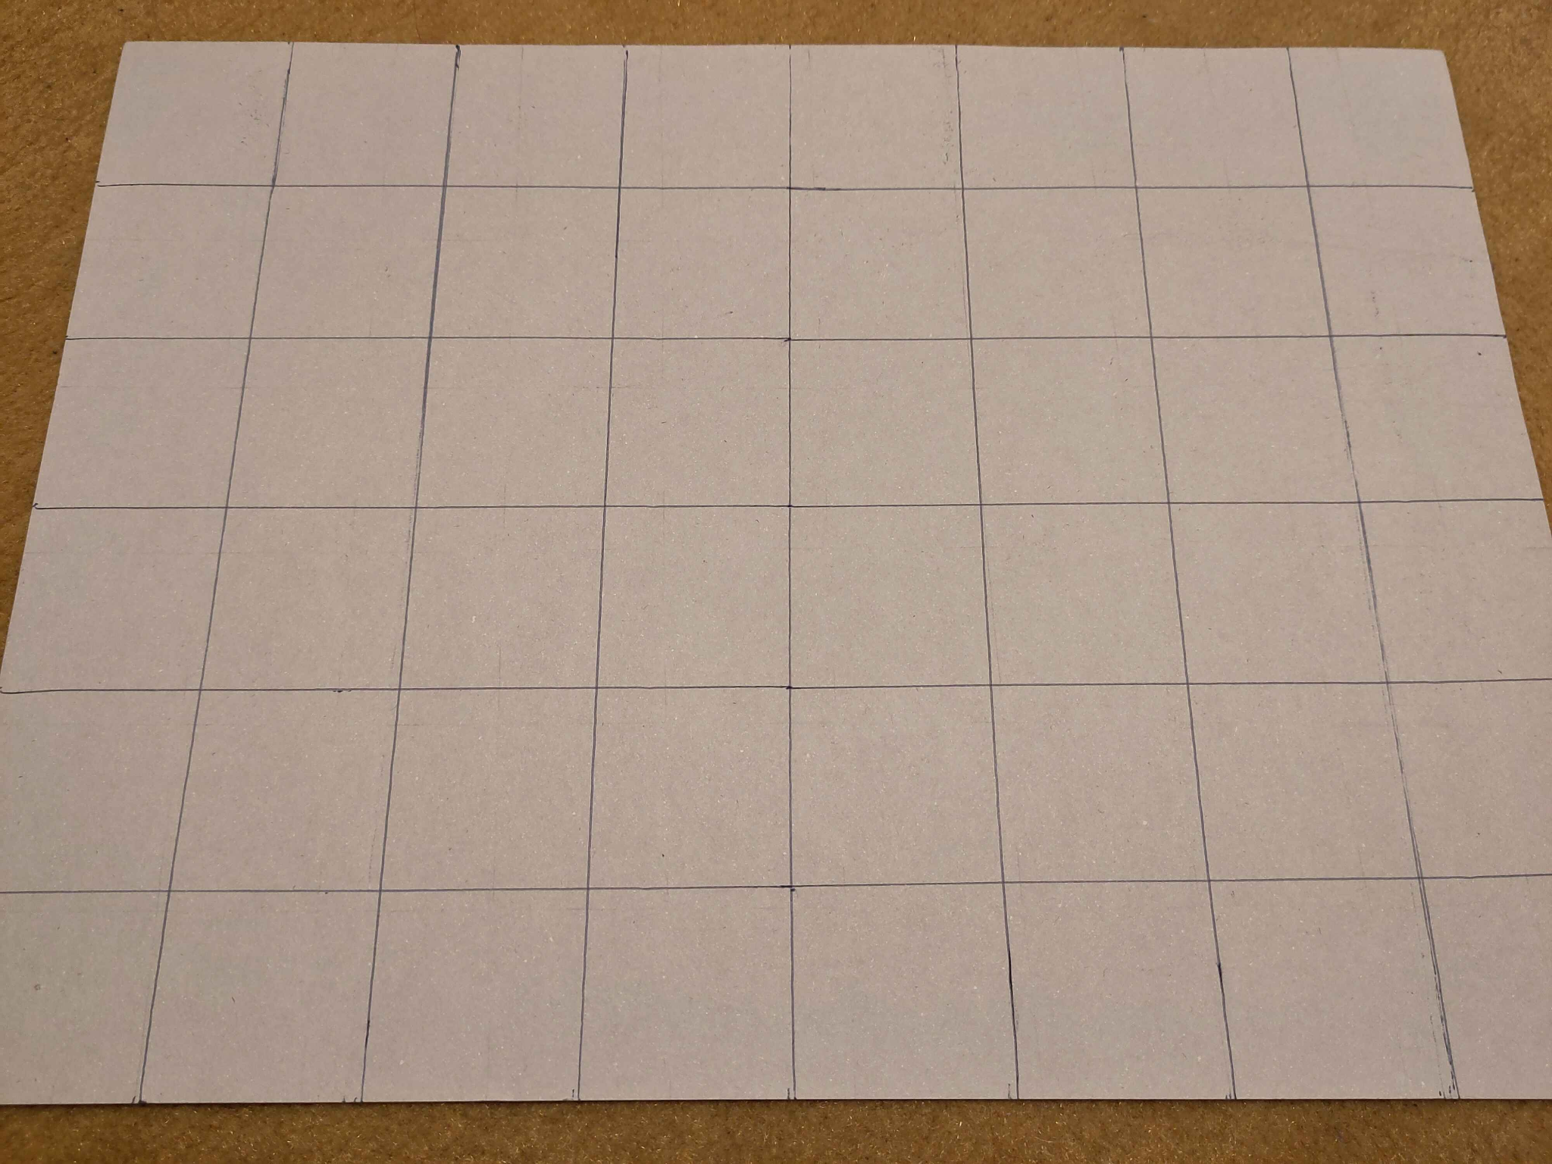
Map

Slide 10
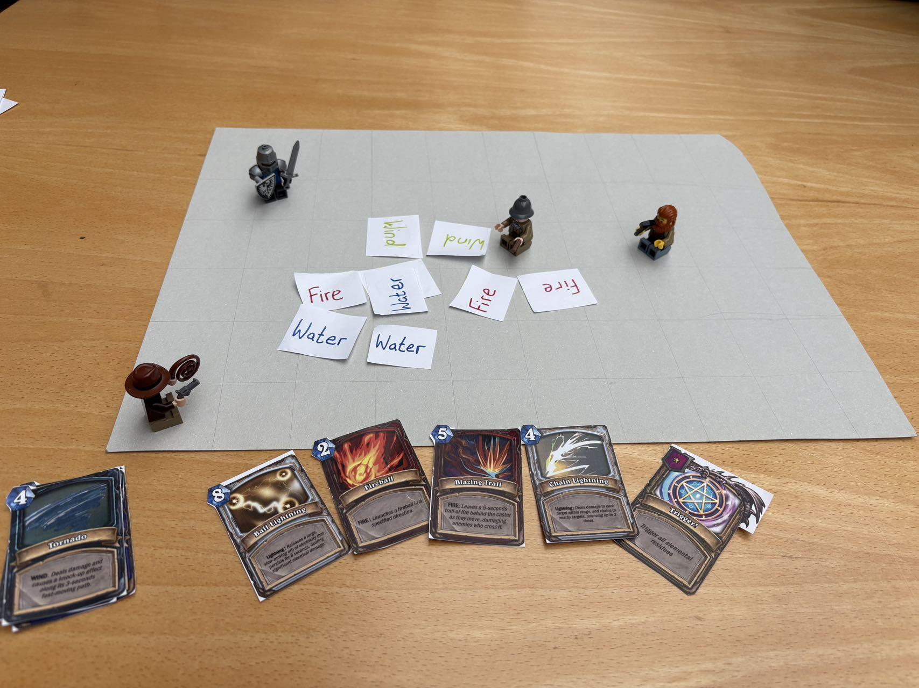

Slide 11
What we learned from paper prototype
1. Unify game flow idea for each teammate.
2. Need appropriately adjust the ppm threshold.
3. Putting trigger card in deck instead of keeping it after using is better in terms of flow and game design.
4. When putting a shield, we should discuss how monster interact with the shield (e.g. how they behave inside it).
5. Improve visibility of availability of different cards with position and coloration.
6. Physical playtesting demonstrated possible edge cases for elemental areas intersection and led to the discussion of how is should be implemented in Unity in general.
7. Find a way to convert real-time gameplay into a tabletop setting.

Slide 12
THANK YOU

