Slide 1
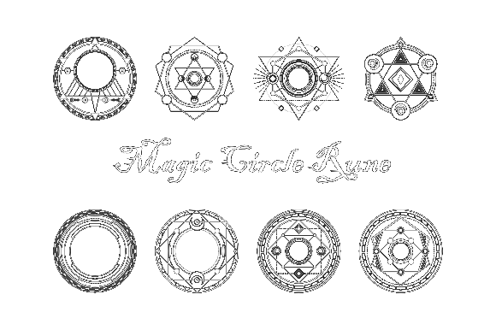
Milestone 1
Chain Reaction
Team Zoo:
Andrey Roytman
Cynthia Drews
Haorui Tan
Yifei Liu

Slide 2

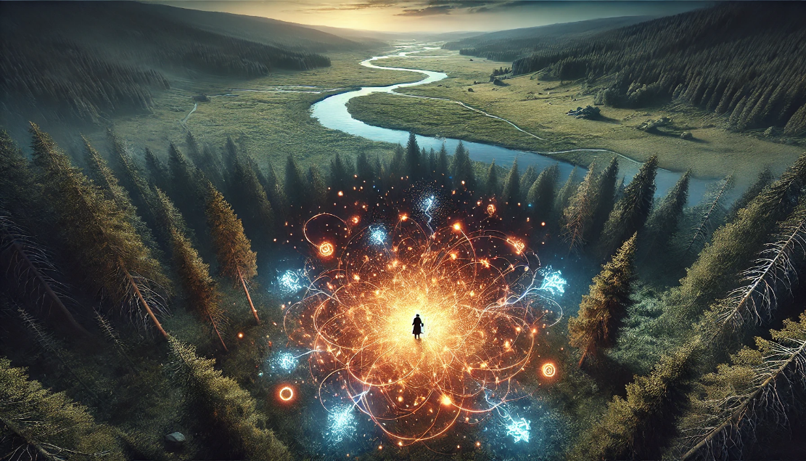

Cataclysm Cards
Background
When you cast magic cards, they leave elemental residues in the air. The consensus among the magic guilds is that casting multiple, different spells in the same location is prohibited, as it can result in uncontrollable natural magic disasters when the concentration of different elements becomes too high.
However, you (player) have accidentally discovered a rune that can activate these residual elements to result in more powerful magic before the concentration is over the threshold of disasters. Utilizing this rune, you have created card that harness these residues, and you are currently testing it with magic deck in battle.
(Detailed background can be found in the pdf we submitted.)

Slide 3
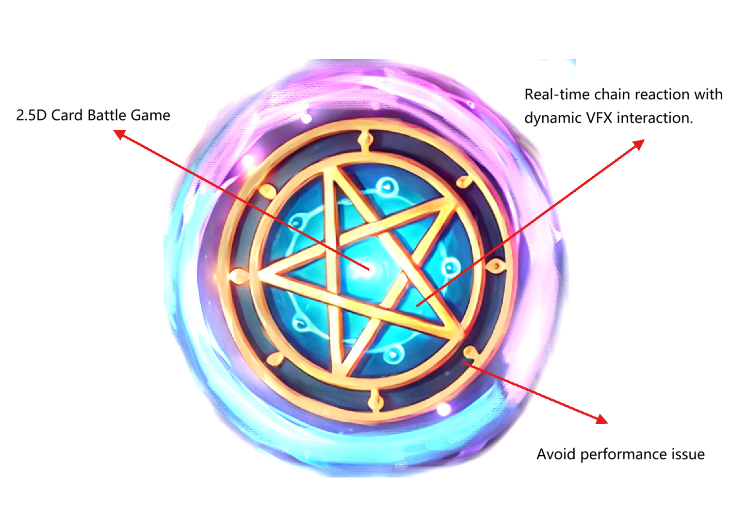
BULLSEYE

Slide 4
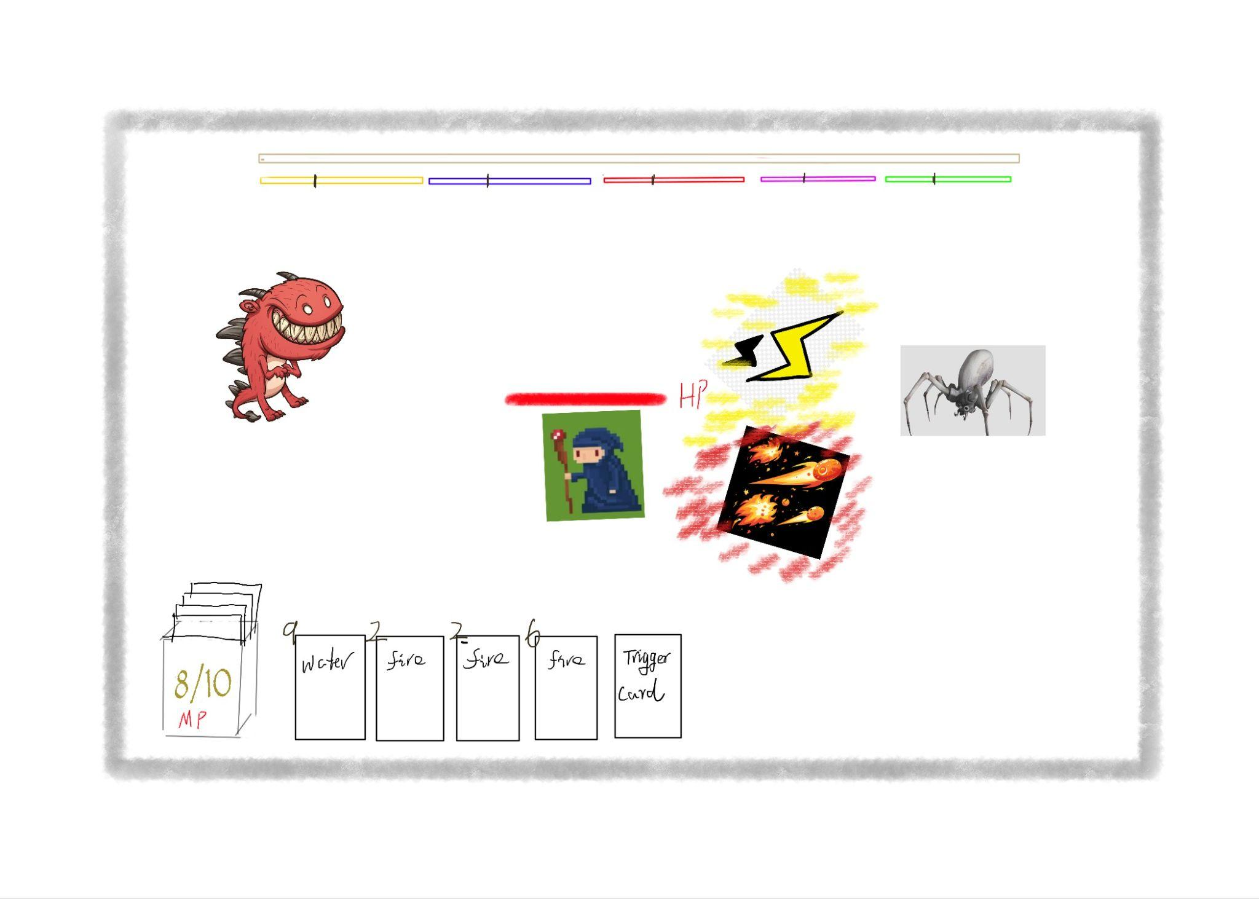
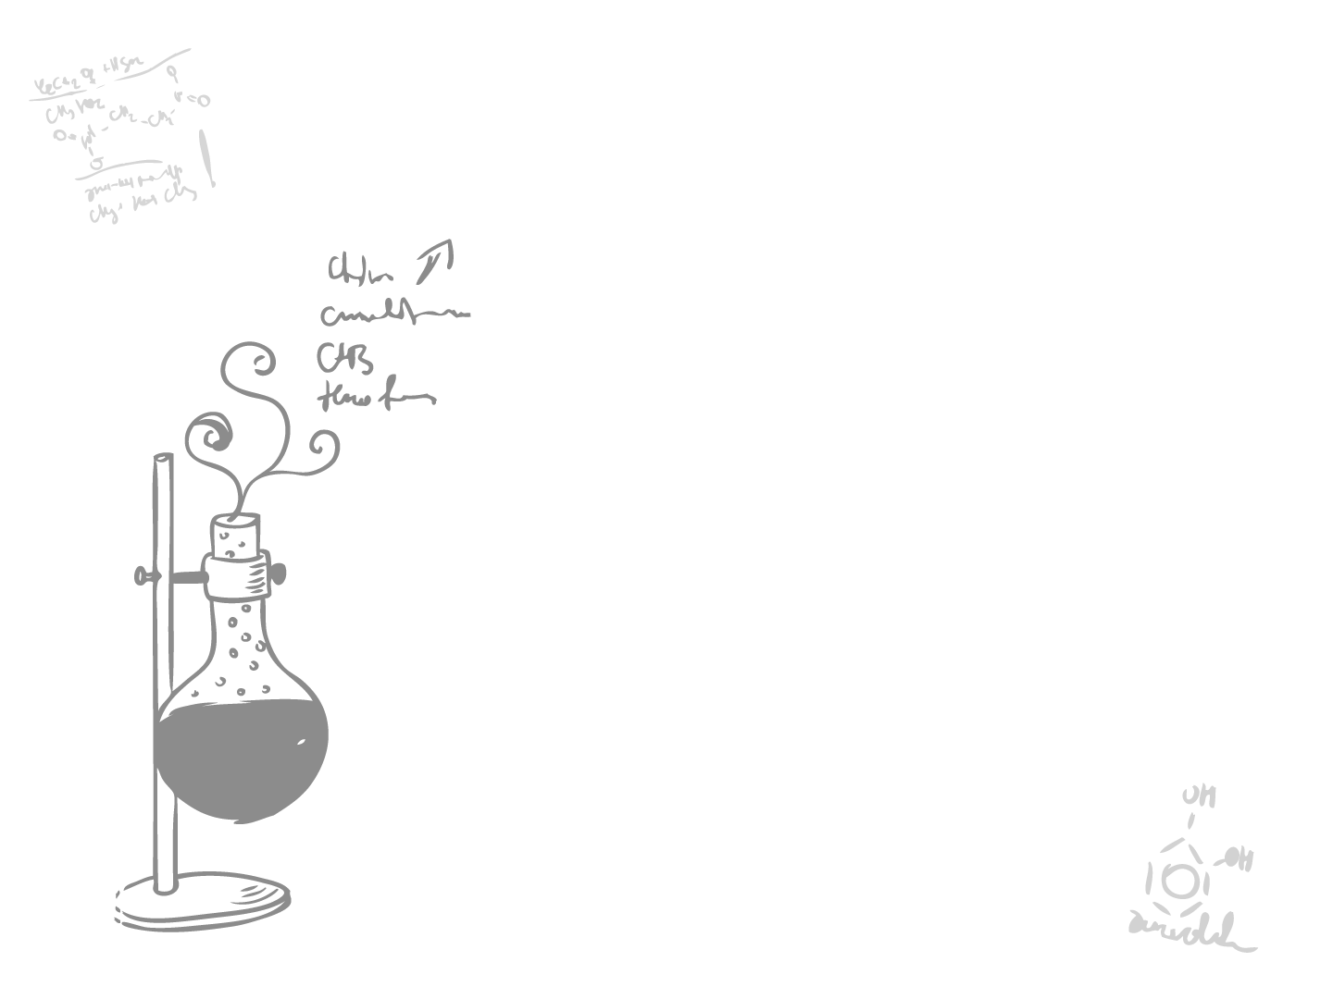
Cataclysm Cards
Looks like…
Use magic cards to survive and defeat the monsters.
Cast normal magic cards to deal small damage and cumulate element residuals.
Cast ‘trigger’ magic card to activate element residues to result in stronger magics before the concentration of element residues higher than threshold of disasters.
Otherwise, the magic disasters will deal damage to both player and monsters.

Slide 5
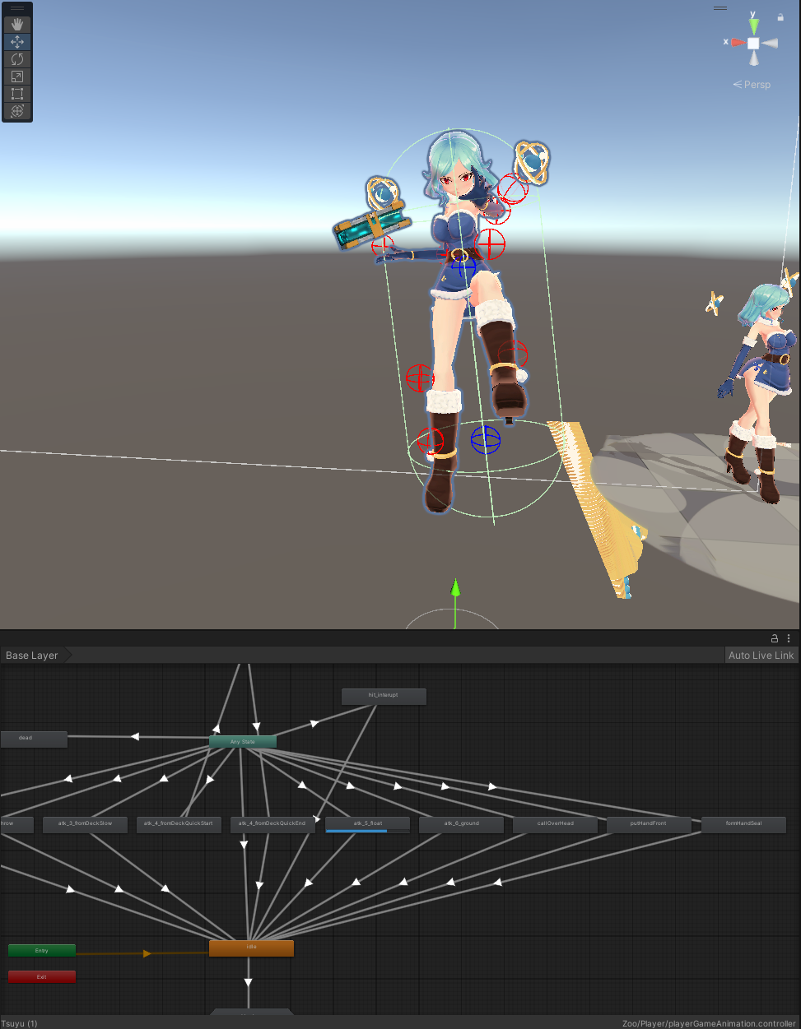
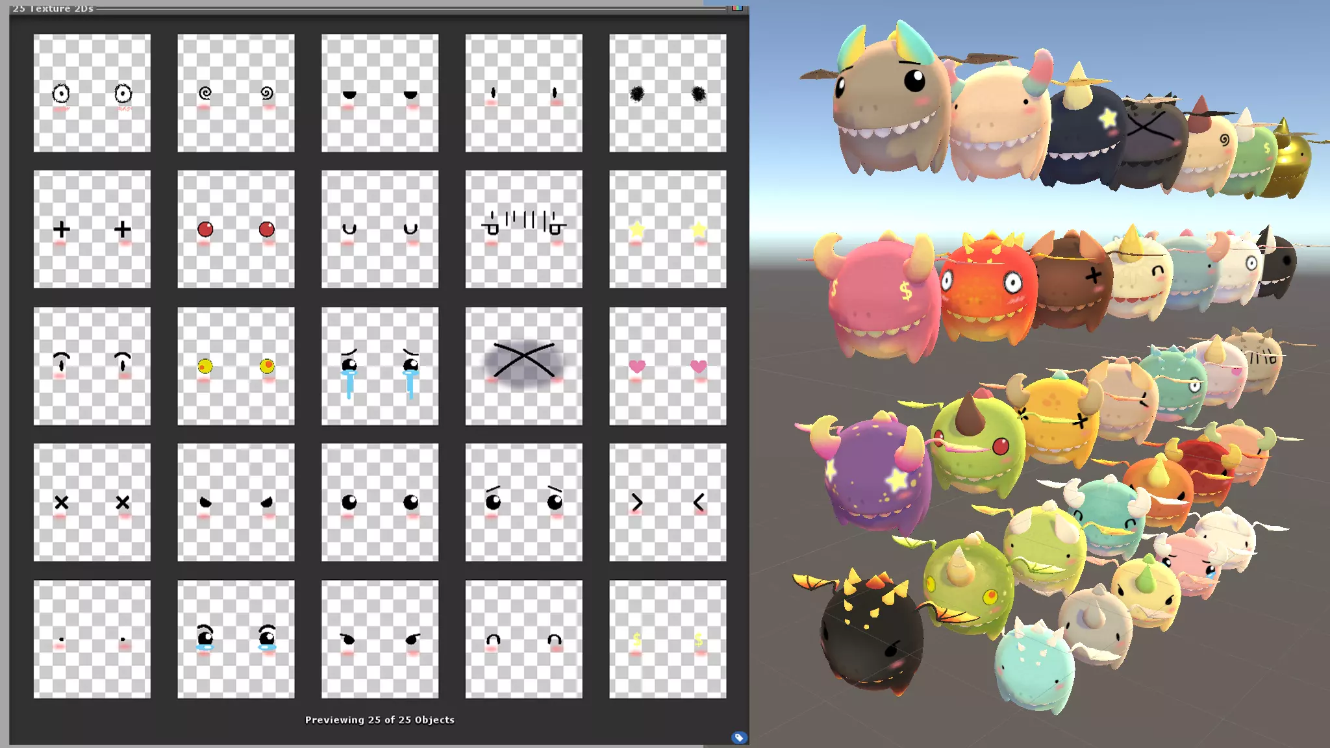
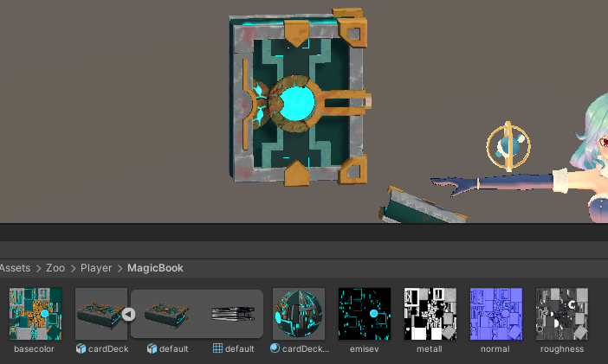
Cataclysm Cards
Player character
Monster

Slide 6
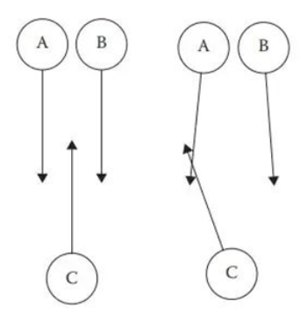
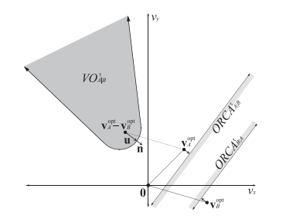
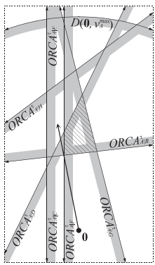
Cataclysm Cards
Architecture of project
DOTS
Data-Oriented Technology Stack
Optimize the running efficiency of games and applications through data-driven design principles
Entity Component System (ECS)
Entities.foreach()
Job System
RVO
Reciprocal Velocity Obstacle
RVO2 - ORCA - Optimal Reciprocal Collision Avoidance
https://gamma.cs.unc.edu/ORCA/publications/ORCA.pdf

Slide 7
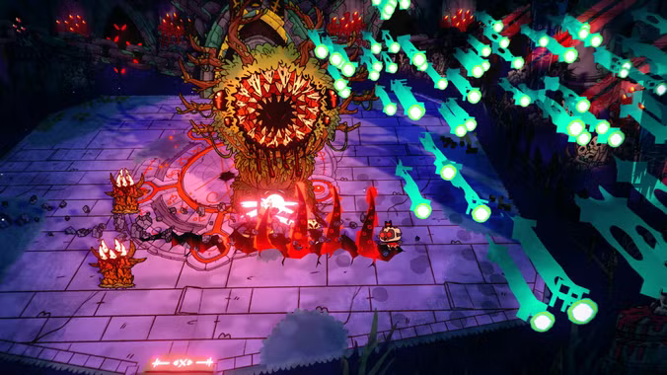
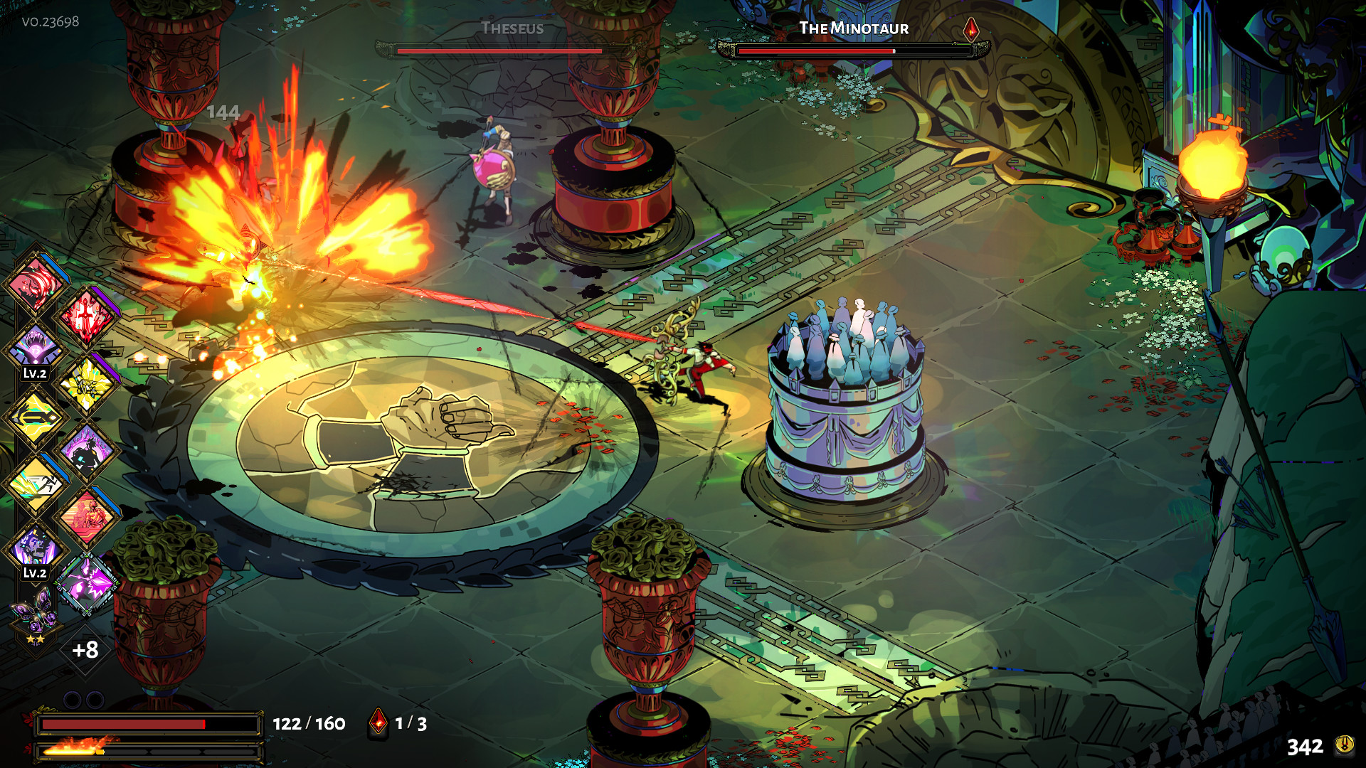
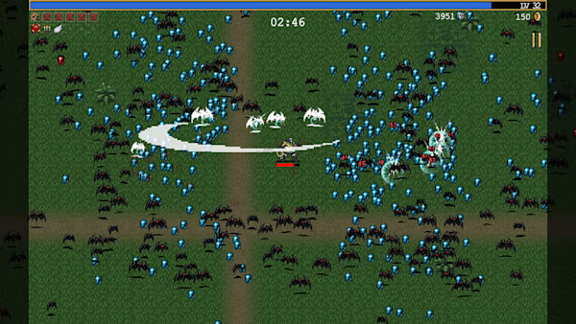
Cataclysm Cards
Real-Time
Not a round-based game
=> BUT enemies arrive in waves
Moving around freely
Monster & player move and act at the same time
Residues are left behind by using magic
=> Player gets limited by mana supply

Slide 8
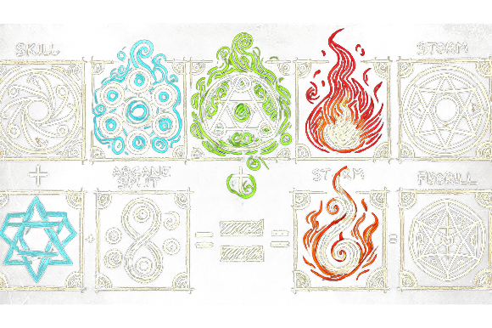
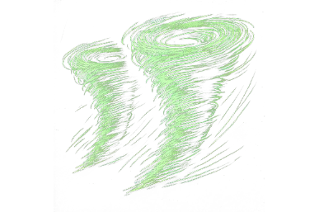
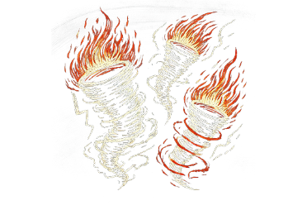
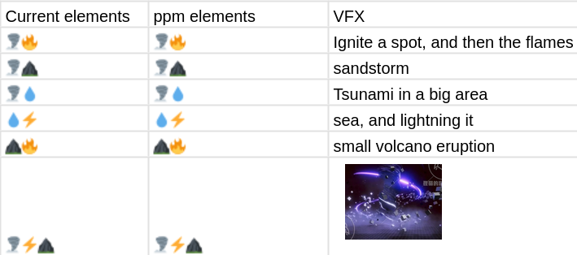
Cataclysm Cards
Game mechanism
Chain reaction example
=
=
Arcane Split Storm Fireball

Slide 9
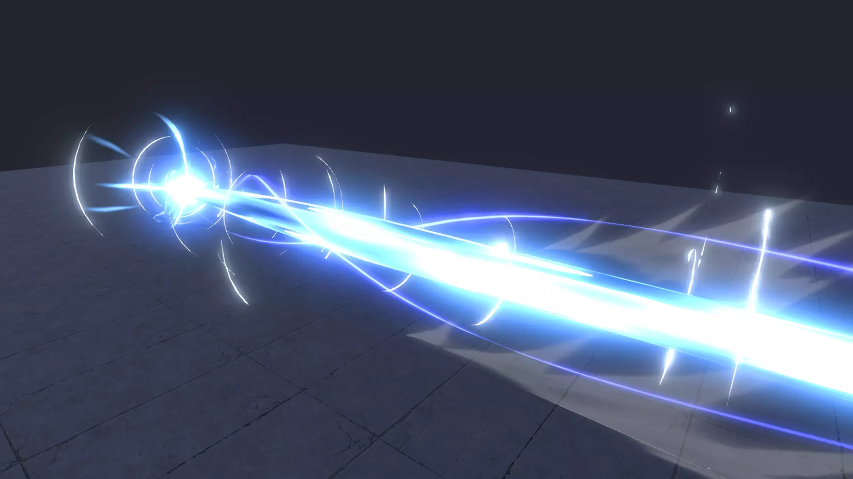
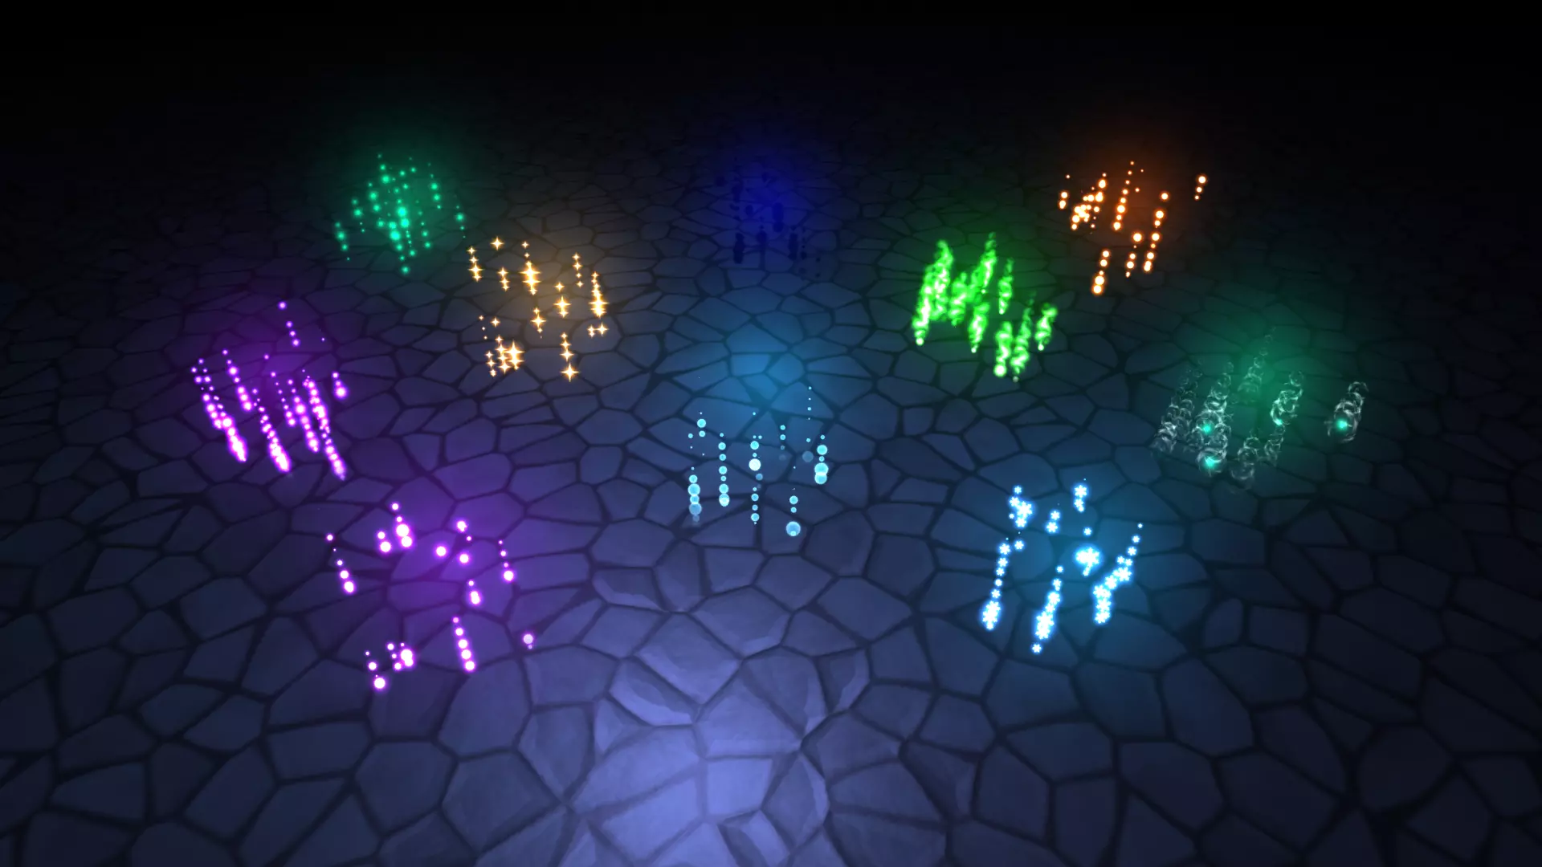
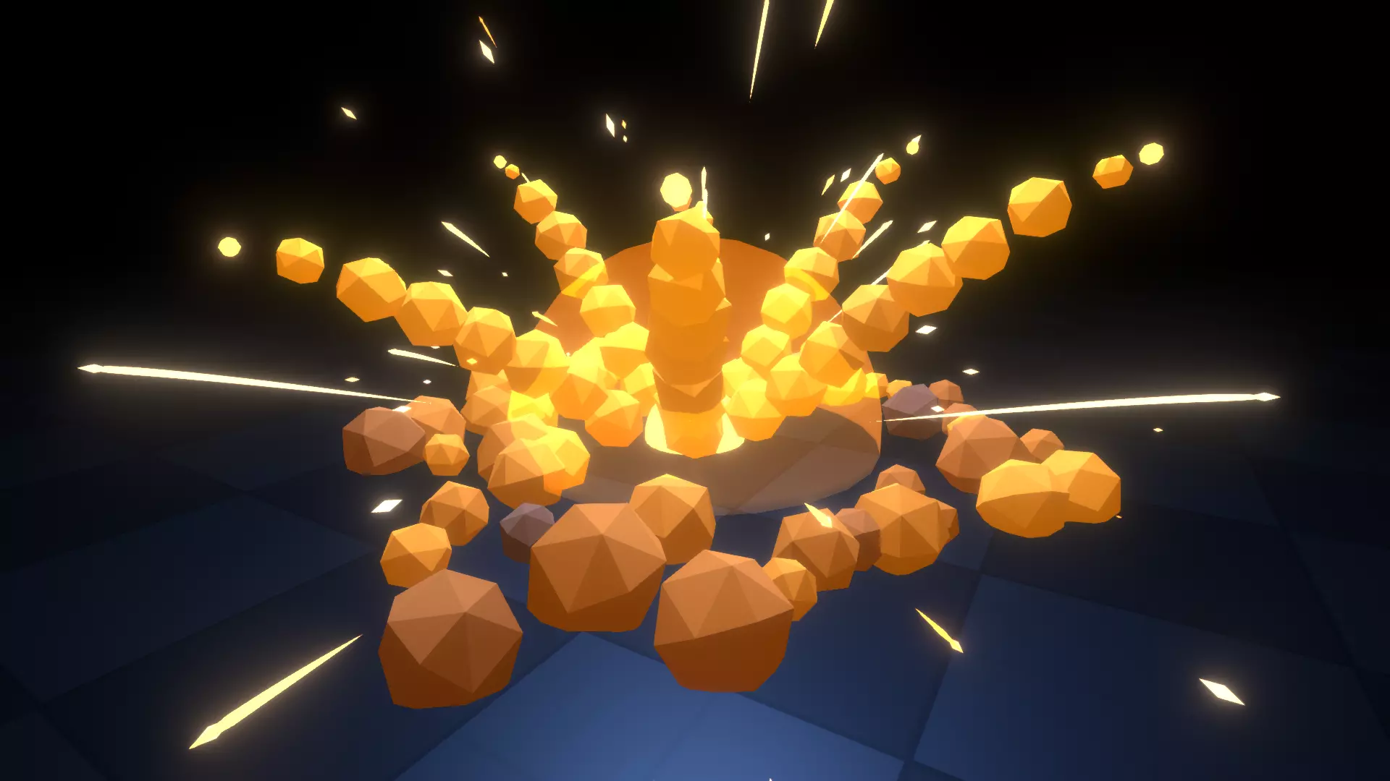
Cataclysm Cards
Game mechanism
Chain reaction example

Slide 10
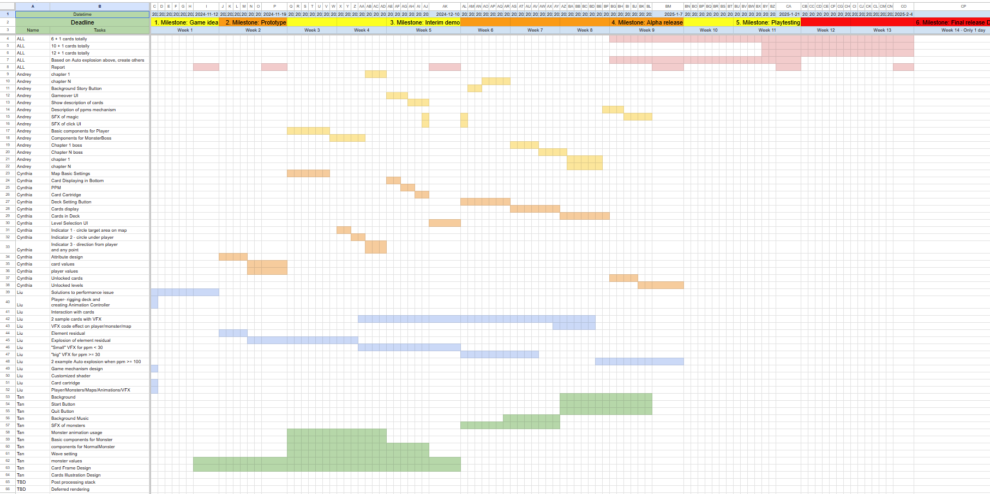
Timeline

Slide 11
QUESTIONS?

